Slide 1
Laporan Status CoP & JCoP (sehingga 30 November 2017)

Slide 2
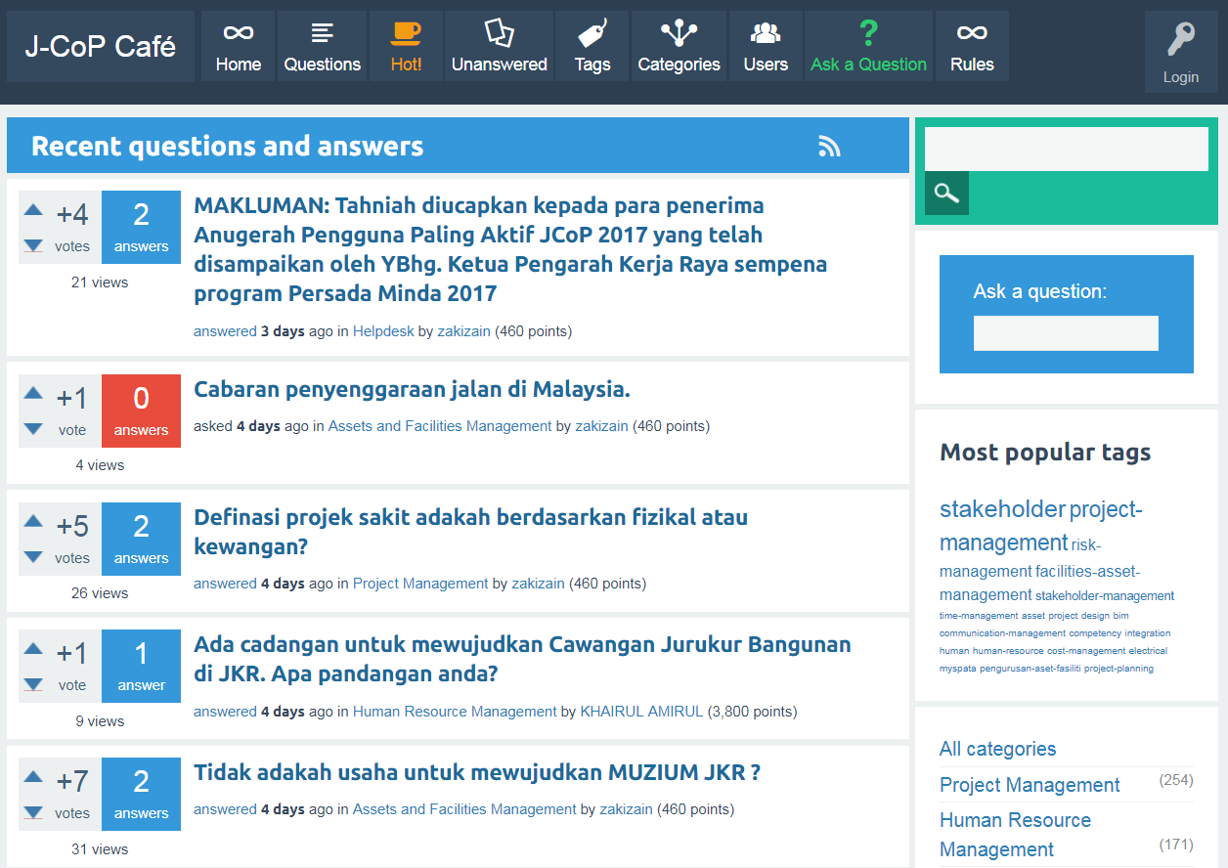
Statistik JCoP

Slide 3
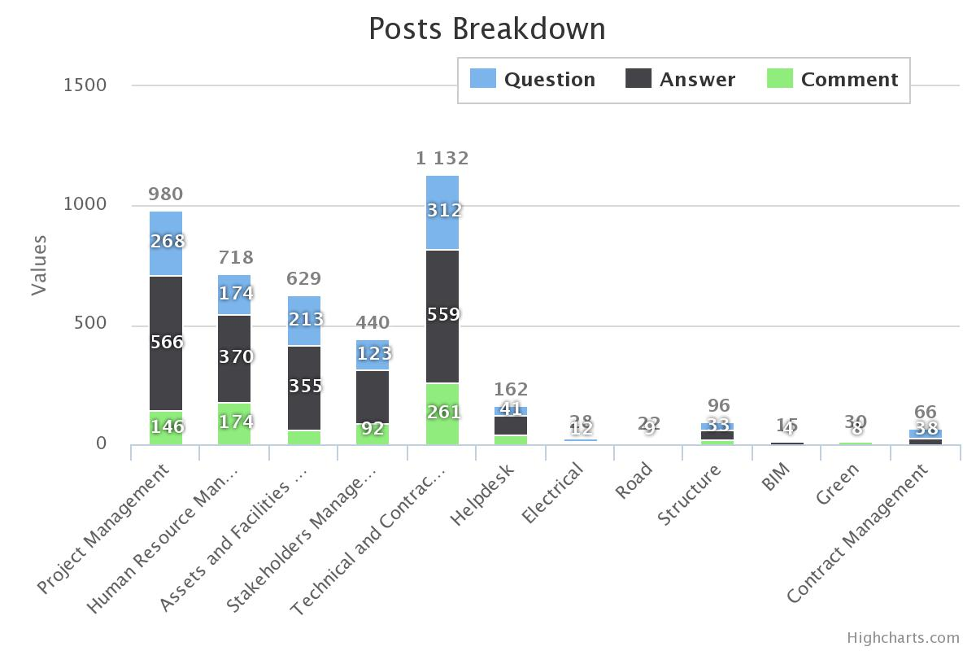
Statistik JCoP (# postings)
4,318 posts

Slide 4
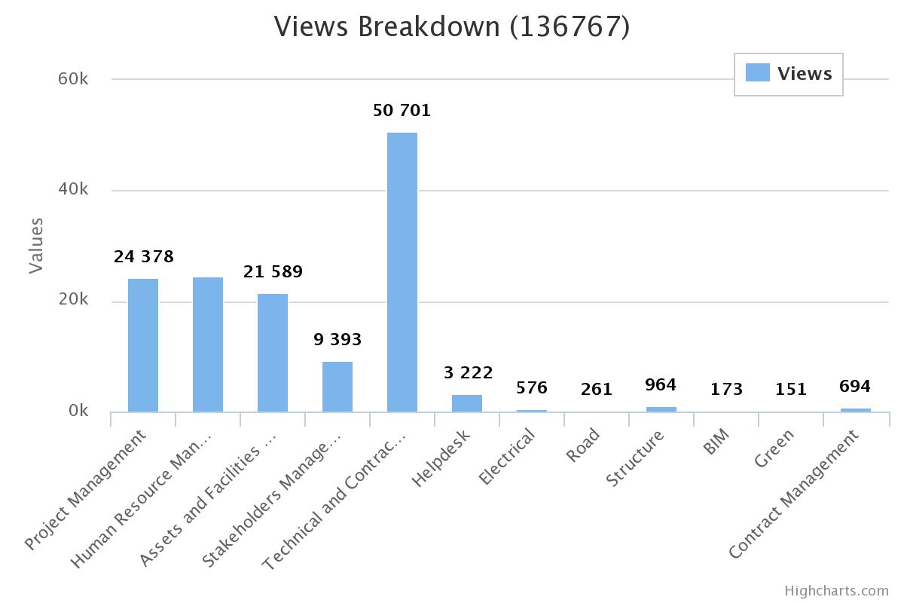
Statistik JCoP (page views)
136,767 views

Slide 5
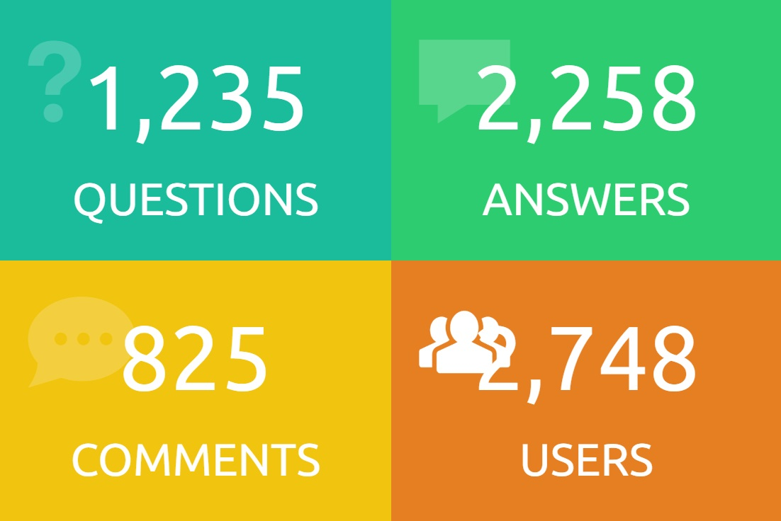
Statistik JCoP (# postings and Users)

Slide 6
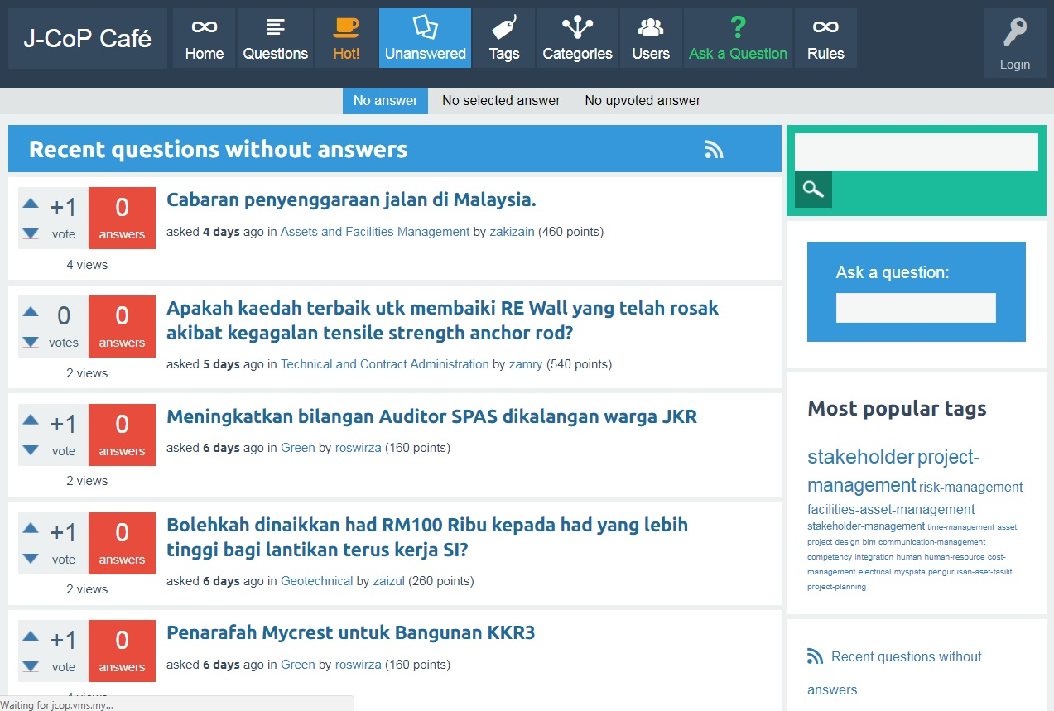
Unanswered Questions
103 soalan

Slide 7
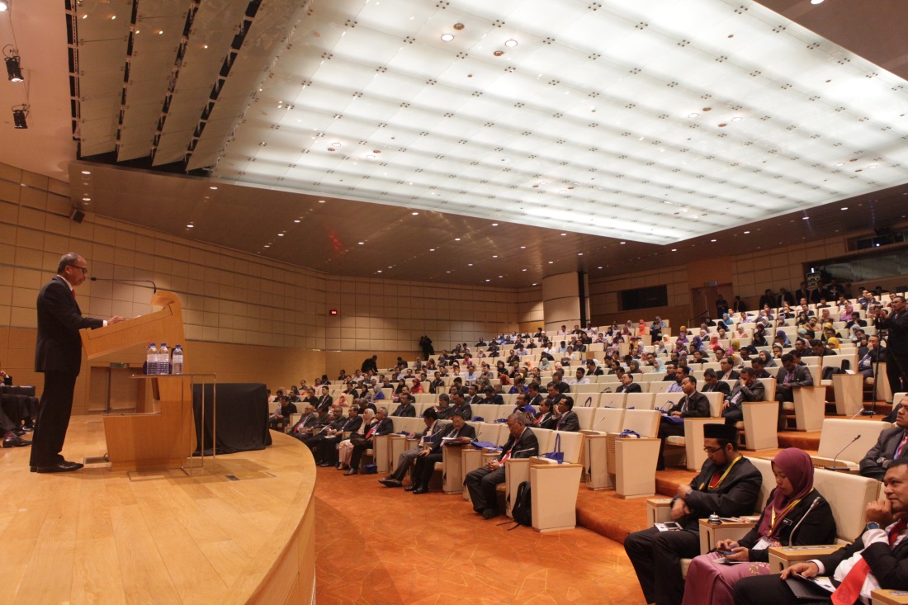
Aktiviti CoP JKR
CoP Asset And Facilities Management
Seminar Pengurusan Fasiliti Sektor Awam 2017
12 – 13 September 2017

Slide 8
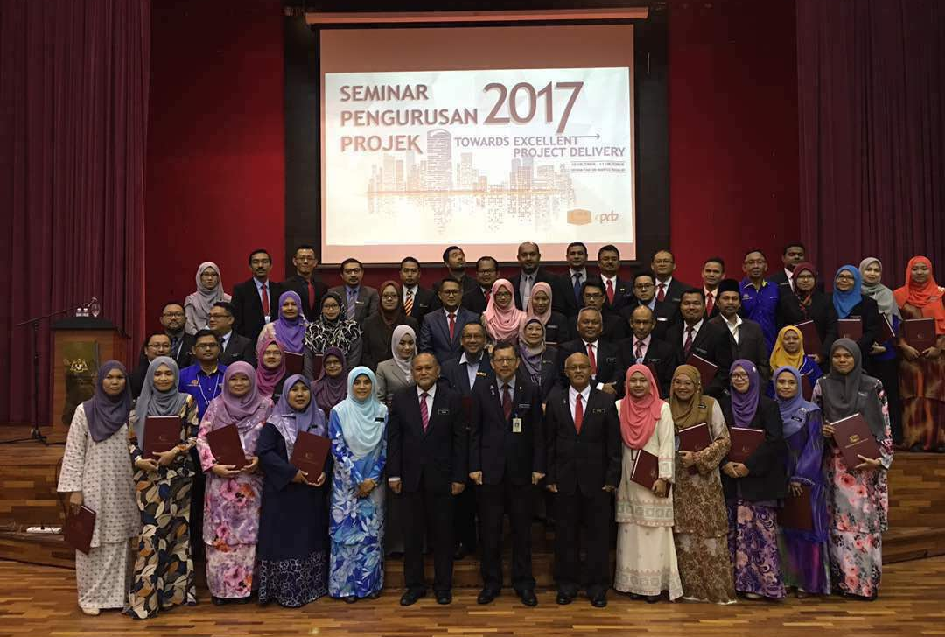
Aktiviti CoP JKR
CoP Asset And Facilities Management
CoP Project Management
Seminar Pengurusan Fasiliti Sektor Awam 2017
12 – 13 September 2017
Seminar Pengurusan Projek 2017
10 – 11 Oktober 2017

Slide 9
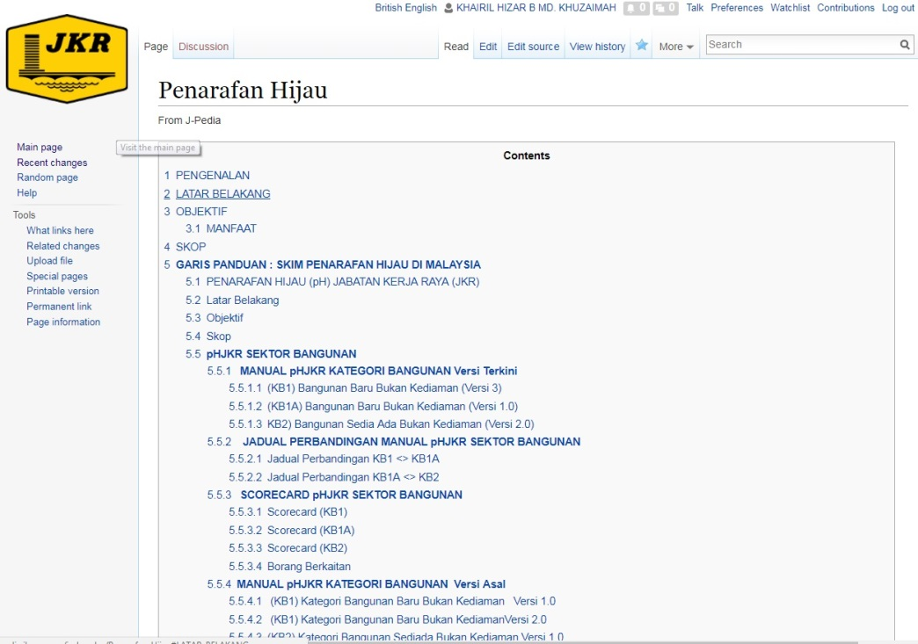
Aktiviti CoP JKR
CoP Asset And Facilities Management
CoP Project Management
CoP Green
Seminar Pengurusan Fasiliti Sektor Awam 2017
12 – 13 September 2017
Seminar Pengurusan Projek 2017
10 – 11 Oktober 2017
Pengemaskinian JPedia Wiki Green secara berkala

