Slide 1
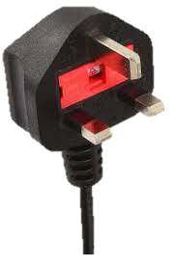
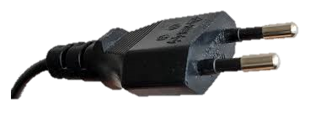
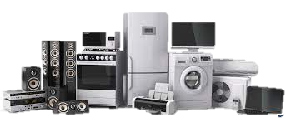
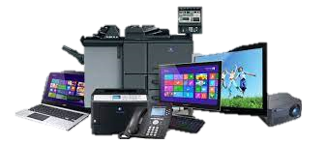
KNOWLEDGE SHARING
ELECTRICAL SAFETY
ELECTRICAL EQUIPMENT APPLIANCE CLASS
Mohd Hanif bin Jamaludin
Makmal Penyelidikan Elektrik
Bahagian Inovasi Penyelidikan dan Pembangunan Kejuruteraan
Pusat Kecemerlangan Kejuruteraan & Teknologi JKR (CREaTE)

Slide 2
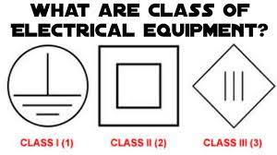
WHAT CLASS OF ELECTRICAL APPLIANCES ?

Slide 3
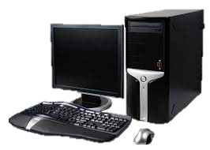
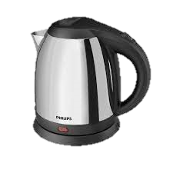
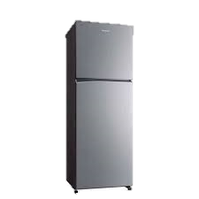
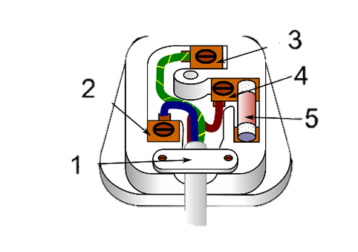
CLASS I APPLIANCE
Class I appliances are usually made of metal, have three cables, have a metal Earth pin, and have a fuse in the plug. However, the only way to confirm whether the appliance is Class I is to look for the Class I symbol on the appliance.
Examples of Class I appliances are refrigerators, microwaves, kettles, irons, and toasters.
EARTH/E
NEUTRAL /N
LIVE /L
SAFETY FUSE
Cable Clamp

Slide 4
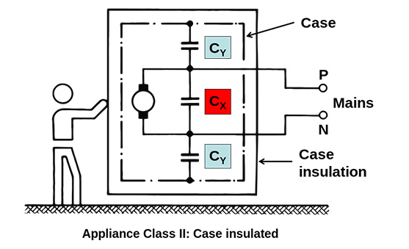
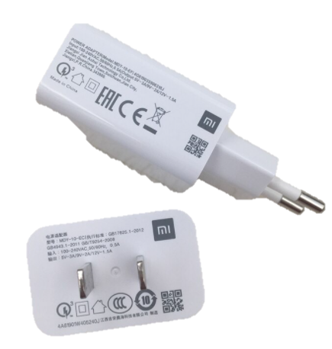
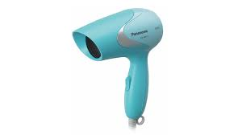
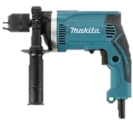
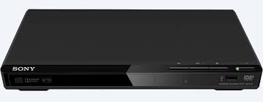
CLASS II APPLIANCE
A Class II appliance usually has a plastic cover.
Class II appliances have two layers of insulation. As in the case of Class I appliances, the plastic connector provides the basic insulation. The added layer of insulation is a plastic casing, which provides backup protection. The double insulation removes a need for an earth connection.
Class II appliances can be identified by the class II symbol .
Examples of Class II appliances are hair dryers, DVD players, hand tools, and phone chargers. Class II appliances may use 2-pin mains plug.

Slide 5
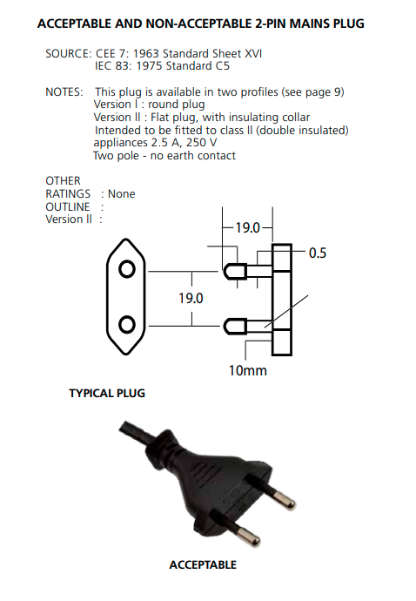
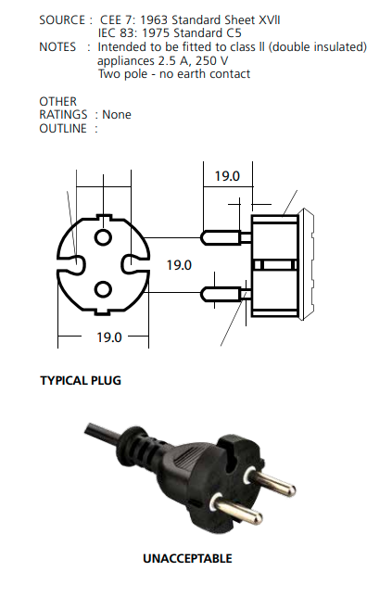
*REFERENCE : GUIDELINE FOR APPROVAL OF ELECTRICAL EQUIPMENT GP/ST/No.14/2017

Slide 6
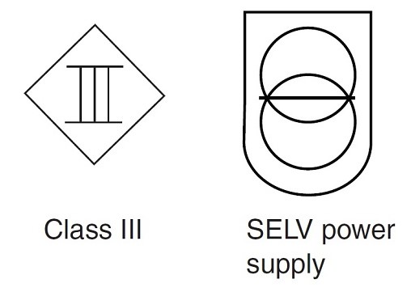
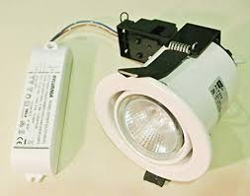
CLASS III APPLIANCE
Class III appliances are appliances which protection against electric shock relies on safety extra-low voltage and in which voltages higher than those of safety extra low voltage are not generated..
Safety Extra Low Voltage are Voltages not exceeding 42 V between conductors and between conductor and earth, and no load voltage not exceeding 50 V.
SELV when obtaining supply from mains, it is to be through isolation transformer.
Examples of Class III appliances are laptops, mobile phones, and low energy light bulbs

Slide 7
CONCLUSION
Every electrical appliance has some level of safety to protect users from electric shock. The type of equipment classification depends on the type of equipment used and its environment. This is to ensure that the equipment works properly and safely.

