Slide 1
MANAGING KNOWLEDGE IN JKR: IMPLEMENTATION INSIGHTS
Sr ROZNITA BT OTHMAN
MATRADE KM CHANGE MANAGEMENT Workshop
8 Disember 2016

Slide 2
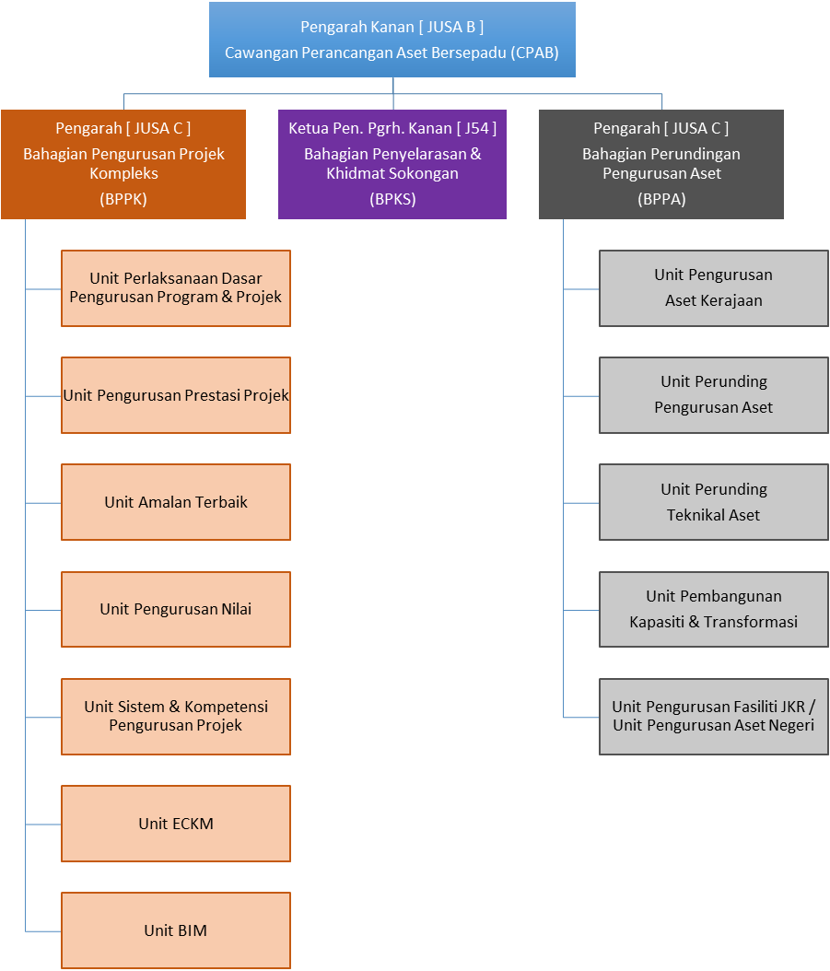
Introduction
Sr. Roznita Othman
Pengarah Kejuruteraan (Komunikasi)
Juruukur Bahan
J48 (JUB)
Khairil Hizar Md. Khuzaimah
J41 (Awam)
Norparzila Abd. Ghaffar
J29 (Awam)
Safira Aiza Ahmad
Unit ECKM

Slide 3
Begin with the end in mind
What I will cover
How KM improves our performance
Our knowledge Assets
JKR KM Agenda & Journey
ECKM Products
Lessons Learned

Slide 4
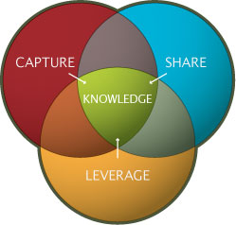
How KM can improve the organisational performance
Easy to find experienced individuals
Enterprise wide knowledge at our finger tips
Improve communication and break down silos
Generate new ideas that can be incorporated into innovative products and processes
Improve productivity by reusing “what we know
Notes:
When we embark into something new and big like KM, we need to address the WIIFM. People will easily buy in if the KM effort can help solve their problems or issues at hand. So as you can see, these are the benefits of leveraging KM. We encounter problems in finding experienced ppl who we need for advice, we have problems in looking for the knowledge at the time we need most .. Even Mr Google can’t help sometimes,
We find that knowledge created by someone else is not used by others. And we start reinventng the wheel, We often talk abt siloness in the organisation and difficulties in communicating across within and across project teams, We need to be innovative all the time.. Yes?

Slide 5
Our Knowledge Assets

Slide 6
The KM Agenda
To cultivate knowledge sharing and learning culture across department
through the use of proven effective knowledge sharing tools
MAJOR KM INITIATIVES (since 2008)
1
JPedia, an online repository to share knowledge-in-context)
2
Communities of Practice to share domains of knowledge
3
JCoP, an online platform to ask and discuss
4
5
Project Lessons Learned System to share key project learnings
KM Toolbox, set of tools and techniques to capture and share insights and ideas
6
JKR Yellow Pages to locate experts within the department
7
E-Learning to provide 24 x 7 learning environment

Slide 7
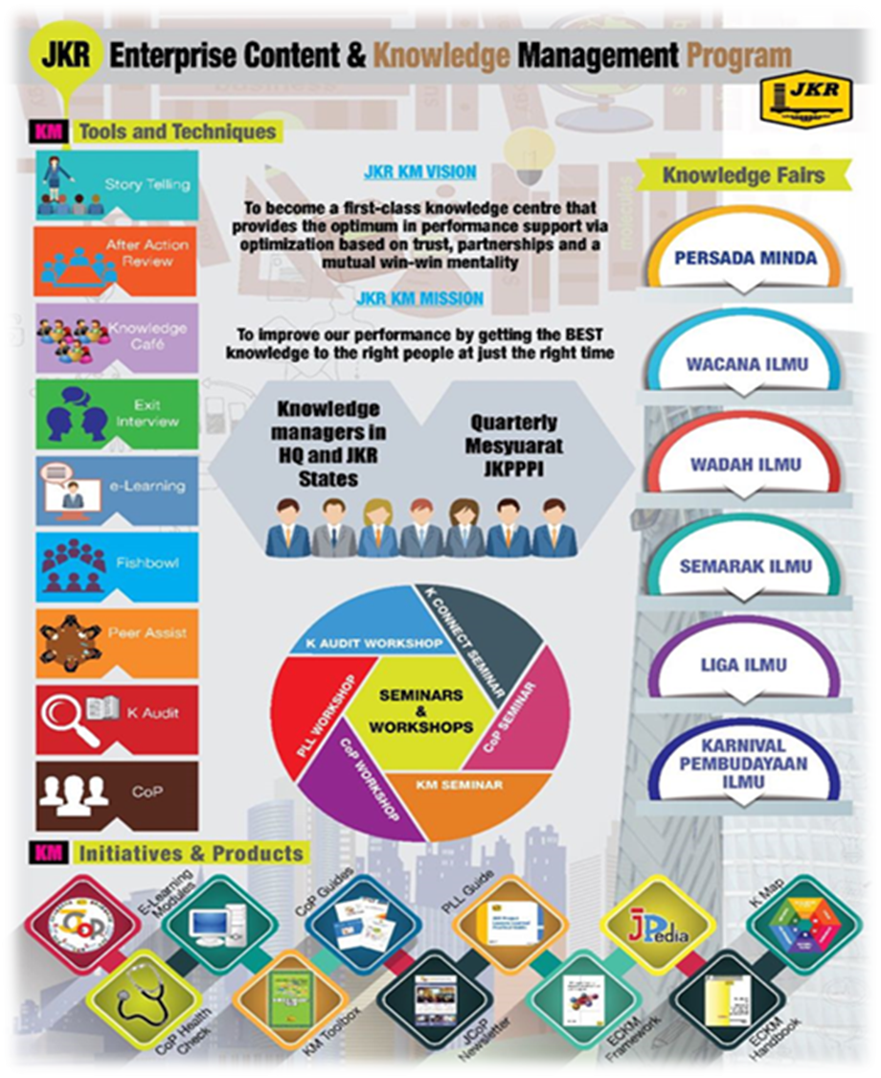

Slide 9
KM is a KEY component in JKR Strategic Framework 2016-2020
OUTSTANDING
PROJECT DELIVERY
CO-CREATIVE CUSTOMER EXPERIENCE
CENTRE OF TECHNICAL EXCELLENCE
LEADING SUSTAINABILITY
INNOVATIVE ORGANIZATION
KM Initiatives
T1.3 Develop PM Competency
JCoP as platform for sharing knowledge
Lessons Learned documentation
T2.3 Develop Customer Centric Workforce
Knowledge Sharing competency development
T3.4 Identity and Develop Experts
SME Profile Page
T4.4 Develop Sustainable Champion
WikiGreen and WikiTAM in Jpedia
T5.3 Enrich Organisational Knowledge Base
&
T5.4 Develop Innovative Centric Workforce
Enhance ECKM,, Governance, e-Learning, CoP Sustenance,

Slide 10
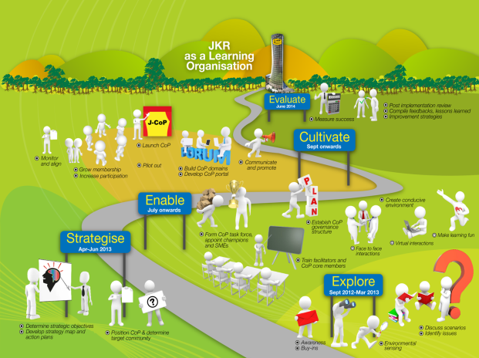
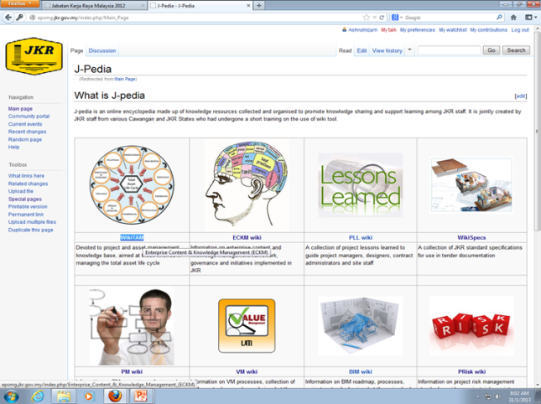
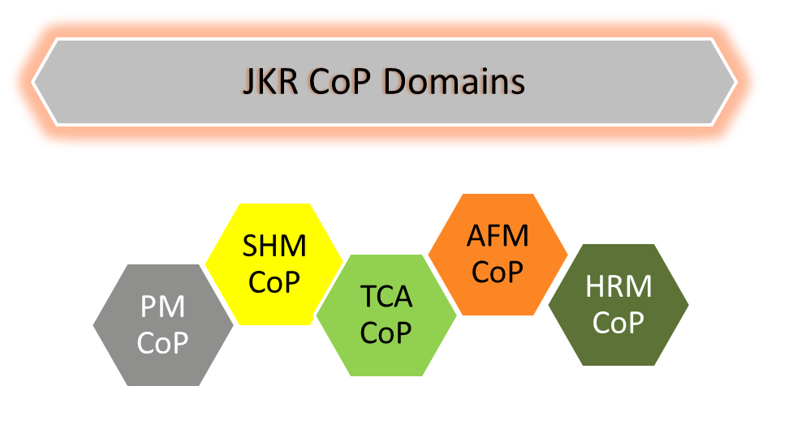
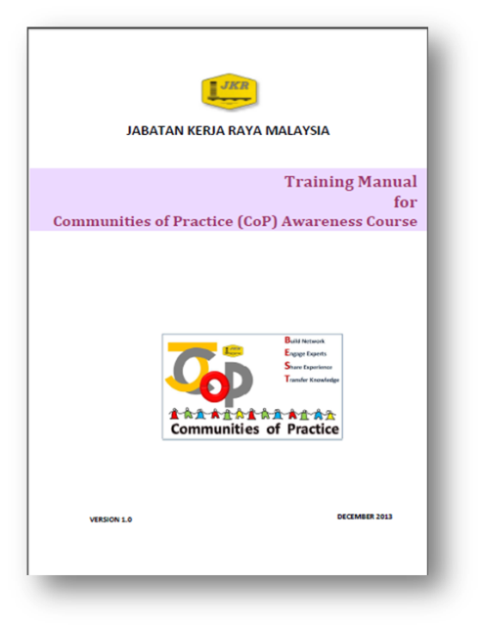
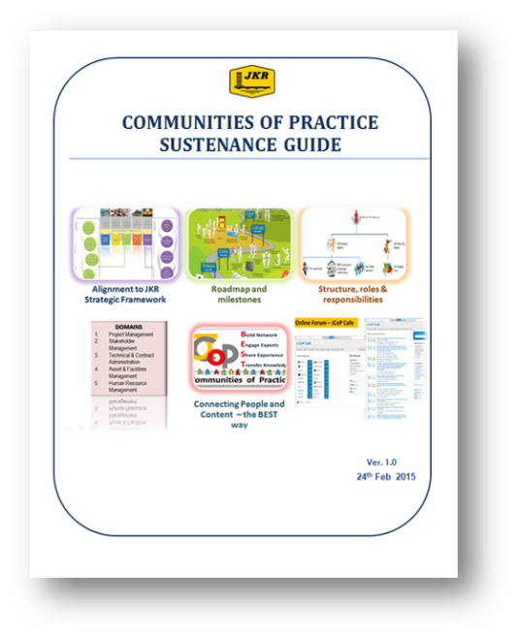
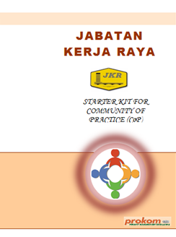
ECKM products
2010 – epsmg
2012 - JPedia
2009
2013
2011 – KM readiness assessment
2013
2014
2013
2015
2016
Contract Mgt CoP
BIM CoP
Structures CoP
Green CoP
?
2016
2016

Slide 11
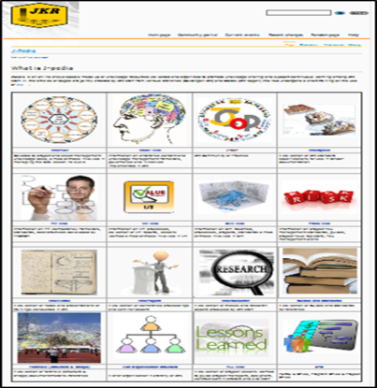
JKR KM Online Tools
JPedia
Online Knowledge Repository
JCoP
Virual Communities of Practice
Best Practices
PM Competency Framework
Project Lessons Learned
Technical References and Guides
Presentations
Conference Papers
CoP Domains
Subject Matter Experts Profile
Ask and Discuss Online Platform
Connect People to Content
Connect People to People

Slide 12
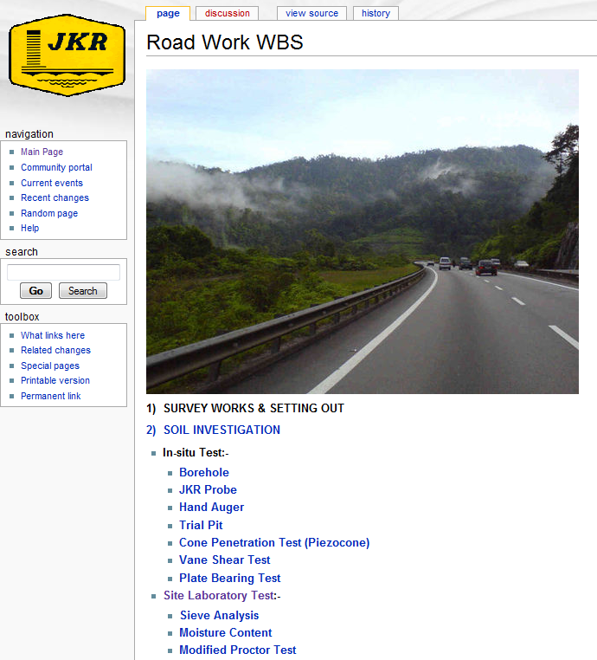
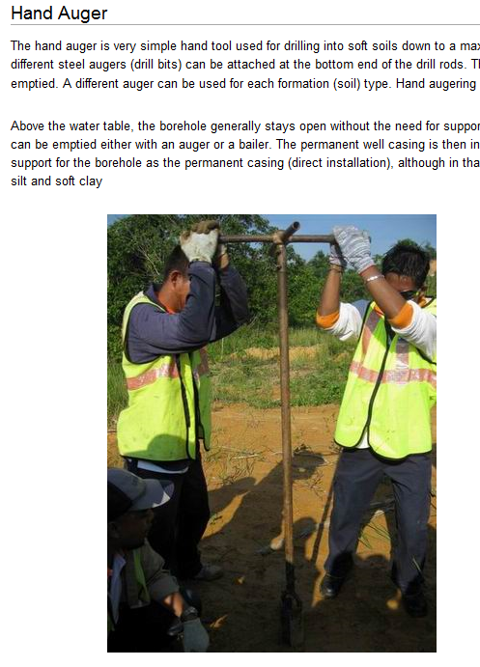
JPedia
Connecting People – The BEST Way
JCoP
Share Explicit Knowledge
Share Tacit Knowledge

Slide 13
Jpedia (formerly called e-psmg)
Started as an experiment to see what works in JKR environment
An online knowledge repository - focused on knowledge needs of site supervisory staff (online site management guide)
Used open source software, Mediawiki
flexible and easy-to-use tool
minimum learning curve
minimal cost

Slide 14
Jpedia content size and users as on 8 December 2016

Slide 15
JCoP
Focus on sharing of experiential knowledge
An online communities of practice – platform to ask and discuss
Used open source software, Stack Overflow
gamification element
users profile

Slide 16
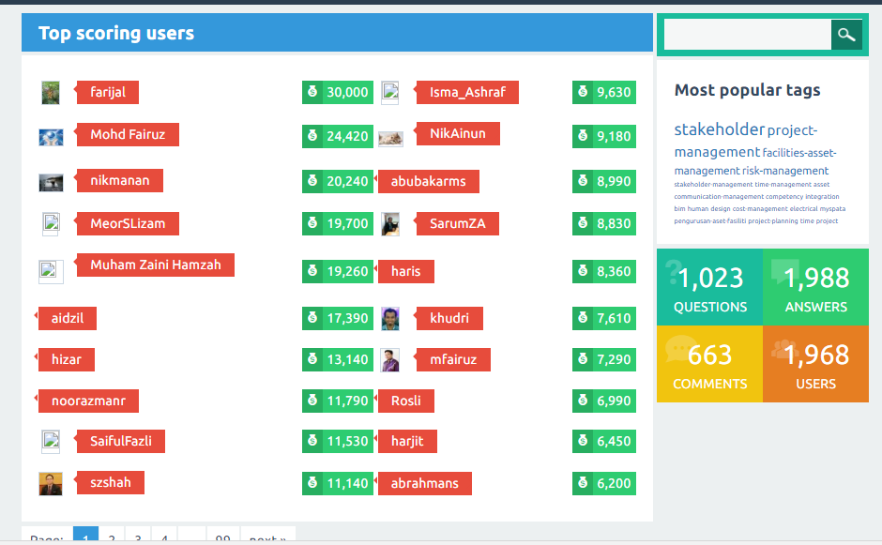
JCoP users and postings as on 8 December 2016

Slide 17
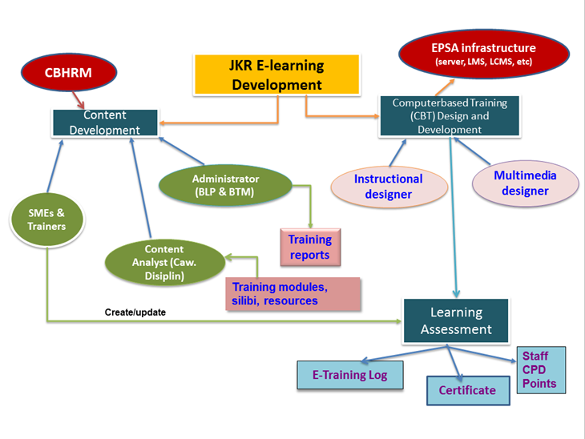
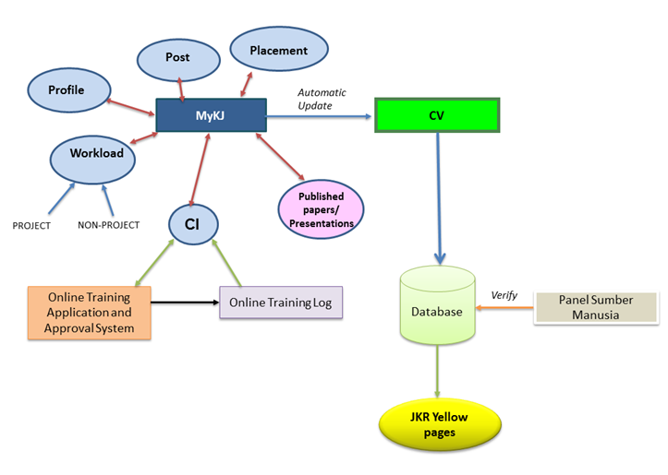
E-Learning
Systems under development
Expert Directory

Slide 18
LESSONS LEARNED in IMPLEMENTING KM
You may have heard what I’ve done, but not what I’ve been through

Slide 19
Why is Change Management critical for Knowledge Management?
Lack of a strong change management strategy is one of the top five reasons for having a failed knowledge management implementation.

Slide 20
Change is all about people..
Change is not predictable and does not follow a set pattern.
An effective change management strategy should address the individual's behavioral aspects to motivate them to adopt change
Notes:
People, being social creatures driven by beliefs and behaviors, are often resistant to adopt new practices and behaviors. To have transformational change, organizations should embed the desired beliefs and behaviors at every level

Slide 21
Can we change people’s behaviour?
What if people just aren't interested?
Do threats work? Do incentives work?

Slide 22
LEADERSHIP AND CHAMPIONS
Identify people who are willing to spend time sharing knowledge;
Get support from friends;
Create enabling environment and provide opportunities for people to become inspired by what their peers have achieved

Slide 23
FOCUS AROUND ACTUAL BUSINESS NEEDS AND OBJECTIVES
Know the pain points, gaps, critical knowledge;
Align to business strategy

Slide 24
START SMALL AND SIMPLE, THEN BUILD FROM THERE
Figure out how to create solutions that answer their real needs. get to know your audience and work with them to innovate solutions
Quick wins, pilots
Incremental approach

Slide 25
RIGHT COMBINATION OF PEOPLE, PROCESS AND TECHNOLOGY
Focus on people;
Embed knowledge capture and sharing in work process;
Technology as enabler and tool
Incentives for knowledge sharing

Slide 26
SELL, SELL, SELL!
Use appropriate marketing strategies and tools;
Broadcast, promote, update via social media

Slide 27
SOLICIT FEEDBACK!
Listen to users’ expectations, preference, suggestions
Analyse users behavior
Monitor targets achievement

Slide 28
Thank you!

