Slide 1
Power Quality Troubleshooting & Monitoring
Cawangan Kejuruteraan Elektrik

Slide 2
Power Quality Troubleshooting

Slide 3
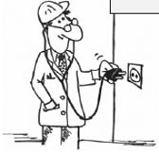
Power Quality Troubleshooting
Start at the Scene of the crime
To start as close to the “victim load” as possible
Use of a sharp eye and take some basic measurements

Slide 4
Power Quality Troubleshooting
Voltage & Current Measurement Analysis
Obtaining voltage & current measurements is the first step when troubleshooting power quality problems

Slide 5
Power Quality Troubleshooting
Neutral-to-earth voltage
Neutral-to-earth voltage measurements are commonly taken when troubleshooting PQ

Slide 6
Power Quality Troubleshooting
Voltage Unbalance
Should not exceed 2%
Voltage unbalance has a very large effect on current unbalance, in the ratio of 1:8. In other words, a voltage unbalance of 1% can cause current unbalance of 8%
Current unbalance will cause the motor to draw more current and degrades the winding insulation

Slide 7
Power Quality Troubleshooting
Voltage Unbalance
Voltage unbalance can be caused by severe load unbalance, loose connections and worn contacts
Example of voltage unbalance calculation:
${\%V}_{UNBALANCE}=\frac{Max deviation from average}{Average of 3 phases}×100\%$
R-Y = 444V, R-B = 446V, Y-B = 444V
Find the average = (444 + 446 + 444) / 3 = 445V
Find the max deviation from the average:
This occurs on the R-B phase: 446 – 445 = 1V
Divide max deviation by average to find % unbalance: 1 / 445 = 0.2%

Slide 8
Power Quality Troubleshooting
Voltage Unbalance
IEEE 1159 | IEC 61000-2-2 | TNB (ESAH)
2% | 2% | 2%

Slide 9
Power Quality Troubleshooting
Current Unbalance at the Installation
Do the same calculation as for voltage unbalance
Should not exceed 30% (IEEE 1159)
Unbalance of load will result in a current flow on neutral. If the unbalance current exceeds the earth fault relay pick up current, this will cause nuisance tripping to the circuit breaker

Slide 10
Power Quality Troubleshooting
Current Unbalance at the motor
Should not exceed 10%
Can be tolerated if the high phase (leg) reading doesn’t exceed the nameplate Full Load Amps
If the voltage unbalance is within limit, high current unbalance can be an indication of damaged winding insulation

Slide 11
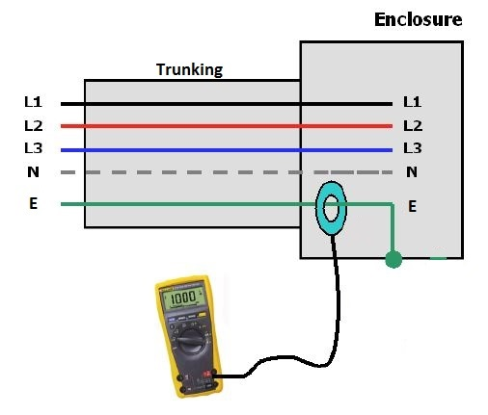
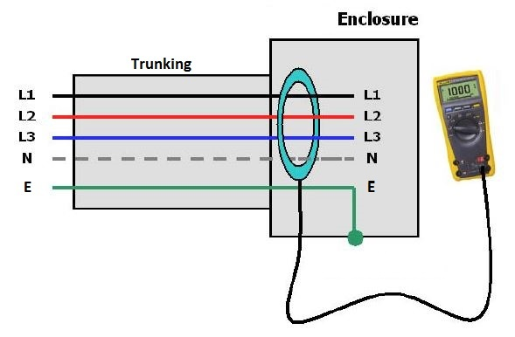
Power Quality Troubleshooting
Leakage Current Measurement Basics
Theoretically
Leakage Current = Residual Current
Practically
Leakage Current ≠ Residual Current

Slide 12
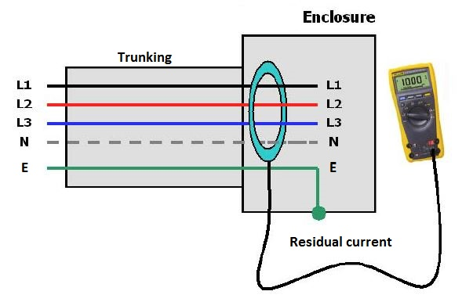
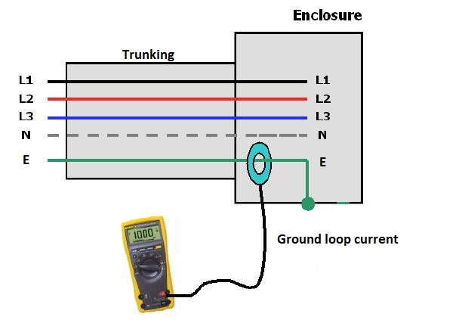
Power Quality Troubleshooting
Leakage Current Measurement Basics

Slide 13
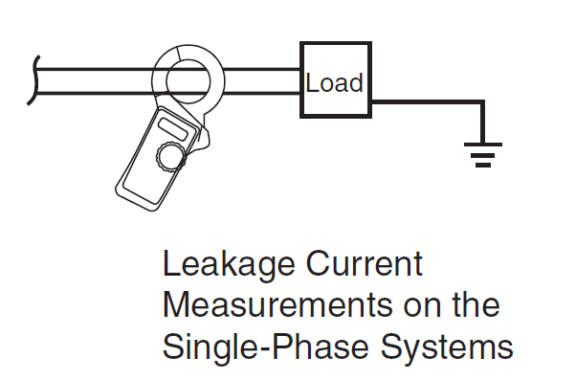
Power Quality Troubleshooting
Leakage Current Measurement Basics

Slide 14
Power Quality Troubleshooting
Leakage Current Measurement Basics

Slide 15
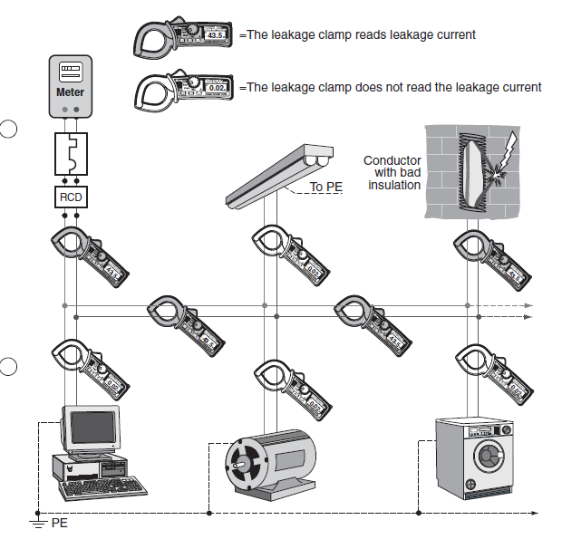
Power Quality Troubleshooting

Slide 16
Power Quality Troubleshooting
Voltage Dips (Sags)
The common mistake will be on the application and settings of the UVR to initiate the opening of CB and operation of standby genset during a power outage.
During the occurrence of a voltage sag event, the CB will also operate and cause power interruption to the customers.
In order for the UVR to operate properly, a time delay scheme must be part of the UVR.

Slide 17
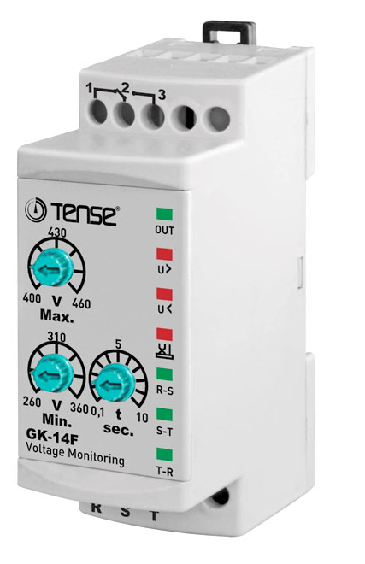
Power Quality Troubleshooting
Voltage Dips (Sags)
The recommended settings for an UVR is 70% with a time delay of 2-3 second.

Slide 18
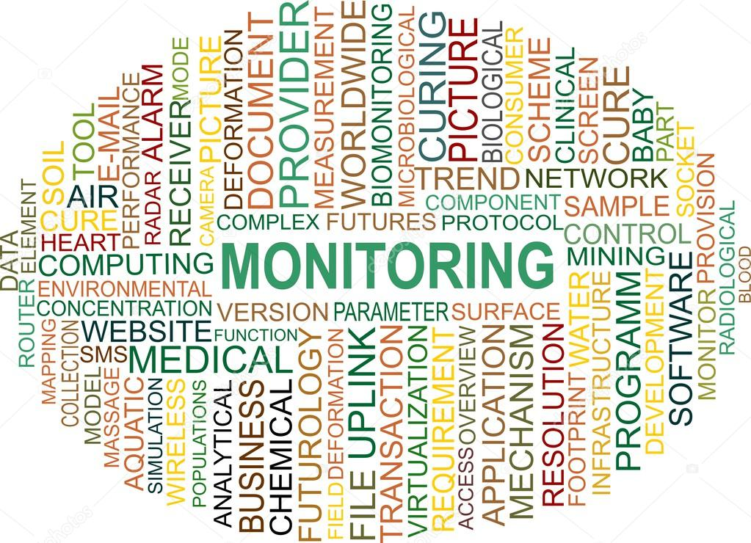
Power Quality Monitoring

Slide 19
Power Quality Monitoring
Power Quality Study
When there is a PQ problem on existing buildings already in operation.
Power Quality Assessment
A health check on the quality of the power system. If there is a problem, then to find the source and nature of the PQ problem.
Power Quality Audit
In-depth PQ survey the electrical distribution. Extensive monitoring of various electrical parameters at the MV switchgears, MSBs, SSBs and DBs.

Slide 20
SYSTEMATIC PQ MONITORING
Step 1: Review of Electrical Disturbance Logs
Step 2: Review of the Building’s Single Line/Schematic Electrical Diagram
Step 3: Site Survey
Step 4: Equipment Documentation
Step 5: Installation of Power Quality
Monitoring Instruments
Step 6: Analysis of Power Quality data
Step 7: Report Writing

Slide 21
SYSTEMATIC PQ MONITORING
Step 1: Review of Electrical Disturbance Logs
Time of Event What was the date and time of each electrical disturbance?
Equipment Affected What equipment was affected, and what were the consequences? Note any equipment failures or data losses.
Length of Outage This will help identify what type of electrical disturbance occurred.
Weather Conditions Weather conditions such as wind, lightning or rain.

Slide 22
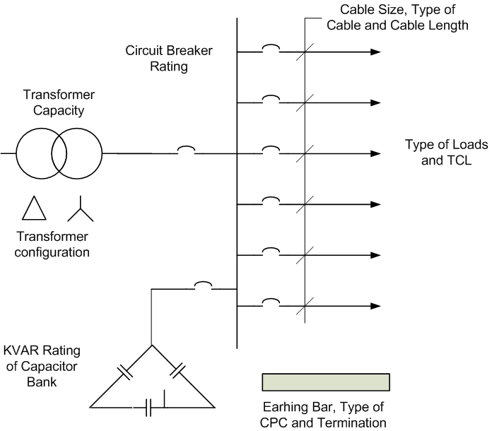
SYSTEMATIC PQ MONITORING
Step 2: Review of the Building’s Single Line/Schematic Electrical Diagram
Getting an up-to-date single line diagram means identifying new loads or other recent changes in the system
Review an up-to-date single line diagram

Slide 23
SYSTEMATIC PQ MONITORING
Step 3: Site Survey
Objective
Determine the condition and adequacy (proper) of the wiring and earthing system
Determine the quality of the AC voltage at the utilization point
Check for loose connections
Visual Inspection will Offer Immediate Clues
A transformer that’s much too hot
Wiring or disconnections discoloured from heat
Signal wiring running in the same trays as power cables
Interview affected personnel. This is most important for problems that are intermittent

Slide 24
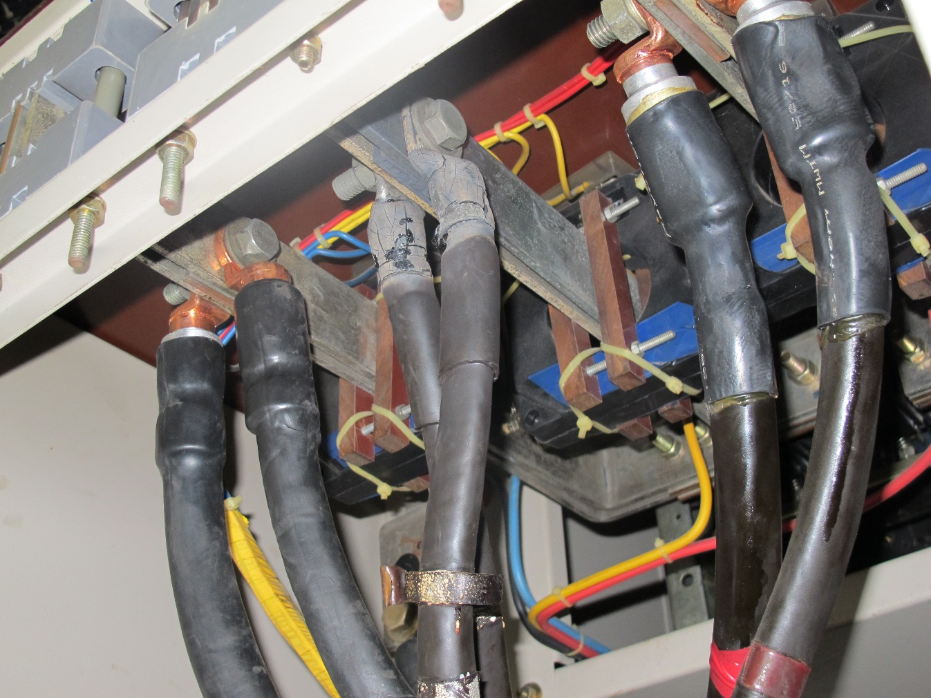
SYSTEMATIC PQ MONITORING
Step 3: Site Survey
Visual Inspection will Offer Immediate Clues
Apa yang tak kena?

Slide 25
SYSTEMATIC PQ MONITORING
Step 3: Site Survey
Information to be Obtained
Nature of the problem (data loss, nuisance trips, component failures, control system malfunction etc.)
Characteristic of sensitive equipment experiencing problems (equipment design information or at least application guide information)
Time of disturbance
Possible sources of power quality variation within the facility (motor switching or capacitor switching)
Existing power conditioning being used.
Electrical system data (single-line diagram, transformer data, load information, capacitor information, data cable etc.)

Slide 26
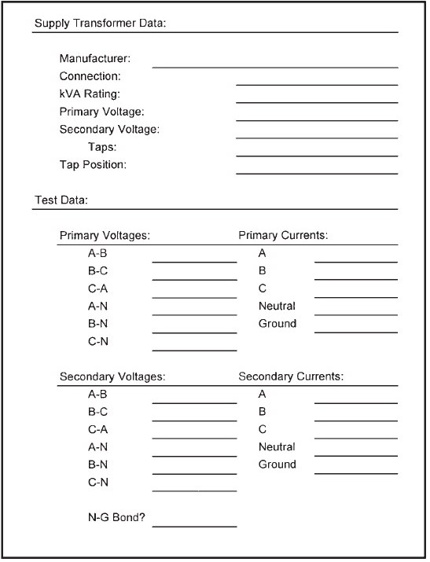
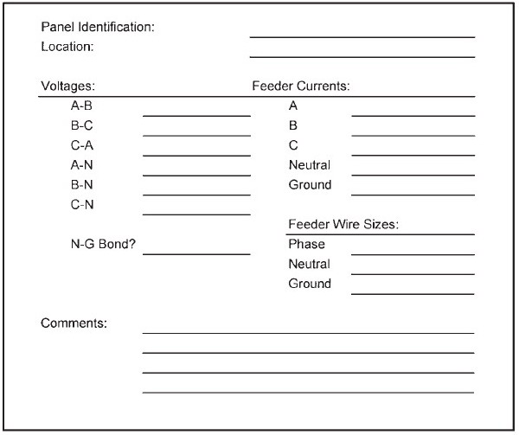
SYSTEMATIC PQ MONITORING
Step 3: Site Survey
Data Forms
Data forms can be used for this initial verification of the power distribution system.
They can be used to organize the power quality monitoring results from throughout the facility.

Slide 27
SYSTEMATIC PQ MONITORING
Step 4: Equipment Documentation
Equipment’s wiring requirements, specifications, and O&M manuals.
Comparing the site survey notes with the equipment documentation may provide clues to resolve a power quality problem.

Slide 28
SYSTEMATIC PQ MONITORING
Step 5: Installation of Power Quality Monitoring Instruments
A number of different instruments may be used, depending on the phenomena being investigated.
Basic categories of instruments that may be applicable include:
Wiring and earthing test devices
Multimeter
Oscilloscopes
Disturbance analyzers
Harmonic analyzers and spectrum analyzers
Combination disturbance and harmonic analyzers
Flicker meters
Energy monitors

Slide 29
SYSTEMATIC PQ MONITORING
Step 5: Installation of Power Quality Monitoring Instruments
The Fluke 1750 power recorder and the Fluke power analyse software are used to conduct the power quality study, assessment and audit.
Other instrument that can be used to help solve power quality problems by measuring ambient conditions; i.e. infrared meter or thermographic camera can be very valuable in detecting loose connections and overheating conductors.

Slide 30
SYSTEMATIC PQ MONITORING
Step 5: Installation of Power Quality Monitoring Instruments
A number of important factors that should be considered when selecting the instrument:
Number of channels (voltage and/or current)
Temperature specifications of the instrument
Ruggedness of the instrument
Input voltage range (e.g., 0 to 600 V)
Power requirements
Ability to measure three-phase voltages
Input isolation (isolation between input channels and from each input to ground)
Ability to measure currents ( wide current range up to 5000A)
Housing of the instrument (portable, rack-mount, etc.)
User friendly (user interface, graphics capability, etc.)
Communication capability (network interface – RJ45, USB)
Data storage, Hard disk or static RAM
Analysis software

Slide 31
SYSTEMATIC PQ MONITORING
Step 5: Installation of Power Quality Monitoring Instruments
Proper measuring techniques are required to safely obtain useful and accurate data

Slide 32
SYSTEMATIC PQ MONITORING
Step 6: Analysis of Power Quality data
Monitoring Standards
IEEE 1159, 1996 : Recommended Practice on Monitoring Electric Power Quality
ER (Engineering Recommendation), E5/4 (UK), for Harmonic limit criteria
ER (Engineering Recommendation), P29 (UK), for Flicker limit criteria
IEEE 519, 1992 : Recommended Practice for Harmonic Control in Electric Power System
IEC 61000-4-x : Monitoring standard

Slide 33
SYSTEMATIC PQ MONITORING
Step 6: Analysis of Power Quality data
Fluke power analyse software is used to conduct the power quality study which enables users to analyse the behaviour of power quality in time domain.
It specially designed to study the six important indicators of power quality:
frequency deviation,
voltage variations,
voltage and current harmonics,
unbalance,
flicker and
events.

Slide 34
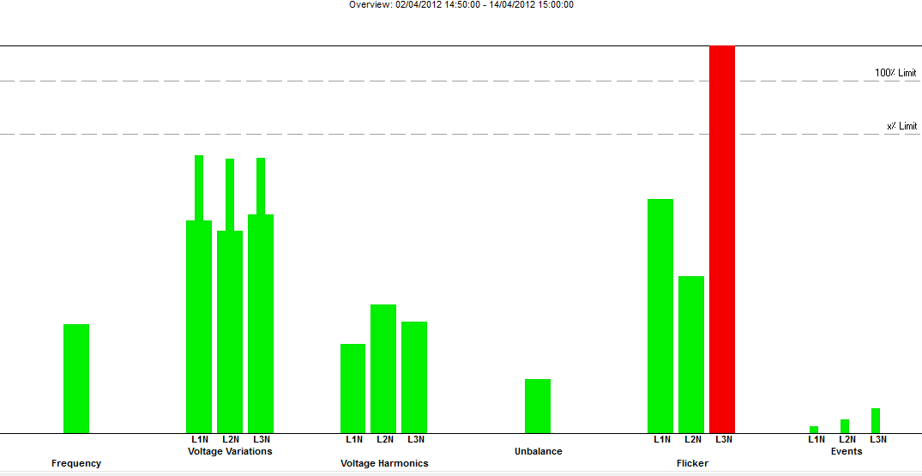
SYSTEMATIC PQ MONITORING
Step 6: Analysis of Power Quality data

Slide 35
SYSTEMATIC PQ MONITORING
Step 7: Report Writing
Acknowledgements
Title pages
Executive summary
Contents page
Terms of reference
Introduction/ background
Methodology/ procedures
Finding and analysis
Conclusions
Recommendations
Appendices
References/ Bibliography
Glossary of terms and abbreviations

Slide 36
SYSTEMATIC PQ MONITORING
Step 7: Report Writing
Easily produce well formatted, easy-to-read reports for management, customers, and clients.
Sorts and analyzes a large volume of data.
Reports on one, several, or all aspects of power.
Combines text and graphics.
Isolates the report to a specific time period.
Suggests solutions to power quality problems.

Slide 37
CONCLUSION
Before any major electrical changes or purchase of power conditioning devices is made, a systematic approach to PQ investigation is required for proper identification of causes and sources to PQ problems so that the proper solution can be developed.

Slide 38
Thank You
Cawangan Kejuruteraan Elektrik

