Slide 1
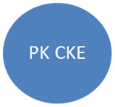
CKE.GP.12.05.(00).2014
HODT CKE
PPR CKE
Kontraktor
PBTs
Perunding
ICU, EPU, MOF
HOPT
HODTs JKR
KPM
UniSZA
Pengarah CPPT
Network Diagram
TKP Pakar
KPKR
Legend:
Direct Communication
Indirect Communication

