Slide 1
CIVIL ENGINEERING ELEMENTAL COST ANALYSIS (CEECA) PENGENALAN KEPADA CEECA PRINSIP PENYEDIAAN CEECA

Slide 2
COST ANALYSIS
Used in establishing Preliminary Estimate
Negotiation
Basis for Detailed Estimate

Slide 3
Principle of Analysis
The CEECA shall be prepared based on the finalised re-measured quantities from the original scope of works ONLY.
For projects with multiple structures, each structure shall be analysed separately.
The analysis of data shall be tabulated in the following sequence by using the standard format:

Slide 4
Principle of Analysis

Slide 5
Principle of Analysis
The Prime Cost and Provisional Sum related to the Builder’s Works (Item 2a to 2k - Form 2), if any, shall be apportioned to the particular element that is to be analysed. The remaining Prime Cost & Provisional Sum items (refer clause 3.1.11 - List and Content of Elements) shall be inserted in item 3 - Form 2 and the amount shall be as allocated in the contract.
Rationalised rates shall be used instead of tendered rates, (where applicable).
Contingency Sum to cover unforeseen expenditure shall not be included in the analysis.

Slide 6
CEECA FORM
FORM 1
FORM 2
FORM 3
FORM 4
FORM 5

Slide 7
FORM I
INFORMATION ON CONTRACT
A) JOB TITLE
Name of project.
B) CLIENT
Example - Kementerian Kerja Raya, Kementerian Kemajuan Luar Bandar dan Wilayah, etc.
C) LOCATION
State, example - Pahang.
D) PROJECT DETAILS AND SITE CONDITION
Project Brief Description
Description of project shall include limit of project area, length of road constructed, type of work (new works/upgrading work) with specified length.
JKR Design Standard
Example - R3, R5, U5 etc.
Terrain/Geographical Condition
Example - flat, undulating, mountainous etc.

Slide 8
FORM I
No. of Berms
To specify number of berms representing the major length of the berm
Overall Road Length
Length of road is measured gross from chainage to chainage.
Road Length (Nett)
Length of road excluding roads above elevated structure (bridges, viaduct and interchange).
Shoulder Width
Refer Sketch
Type of Shoulder
Example - paved, earth-filled etc.
Median Width
Refer Sketch
Type of Median
Example - paved, earth-filled etc.

Slide 9
FORM 1
No. of Lanes
Number of lanes constructed
Type of Carriageway
Example - four lane dual carriageway etc.
No. of Structure
Total number of structures constructed (for multiple structures projects).
Note :
In cases where the scope of works involves variety of types and designs (e.g. : design standard, type of shoulder/median, width of shoulder/median etc.), the major scope (in term of length) shall determine the project details

Slide 10
FORM 1
CONTRACT PARTICULARS
Contract No.
Basis of tender - Open/Selective Tender or Negotiated. (Prequalification to be treated as selective tender)
Type of Contract - Conventional, Design & Build, Turnkey or Cost Plus including whether tendered internationally or locally
Form of Contract – e.g.: PWD 203A
Contract Period
Date of Tender - Date of closing tender (for open/selective tender) or date of final negotiation (for direct negotiated tender)
Commencement Date
Completion Date (Original)

Slide 11
FORM 1
F) ADJUSTMENT OF CONTRACT SUM
Original Contract Sum
As stated in Letter of Acceptance.
Adjusted Contract Sum
Contract Sum after taking into account final re-measured quantities excluding Variation Works and Variation of Price.
G) OTHER INFORMATION
Source of Materials
Haulage distance for sand, crusher run, asphaltic concrete binder course, asphaltic concrete wearing course and imported earth.

Slide 12
FORM 2
The analysis is tabulated in a format comprising of:
Description
Percentage of contract sum
Cost per kilometre (cost/km)
Total cost of element (RM)

Slide 13
FORM 2
The elements of works shall be described as follows:
1) Preliminaries
General Item
Turnkey Elements (if applicable)
2) Main Works
2a) Site Clearance & Demolition Works
2b) Earthworks
2c) Drainage Works
2d) Pavements Works
2e) Road Furniture
2f) Geotechnical Works
2g) Structures
2h) Traffic Management & Control
2i) Environmental Protection Works
2j) Routine Maintenance Works
2k) Others (To specify, if any)
3) Prime Cost Sum & Provisional Sum (not related to builder’s work)
The Prime Cost and Provisional Sum related to the Builder’s Works (Item 2a to 2k - Form 2), if any, shall be apportioned to the particular element that is to be analysed. The remaining Prime Cost & Provisional Sum items (refer clause 3.1.11 - List and Content of Elements) shall be inserted in item 3 - Form 2 and the amount shall be as allocated in the contract.

Slide 14
FORM 2
PERCENTAGE OF CONTRACT SUM
The percentage calculation is derived from cost of each element over the Contract Sum and shall be calculated to the nearest one decimal place.
However, the percentage of Preliminaries shall be based on the remainder of Contract Sum excluding Preliminaries. General Item and Turnkey Element of Preliminaries shall be analysed separately.
TOTAL COST OF ELEMENT (RM)
The total cost shall include the amount for the related Prime Cost Sum and Provisional Sum items that have been apportioned to that particular element. The amount is carried from Form 5 – Final Re-measurement of Project Cost.
COST PER KILOMETRE (Cost/km)
The total cost for each element is divided by length of the road (nett) in kilometre (to the nearest Sen).

Slide 15
FORM 3
The type of structures is categorised as follows:
Bridge
Viaduct
Interchange
Underpass
Tunnel
Culverts (more than 3 meter wide) (Culverts function as drainage shall be analysed under Element Drainage Works)
Type of Structure
- Type of structure shall be stated.
- The following shall be described :
i) Type of pile
ii) Type of structure (e.g. beam, box girder / segmental)
iii) No. of span
Dimension
A) Bridge
Length (L) – measured from abutment to abutment
Width (W) – measured from the outer edge of parapet

Slide 16
FORM 3
B) Pedestrian Bridge / Pedestrian Bridge with Motorcycle Ramp
Length (L) – total length of bridge from end A to end B
Width (W) – measured from the outer edge of slab
C) Viaduct/ Interchange
Length (L) – total length of bridge from end A to end B
Width (W) – measured from the outer edge of parapet
D) Underpass/ Tunnel/ Culvert
Length (L) – total length of bridge from end A to end B
Width (W) – measured from the outer edge of wall

Slide 17
FORM 3
Area of structure (m2)
Measured to the nearest whole number.
Total length of pile (m)
Measured from toe to cut-off level
Cost of structure (RM)
Cost excludes temporary work. Refurbishment works (if any) and
bridge widening shall not be analysed.

Slide 18
FORM 3 STRUCTURE COMPONENT

Slide 19
FORM 4

Slide 20
FORM 5
The final re-measurement of project cost is tabulated in a format comprising of:
Description of work
Contract cost (RM)
Allocation of provisional sum items from original contract cost (RM)
Adjustment due to re-measurement of final quantities (Addition/Omission) (RM)
Final cost (RM)
DESCRIPTION OF WORKS
The elements of works shall be stated.
CONTRACT COST (RM)
The amounts for the particular elements are derived from the original Contract Amount.
ALLOCATION OF PROVISIONAL SUM ITEMS FROM ORIGINAL CONTRACT COST (RM)
The Prime Cost and Provisional Sum related to the Builder’s Works (Item 2a to 2k - Form 2), if any, shall be apportioned to the particular element that is to be analysed. The remaining Prime Cost & Provisional Sum items (refer clause 3.1.11 - List and Content of Elements) shall be inserted in item 3 - Form 2 and the amount shall be as allocated in the contract.

Slide 21
FORM 5
ADJUSTMENT DUE TO RE-MEASUREMENT OF FINAL QUANTITIES (ADDITION/OMISSION) (RM)
The nett addition/omission due to the re-measurement of quantities shall be stated for the particular element EXCEPT for works with variation due to substitution, the original amount shall remain.
FINAL COST (RM)
The final cost for the particular element after the adjustment shall be taken to Form 2.

Slide 27
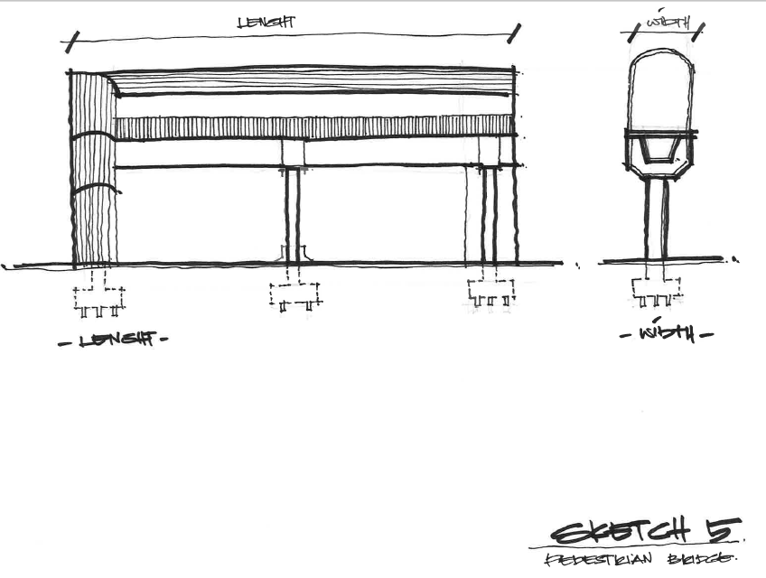

Slide 28
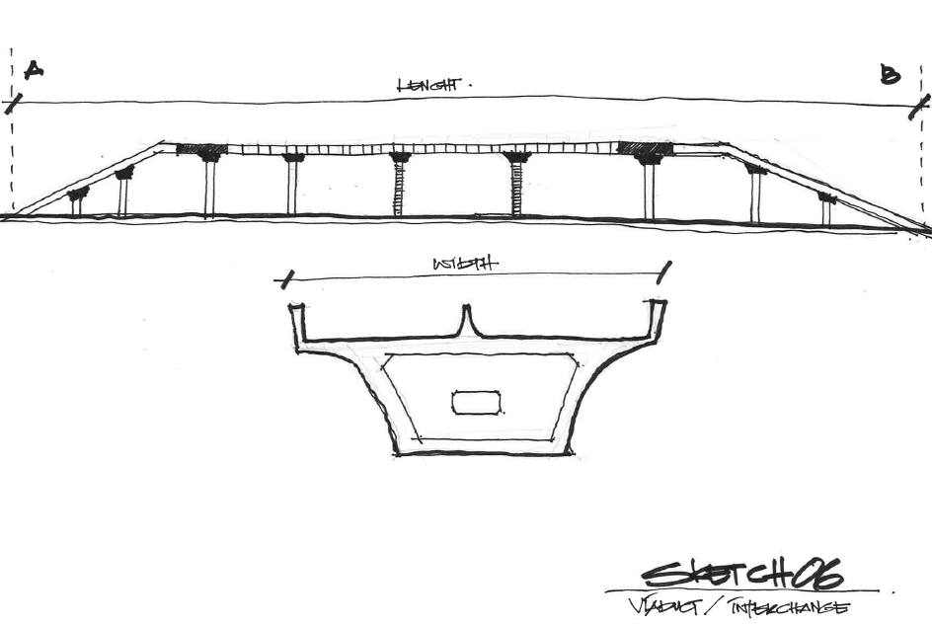

Slide 29
