Slide 1
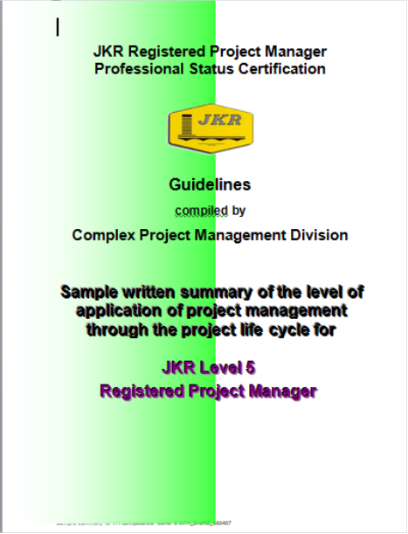
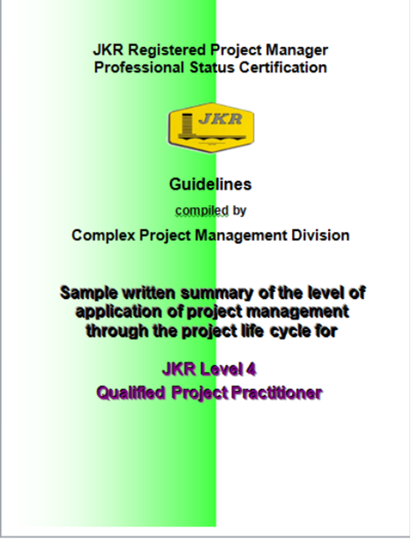
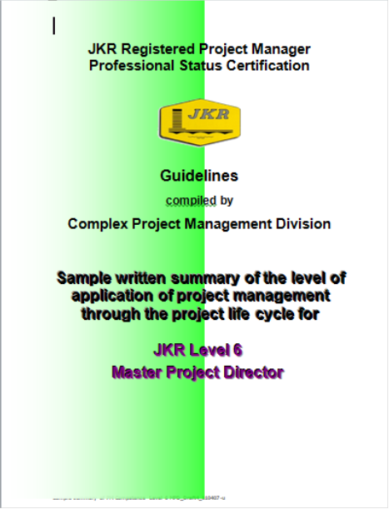
WRITTEN SUMMARY
PM CBAS REQUIREMENTS

Slide 2
Content
What it is
Why it is required
When it is required
Where it is to be deposited
How it is develop
Written Summary Templates
Samples of Written Summary

Slide 3
What It Is ?
It is a document explicitly developed by the candidate to demonstrate his/her competency based on the respective units and elements of the JKR Project Management Competency Standards.
It is a document that indicates, quotes and cross-reference, the evidences pertaining to the candidates competency on the units and elements that he/she claimed to have.

Slide 4
Why It is required ?...
It is a document to be used during assessment interview by both the assessor and candidate for verification and validation of competency.
It is a document to be attached in the candidate’s Assessment Record Book (ARB), for Competency Based Assessment Systems (CBAS) Unit on-ward actions before giving approval for registration of the candidate as a:
  Registered Project Director (RPD)
  Registered Project Manager (RPM), and
  Qualified Project Practitioners (QPP).

Slide 5
When it is Required?
It should be prepared by the candidate prior to the each of the assessment interview session based on the agreed units.
Preferably it should be given to the assessor at least 1 week before the assessment session for his review.

Slide 6
Where it is to be deposited?
The written summary should be send directly to the candidate’s assigned assessor so that he/she can:-
  Analyse
  Review
  Verify
  Validate
  Approve and
  Endorsed
The final written summary will be deposited to CBAS Manager Office by the assessor together with the Candidate Files.

Slide 7
How it is developed?
The written summary should be able to explicitly explain the candidate competency (knowledge, skills and attitude) accordingly.
It should be written in a structured manner so that it facilitates:-
  Assessment interview process
  Jugdement on the level competetency
  Consistency application of JKR Competency Standards
  Sufficiency of the evidences provided

Slide 8
Registered Project Directed (RPD)

Slide 9
Registered Project Manager (RPM)

Slide 10
Qualified Project Practitioner (QPP)

Slide 11
Samples of Written Summary
Registered Project Director (Level 6)
AR. AZMAN MD HASHIM
Registered Project Manager (Level 5)
AR. SUZANA BT. AMAT
Qualified Project Practitioner (Level 4)
MARWARNI BT ABD MANAP

Slide 12

THANK YOU

