Slide 1
KNOWLEDGE MANAGEMENT @ JABATAN KERJA RAYA MALAYSIA
TAKLIMAT
Majlis amanah rakyat
11 ogos 2017
Sr ROZNITA BT OTHMAN
PENGARAH KEJURUTERAAN
CAWANGAN PERANCANGAN ASET BERSEPADU
IBU PEJABAT JKR MALAYSIA

Slide 2
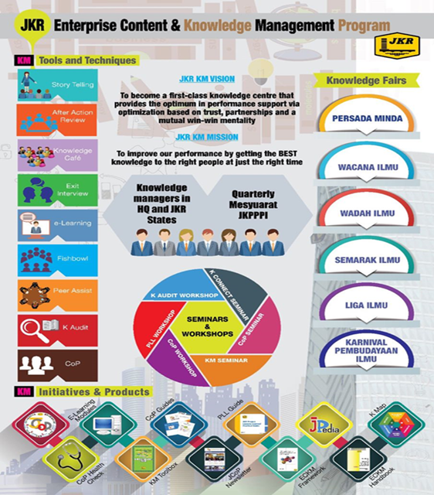
Begin with the end in mind
What I will cover
Why ECKM matters to us
JKR KM Agenda and Journey
ECKM Products
ECKM Activities

Slide 3
WHY DO YOU WANT TO IMPLEMENT KNOWLEDGE MANAGEMENT?

Slide 4
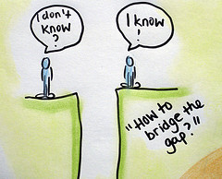
Why ECKM matters to JKR
1
Our most critical technical knowledge remains siloed in the organisation – or worse, is heading out the door
2
Our people work at different locations and are geographically dispersed. Knowledge sharing across the department becomes more challenging. People are not learning from each other and are reinventing the wheel

Slide 5
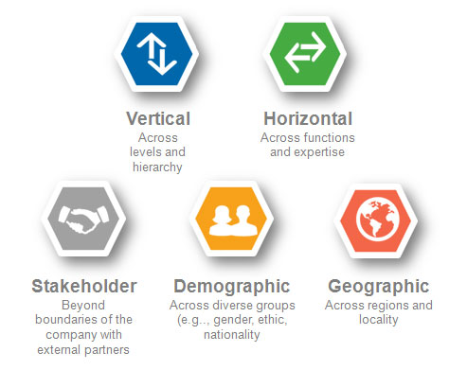
SILOS result in lack of trust,
limited communication and isolation
http://www.chrisernst.org/why-boundary-spanning-networks/activate-the-network/

Slide 6
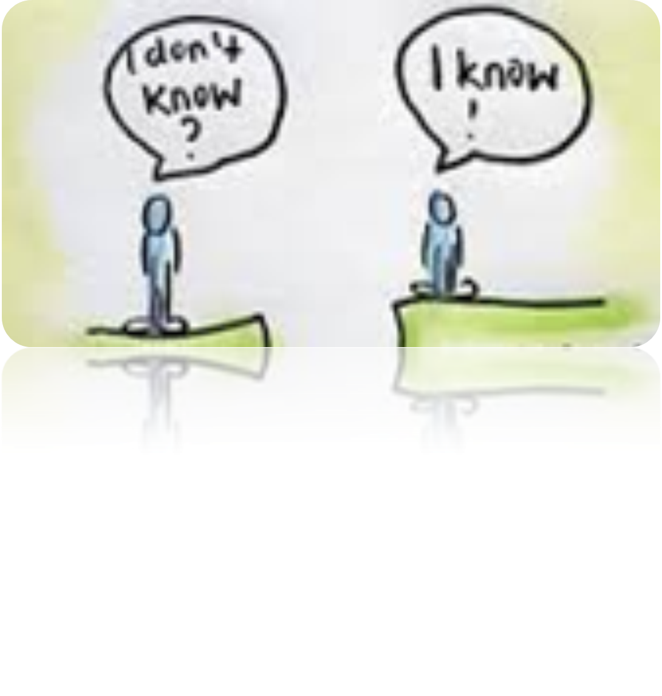
Knowledge gap
Knowledge seeker
Knowledge bearer

Slide 7
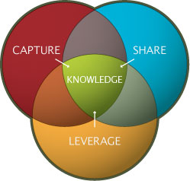
How KM can improve the organisational performance
Easy to find experienced individuals
Enterprise wide knowledge at our finger tips
Improve communication and break down silos
Generate new ideas that can be incorporated into innovative products and processes
Improve productivity by reusing “what we know

Slide 8
ISO 9001:2015 -Clause 7.1.6
Organisations need to determine and manage its knowledge to ensure the operation of its processes and that it can achieve conformity of products and services

Slide 9
GIVING THE BEST KNOWLEDGE TO THE RIGHT PEOPLE AT THE RIGHT TIME
WILL NOT ONLY
PROVIDE PERFORMANCE SUPPORT FOR EMPLOYEES TO DO THEIR JOB MORE EFFICIENTLY AND EFFECTIVELY BUT WILL ALSO ENHANCE THE INNOVATION CAPACITY OF THE DEPARTMENT

Slide 10
DATA/ DOCUMENT
METHODS
SKILL
EXPERIENCE
RELATION-SHIP
TALENT

Slide 11
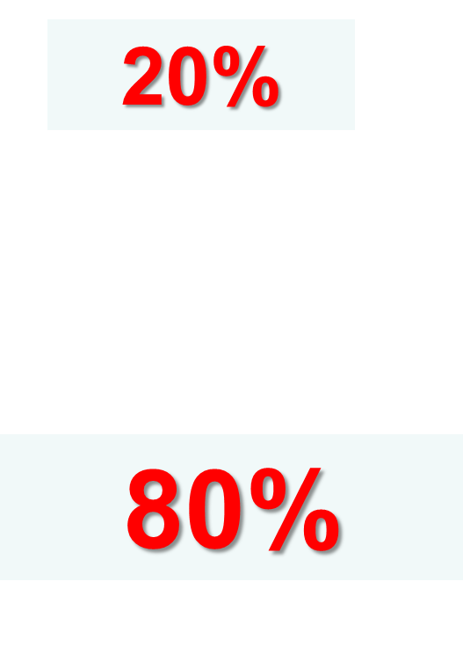
Types of Knowledge

Slide 12
RISK
ACCESSIBILITY
GAP
ANALYSIS
KNOWLEDGE AUDIT

Slide 14
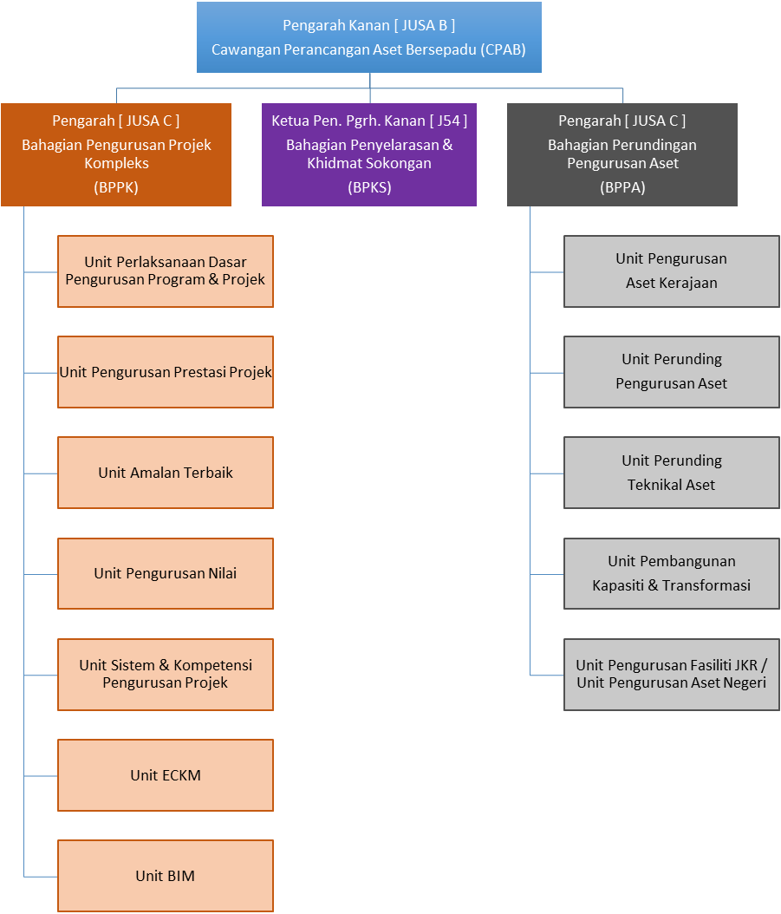
ECKM Office Team
Sr. Roznita Othman
Pengarah Kejuruteraan (Komunikasi)
Juruukur Bahan
J48 (JUB)
Sr Dr Khairil Hizar Md. Khuzaimah
J41 (Awam)
Norparzila Abd. Ghaffar
J41 (Awam)
Safira Aiza Ahmad
Khairunnisa Mohd Hairuddin
J29 (Awam)
Unit ECKM

Slide 15
Knowledge Managers Roles & Responsibilities
Accountable for improving the circulation of knowledge throughout the organization.
Responsible for applying new knowledge to improve behaviors.
Responsible for creating awareness and conducting at least five knowledge sharing sessions per year.
Act as resources to help manage/leverage knowledge content
Implement and monitor KM strategy and activities
Promote awareness and understanding of KM
Improve processes and practices for collection, safekeeping, disseminating and sharing of knowledge assets to ensure their quality and availability
Reports to J/K Pelaksanaan dan Pemantauan Pembudayaan Ilmu on knowledge and learning activities conducted at the Branch/State level

Slide 16
The KM Agenda
To cultivate knowledge sharing and learning culture across department
through the use of proven effective knowledge sharing tools
MAJOR KM INITIATIVES (since 2008)
1
JPedia, an online repository to share knowledge-in-context)
2
Communities of Practice to share domains of knowledge
3
JCoP, an online platform to ask and discuss
4
5
Project Lessons Learned System to share key project learnings
KM Toolbox, set of tools and techniques to capture and share insights and ideas
6
JKR Yellow Pages to locate experts within the department
7
E-Learning to provide 24 x 7 learning environment

Slide 17
JKR Knowledge Transfer
Strategies and Initiatives
Communities of Practice
JCoP
JKR Yellow Pages
Personalisation Strategy
Uses technology to provide information of “Who knows what?” and to stimulate personal contacts via collaborative means.
Connecting
People to People
Codification Strategy
Detaches knowledge from the knowledge bearers by articulation and electronic storage so the knowledge becomes explicit.
JPedia
E-Learning
Project Lessons Learned
Connecting
People to Content
Notes:
There are 2 strategies
Personalisation Strategy: This is done via collaborative means., communities of practice, JCoP Yellow Pages. The focus is on connecting People to People through face to face or virtual interactions.
Codification Strategy: This is converting the tacit knowledge to explicit knowledge by articulation and use of electronic storage, as in Jpedia, e-learning, project lessons learned. Since we know more that we can tell, the use of technology such as podcast, videos will help a lot.

Slide 18
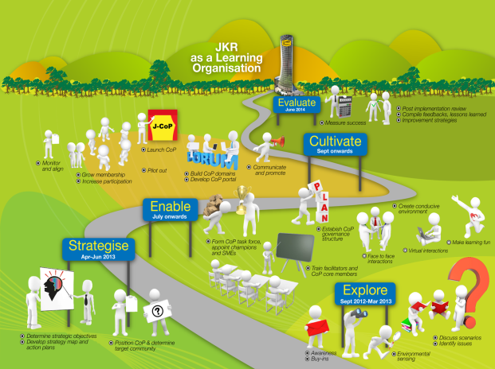
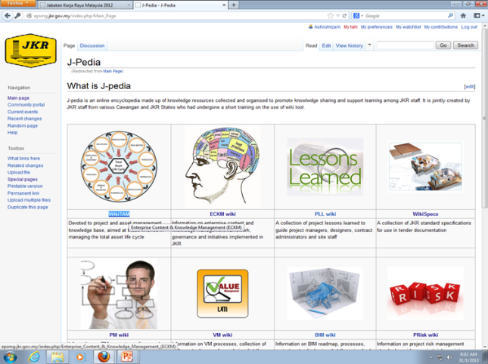
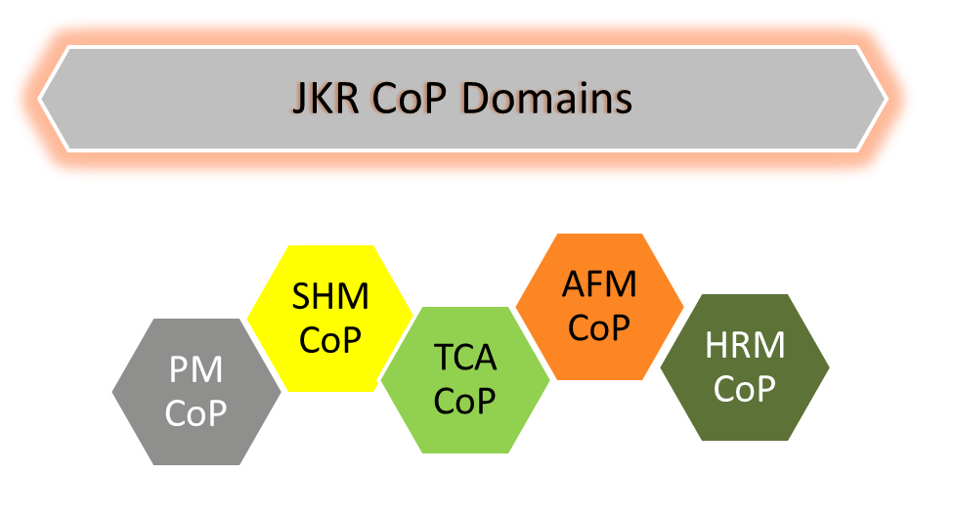
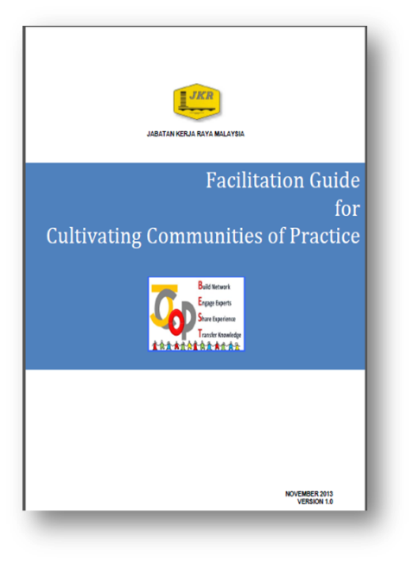
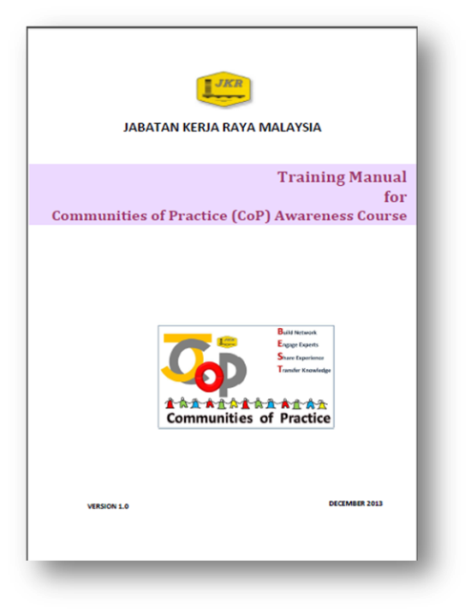
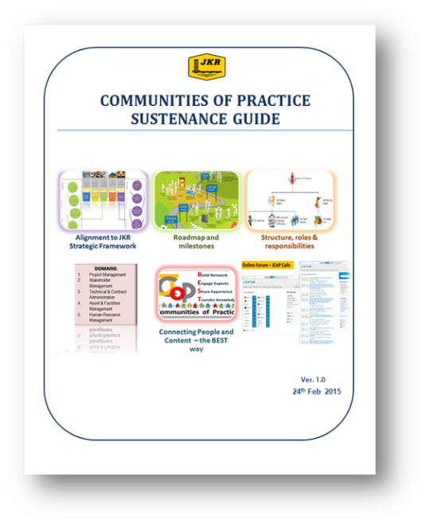
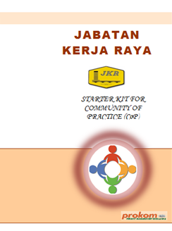
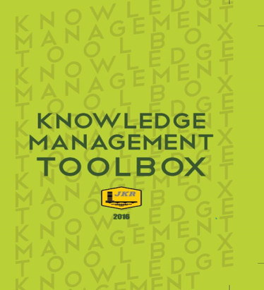
ECKM products
2010 – epsmg
2012 - JPedia
2009
2013
2011 – KM readiness assessment
2013
2014
2013
2015
2016
Contract Mgt CoP
BIM CoP
Structures CoP
Green CoP
?
2016
2016

Slide 19
The KM Agenda
To cultivate knowledge sharing and learning culture across department
through the use of proven effective knowledge sharing tools
MAJOR KM INITIATIVES (since 2008)
1
JPedia, an online repository to share knowledge-in-context)
2
Communities of Practice to share domains of knowledge
3
JCoP, an online platform to ask and discuss
4
5
Project Lessons Learned System to share key project learnings
KM Toolbox, set of tools and techniques to capture and share insights and ideas
6
JKR Yellow Pages to locate experts within the department
7
E-Learning to provide 24 x 7 learning environment

Slide 20
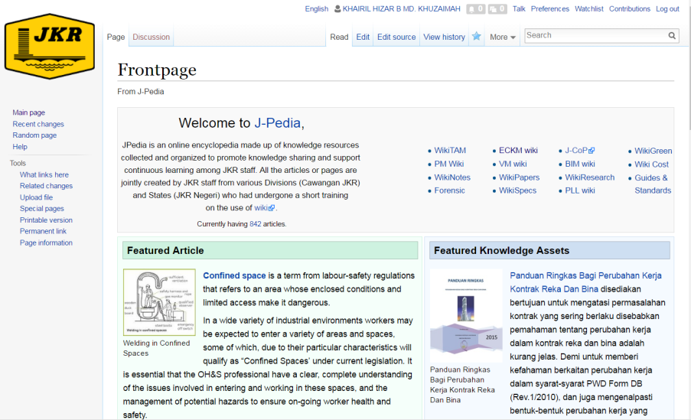
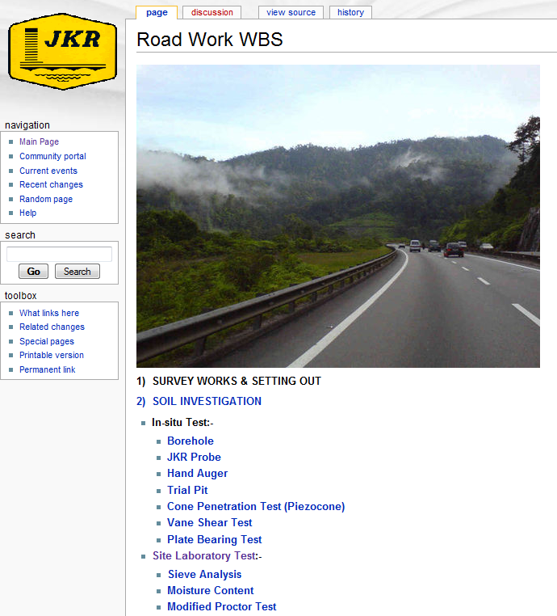
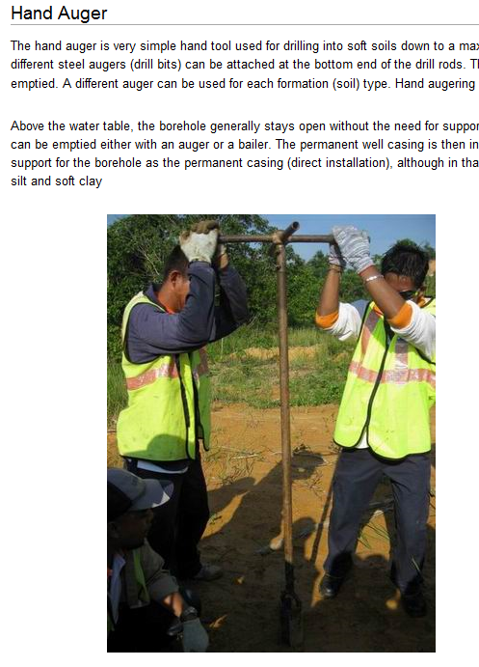
JKR KM Online Tools
JPedia
Online Knowledge Repository
Best Practices
PM Competency Framework
Project Lessons Learned
Technical References and Guides
Presentations
Conference Papers
Share Explicit Knowledge
Connect People to Content

Slide 21
JPedia Statistics
PAGE STATISTICS
60
AVERAGE VISITS/DAY
2,976
10,200
PAGES
REGISTERED USERS
8,098
UPLOADED FILES
* As of 08.08.2017

Slide 22
The KM Agenda
To cultivate knowledge sharing and learning culture across department
through the use of proven effective knowledge sharing tools
MAJOR KM INITIATIVES (since 2008)
1
JPedia, an online repository to share knowledge-in-context)
2
Communities of Practice to share domains of knowledge
3
JCoP, an online platform to ask and discuss
4
5
Project Lessons Learned System to share key project learnings
KM Toolbox, set of tools and techniques to capture and share insights and ideas
6
JKR Yellow Pages to locate experts within the department
7
E-Learning to provide 24 x 7 learning environment

Slide 23
JKR CoPs
Peer networks of practitioners within JKR who help each other to perform better by sharing knowledge and experience.
Through this collaborative environment, new knowledge is created and will help spark innovation

Slide 25
5
4
3
2
1

Slide 26
CoP Domains @ JKR
Stakeholder Management
Human Resource Management
Structure
BIM
Green
Contract Management
Project Management
Assets and Facilities Management
Technical and Contract Administration

Slide 27
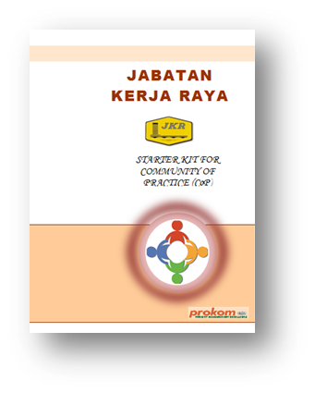
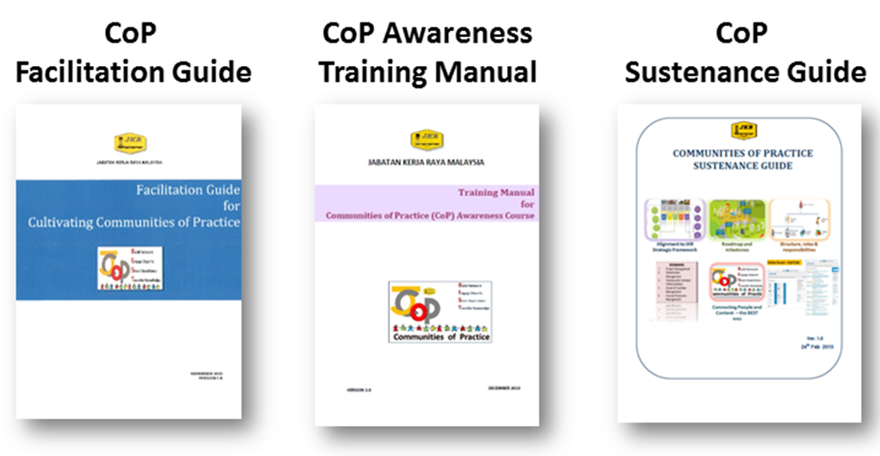
CoP Publications
CoP Starter Kit

Slide 28
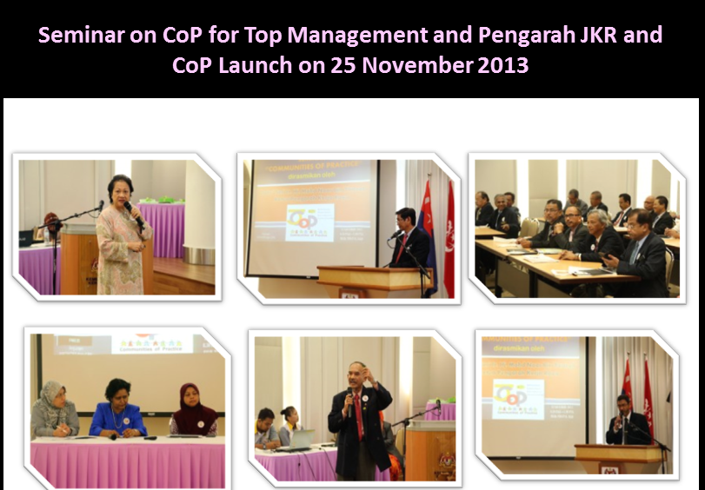

Slide 29
The KM Agenda
To cultivate knowledge sharing and learning culture across department
through the use of proven effective knowledge sharing tools
MAJOR KM INITIATIVES (since 2008)
1
JPedia, an online repository to share knowledge-in-context)
2
Communities of Practice to share domains of knowledge
3
JCoP, an online platform to ask and discuss
4
5
Project Lessons Learned System to share key project learnings
KM Toolbox, set of tools and techniques to capture and share insights and ideas
6
JKR Yellow Pages to locate experts within the department
7
E-Learning to provide 24 x 7 learning environment

Slide 30
Connecting People – The BEST Way
JKR KM Online Tools
JCoP
Virual Communities of Practice
CoP Domains
Subject Matter Experts Profile
Ask and Discuss Online Platform
Share Tacit Knowledge
Connect People to People

Slide 31
Connecting People and Content – The BEST Way!
collaborative tool enables people to share data, information and knowledge in real time
facilitate exchange of ideas and solutions as well as track members’ participation

Slide 32
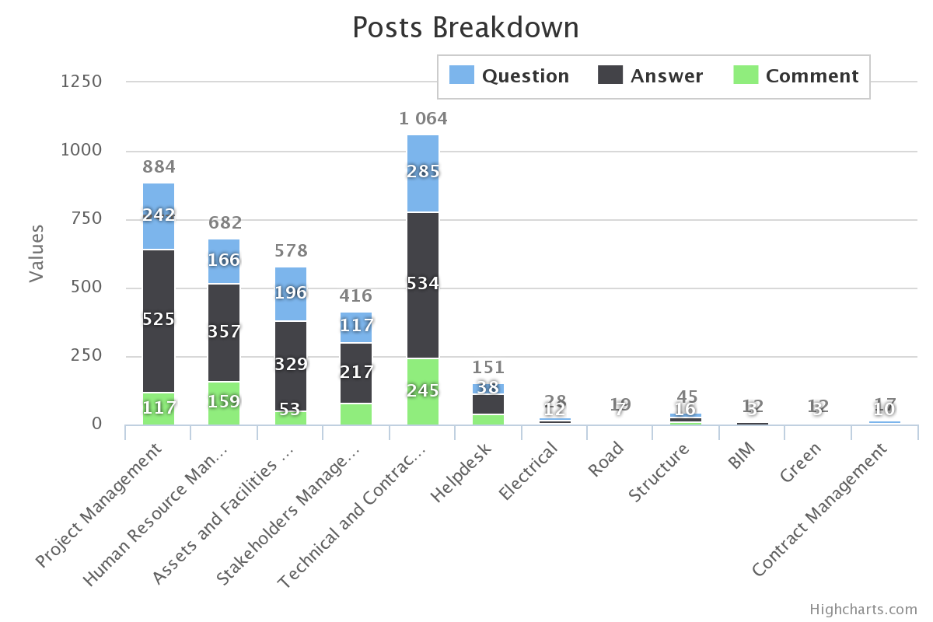
JCoP Statistics – Posts Breakdown
4,066 posts

Slide 33
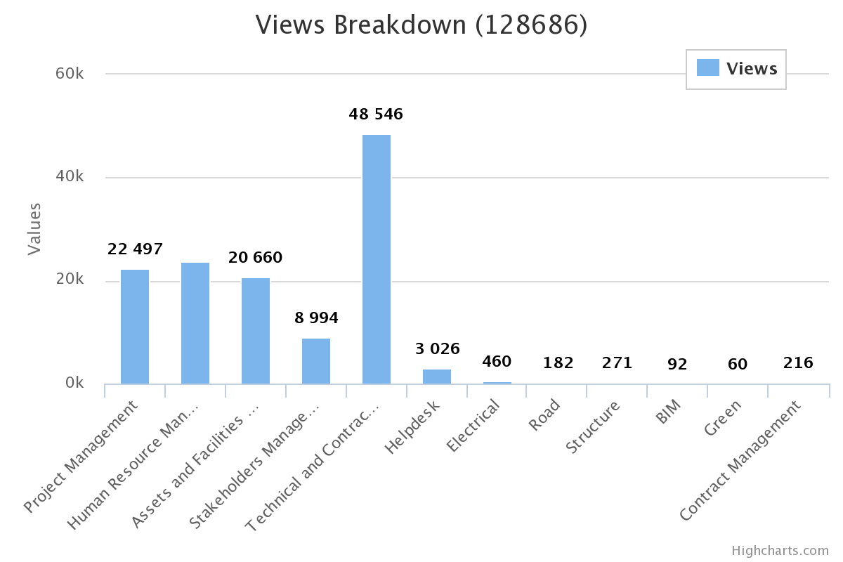
JCoP Statistics – Views Breakdown
131,745 views

Slide 34
JCoP Statistics – Quick Stats
1,134
QUESTIONS
2,481
2,158
ANSWERS
774
COMMENTS
REGISTERED USERS
* As of 08.08.2017

Slide 35
The KM Agenda
To cultivate knowledge sharing and learning culture across department
through the use of proven effective knowledge sharing tools
MAJOR KM INITIATIVES (since 2008)
1
JPedia, an online repository to share knowledge-in-context)
2
Communities of Practice to share domains of knowledge
3
JCoP, an online platform to ask and discuss
4
5
Project Lessons Learned System to share key project learnings
KM Toolbox, set of tools and techniques to capture and share insights and ideas
6
JKR Yellow Pages to locate experts within the department
7
E-Learning to provide 24 x 7 learning environment

Slide 36
Project Lessons Learned

Slide 37
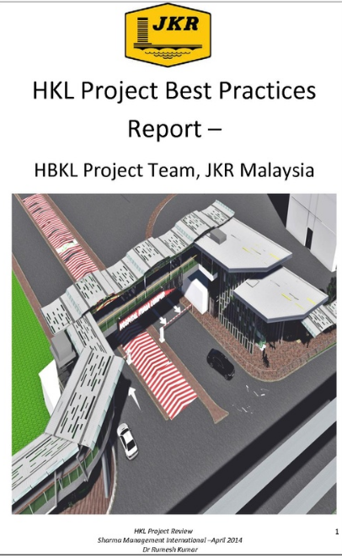
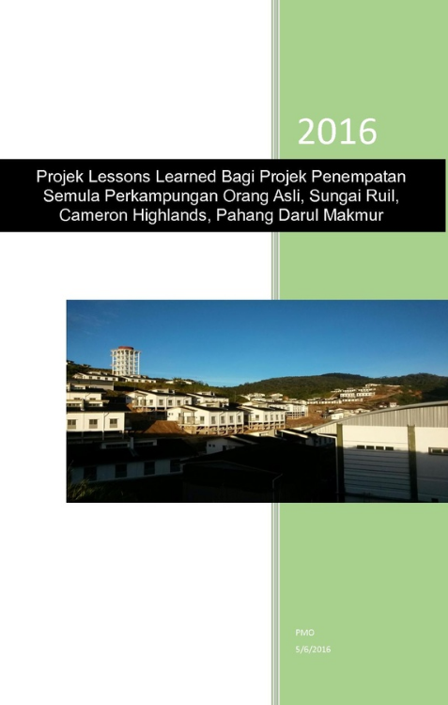
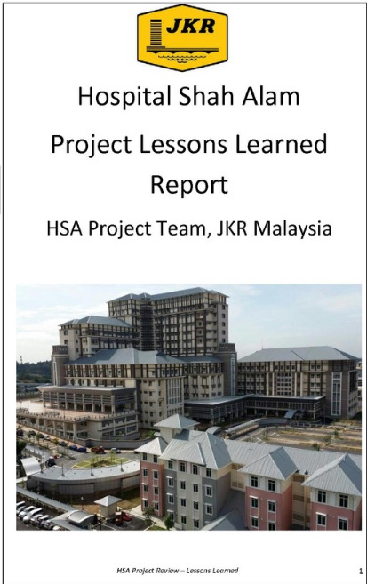
Project Lessons Learned Reports

Slide 38
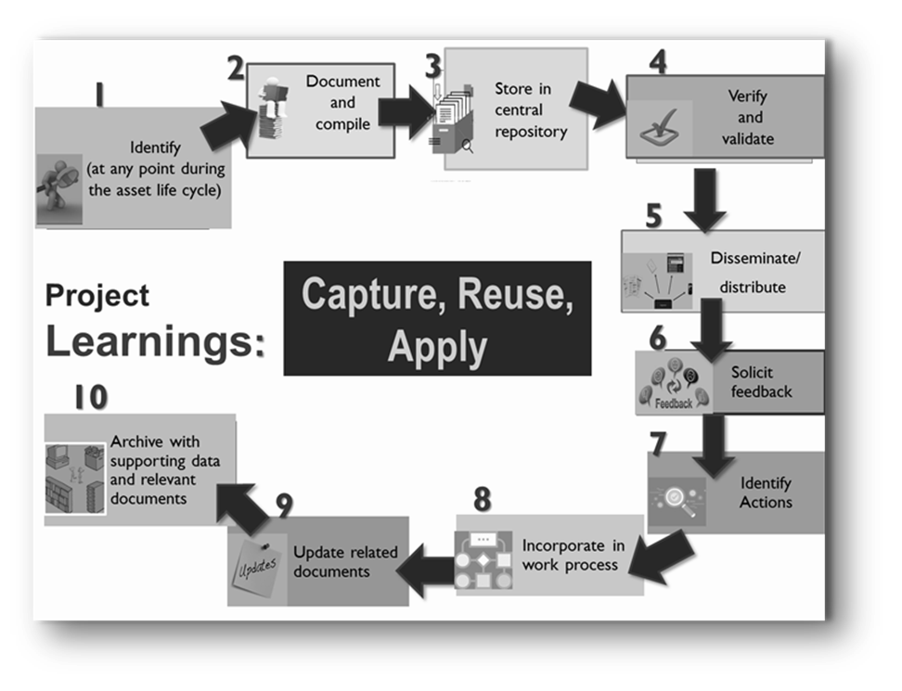
PLL ACTIVITIES

Slide 39
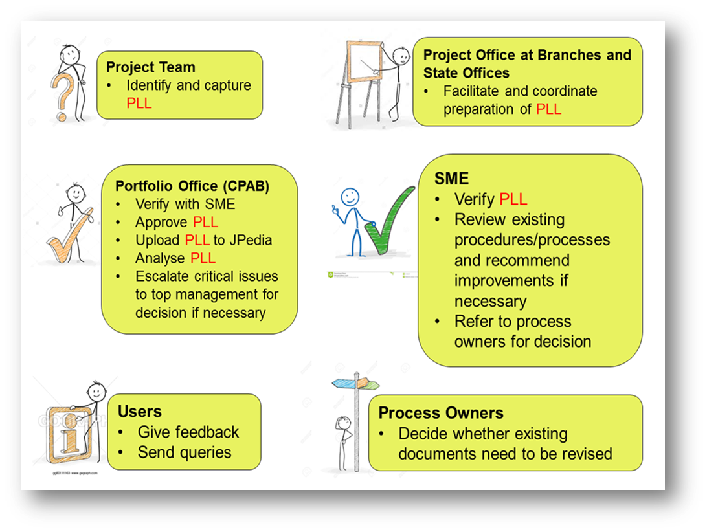
ROLES AND RESPONSIBILITIES

Slide 40
Systems under development

Slide 41
The KM Agenda
To cultivate knowledge sharing and learning culture across department
through the use of proven effective knowledge sharing tools
MAJOR KM INITIATIVES (since 2008)
1
JPedia, an online repository to share knowledge-in-context)
2
Communities of Practice to share domains of knowledge
3
JCoP, an online platform to ask and discuss
4
5
Project Lessons Learned System to share key project learnings
KM Toolbox, set of tools and techniques to capture and share insights and ideas
6
JKR Yellow Pages to locate experts within the department
7
E-Learning to provide 24 x 7 learning environment

Slide 42
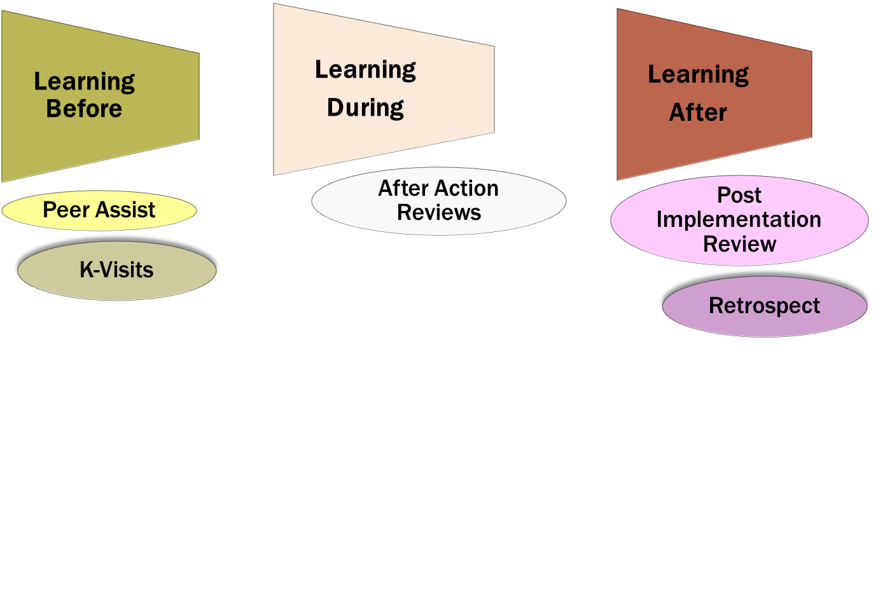
Tools to capture/harvest Knowledge

Slide 43
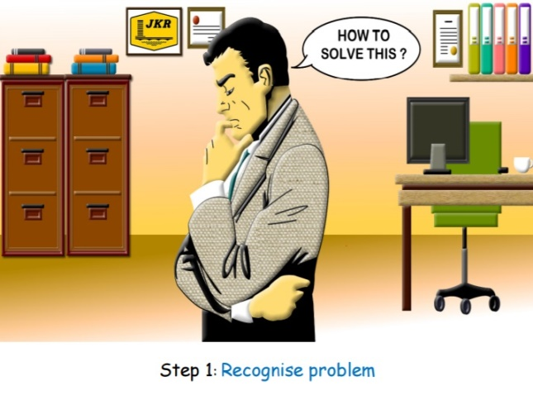
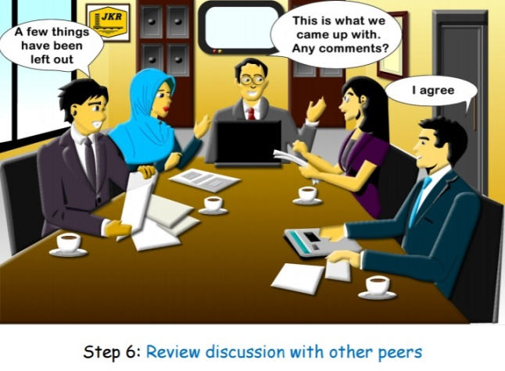
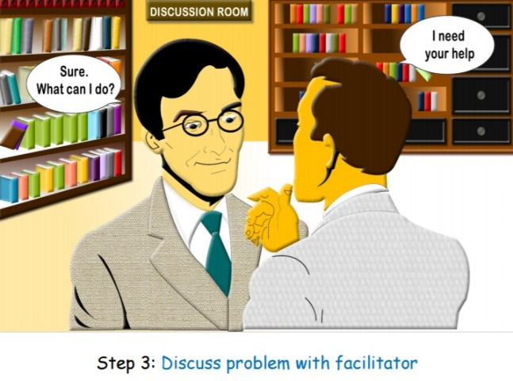
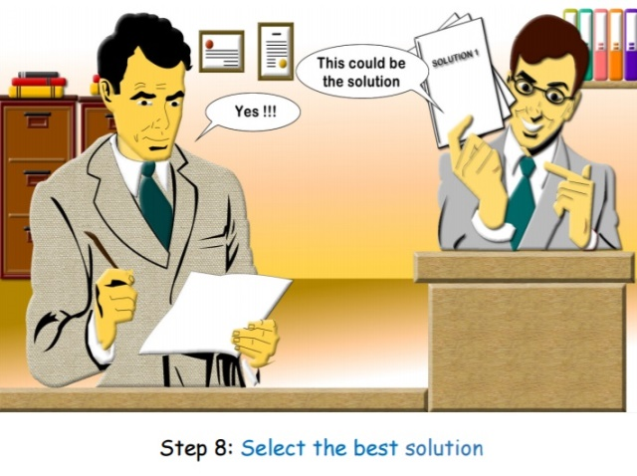

Slide 44
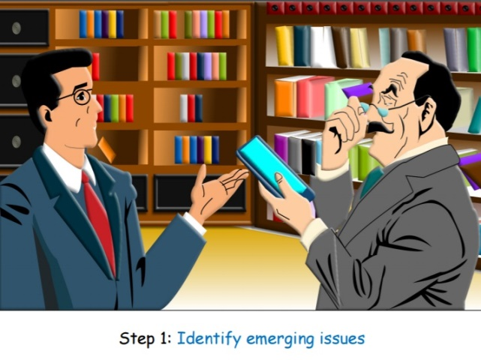
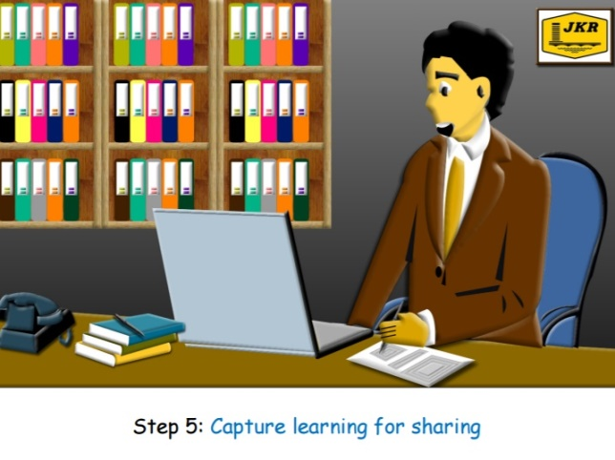
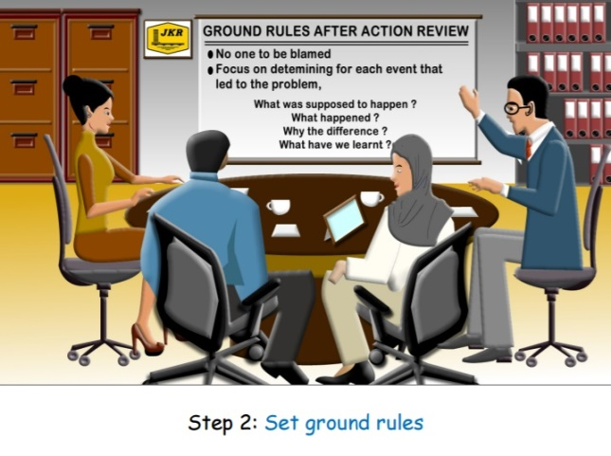
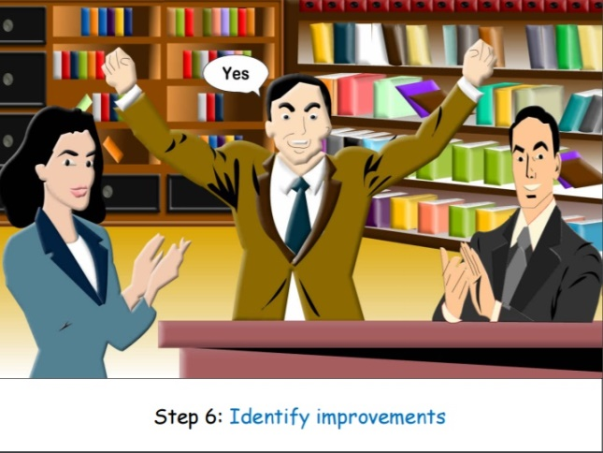

Slide 45
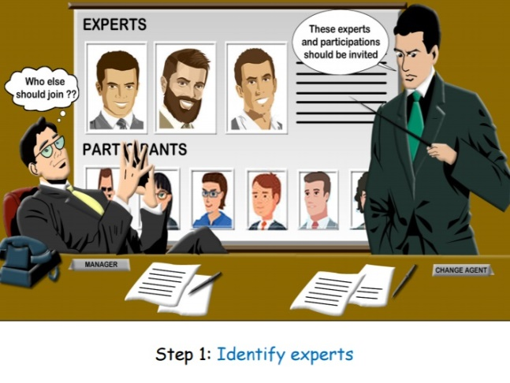
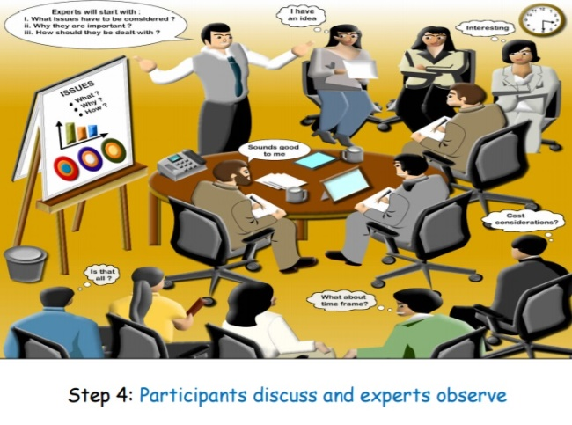
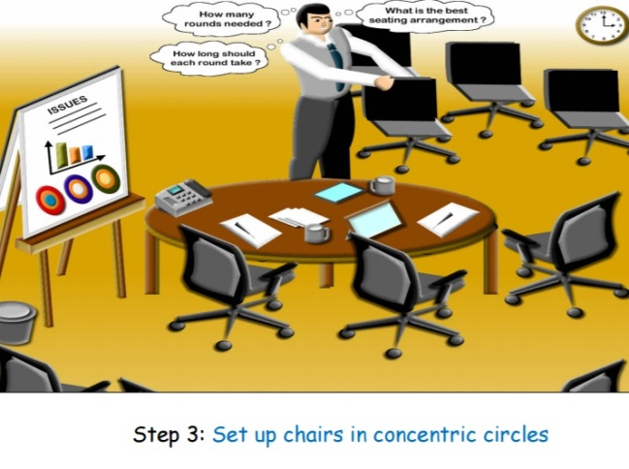

Slide 46
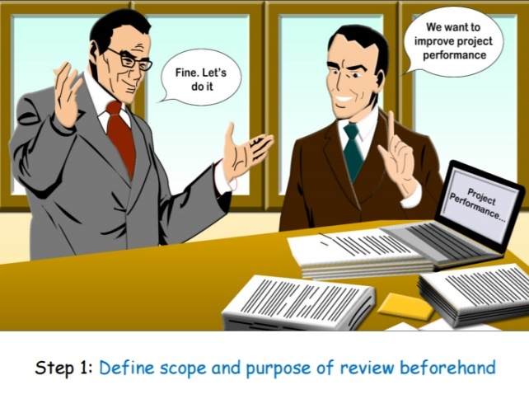
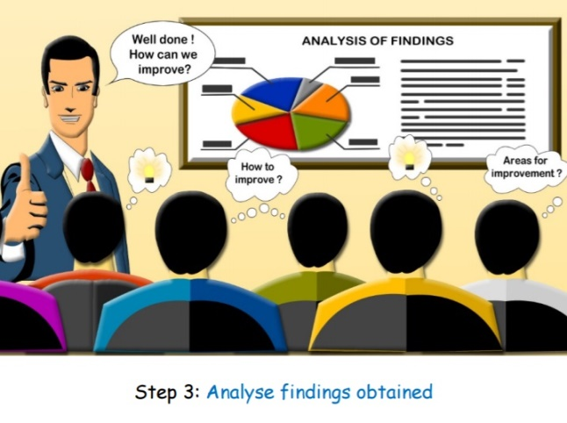
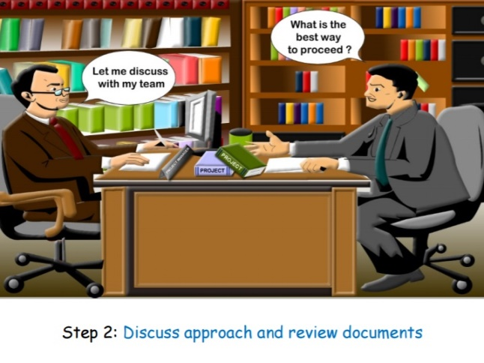

Slide 47
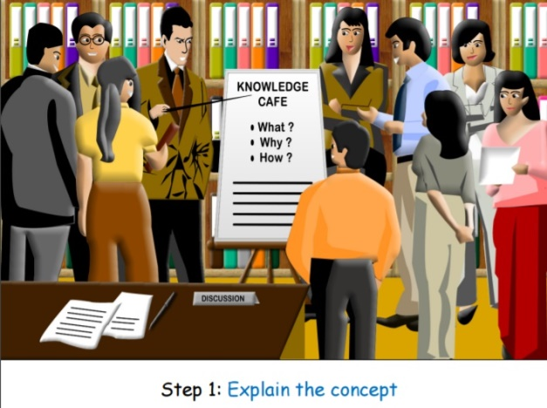
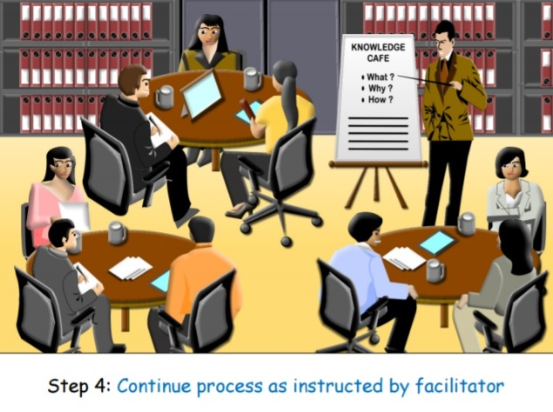
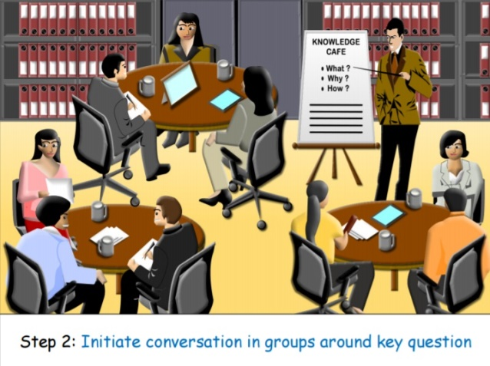

Slide 48
The KM Agenda
To cultivate knowledge sharing and learning culture across department
through the use of proven effective knowledge sharing tools
MAJOR KM INITIATIVES (since 2008)
1
JPedia, an online repository to share knowledge-in-context)
2
Communities of Practice to share domains of knowledge
3
JCoP, an online platform to ask and discuss
4
5
Project Lessons Learned System to share key project learnings
KM Toolbox, set of tools and techniques to capture and share insights and ideas
6
JKR Yellow Pages to locate experts within the department
7
E-Learning to provide 24 x 7 learning environment

Slide 49
JKR Yellow Pages – Who’s Who

Slide 50
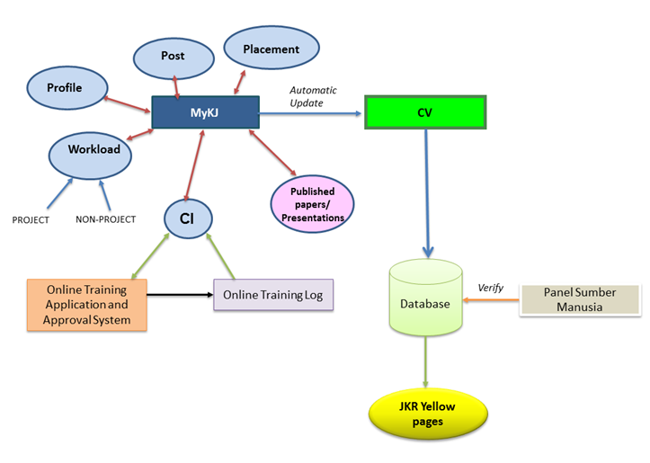
Systems under development
JKR Yellow Pages: Expert Directory

Slide 51
The KM Agenda
To cultivate knowledge sharing and learning culture across department
through the use of proven effective knowledge sharing tools
MAJOR KM INITIATIVES (since 2008)
1
JPedia, an online repository to share knowledge-in-context)
2
Communities of Practice to share domains of knowledge
3
JCoP, an online platform to ask and discuss
4
5
Project Lessons Learned System to share key project learnings
KM Toolbox, set of tools and techniques to capture and share insights and ideas
6
JKR Yellow Pages to locate experts within the department
7
E-Learning to provide 24 x 7 learning environment

Slide 52
E-Learning - EPSA

Slide 53
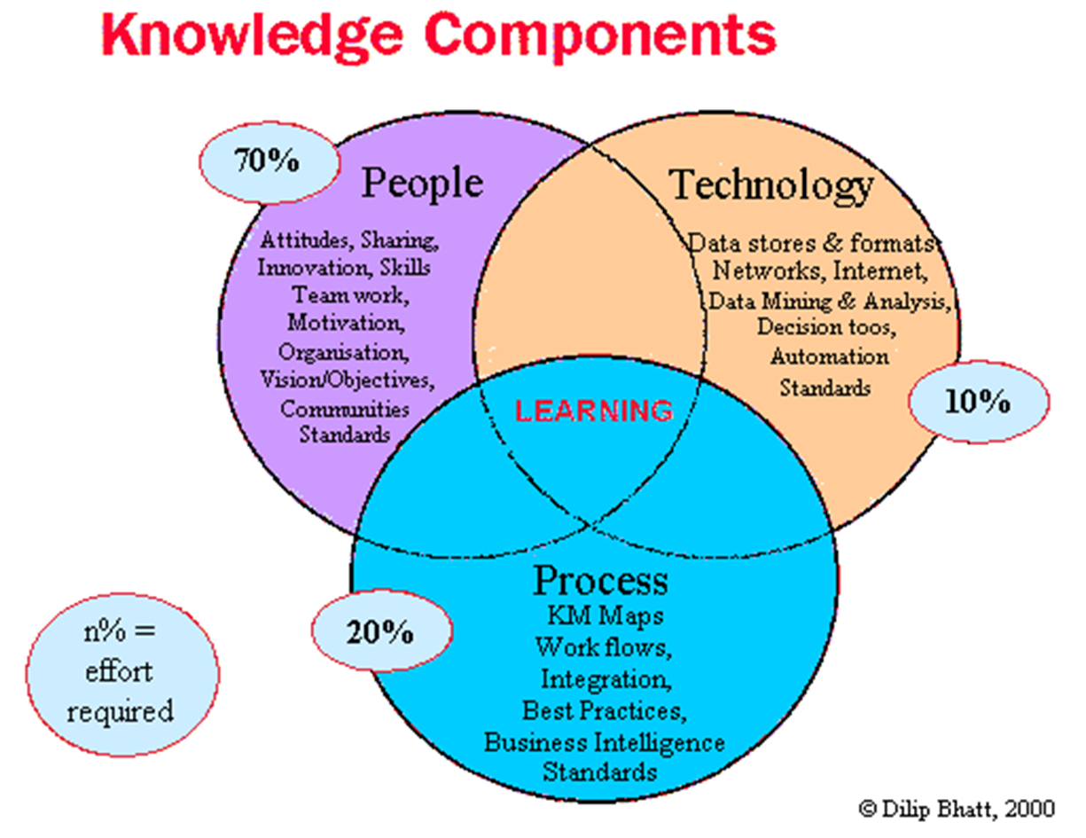

Slide 54
Knowledge Audit
Objectives
create a baseline inventory of knowledge assets
pinpoint knowledge availability and accessibility issues
identify knowledge asset gaps and KM barriers
make recommendations on areas for improvement
Outputs:
1. Knowledge Needs Analysis – knowledge required to meet JKR’s current business process activities.
2. Knowledge Inventory Analysis – stock-taking exercise to identify and locate knowledge assets and resources in JKR.
3. KM Barriers – common knowledge issues across the organisation.
Knowledge gaps identified
Gap in managing knowledge of experts
Gap in recoding knowledge
Gap in enhancing and maintaining timely knowledge
Gap in building a learning culture

Slide 55
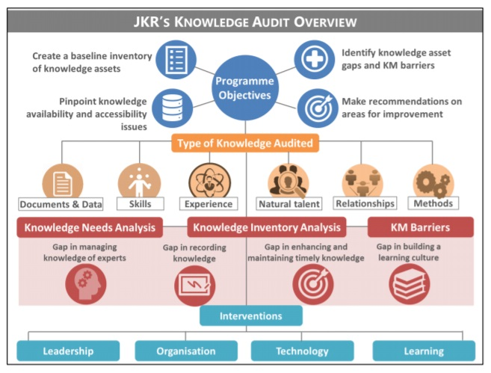
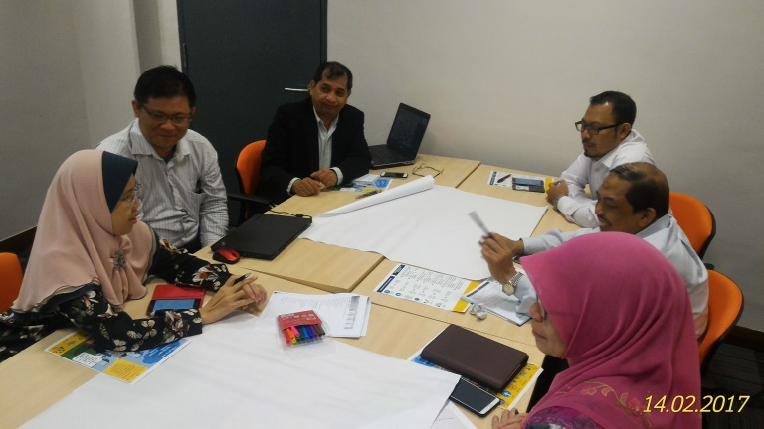
KM Audit Workshop
13 – 14 Feb 2017

Slide 56
KM Events & Activities
Bengkel & Mesyuarat Project Lessons Learned

Slide 57
KM Events & Activities
Mesyuarat JKPPPI

Slide 58
KM Events & Activities
Program K-Visit

Slide 59
KM Events & Activities
Program Persada Minda JKR

Slide 60
KM Events & Activities
Seminar KConnect 2017

Slide 61
LESSONS LEARNED IN IMPLEMENTING KM
1. Get Buy-in
“People aren’t going to consider anything until they are convinced there is a problem that truly needs to be addressed”- John Kotter
Find a way that makes the problem feel real!

Slide 62
LESSONS LEARNED IN IMPLEMENTING KM
2. Envision an inspiring future
“The best way to predict the future is to create it” - Peter Drucker
Communicate the change early, often, and well and in a variety of mediums.
Consistency and repetition are key.
Use metaphors, analogies, examples and stories

Slide 63
LESSONS LEARNED IN IMPLEMENTING KM
3. Start small
There is NO one-size-fits-all KM solution
Select pilots and quick wins
Identify resources needed
Identify barriers and enablers

Slide 64
LESSONS LEARNED IN IMPLEMENTING KM
4. Involve management and others
Support from the management and staff is crucial
Identify champions
Develop relationships with key people
Define roles and responsibilities
Train and motivate continuously

Slide 65
LESSONS LEARNED IN IMPLEMENTING KM
5. Measure
How do we know that we are there?
Identify suitable metrics

Slide 66
Thank you for your attention
Mobile- 019 603 6464
roznita@jkr.gov.my

