Slide 1
BASIC COURSE IN KNOWLEDGE MANAGEMENT
10-11 APRIL 2017

Slide 2
Objective 1
Understand concepts and models relevant to acquisition, development and dissemination of knowledge
Objective 2
How to apply the tools and techniques of knowledge sharing and transfer

Slide 3
Learning Outcomes
understand different types of knowledge assets
design strategies to leverage on the knowledge assets
Identify and apply suitable KM tools and techniques to transfer knowledge

Slide 4
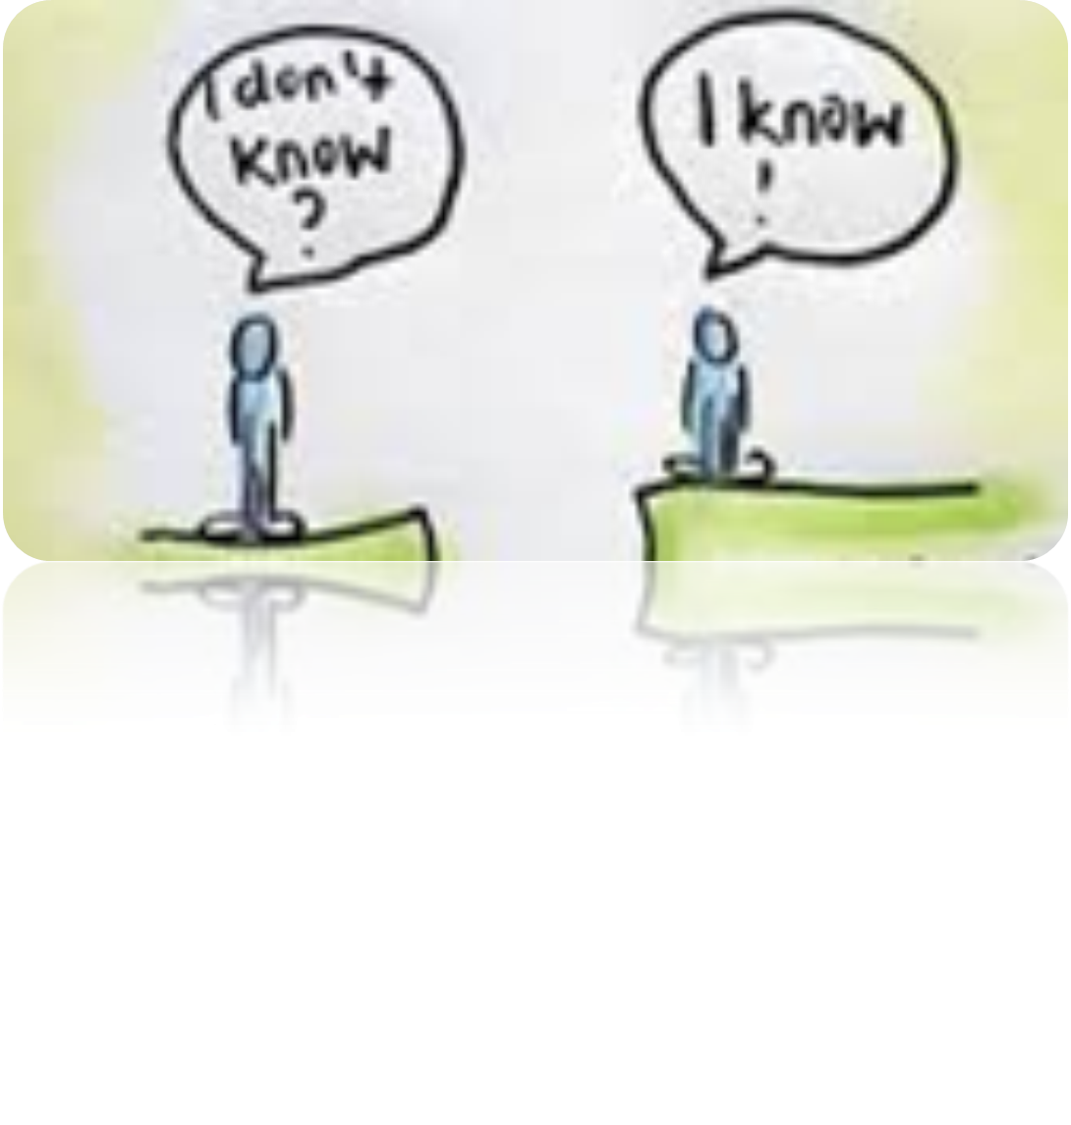
ICE BREAKING session
Knowledge seeker
Knowledge bearer

Slide 5
RESULTS
BEST KNOWLEDGE SEEKER
BEST KNOWLEDGE CONTRIBUTOR
Pn. Marrion Waynor (15)
Pn. Nor Hayati Yahya (12)
En. Mahalil Makhtar (11)
En. Muhammad Izzat Ishak (11)
Pn. Zainon Hj. Tohid (11)
Pn. Anis Hanum Hamzah (13 ; 33pts)
Pn. Nor Hayati Yahya (12 ; 33pts)
En. Muhammad Faris Anuar (12 ; 31pts)
En. Muhammad Izzat Ishak (12 ; 31pts)
Pn. Zainon Hj. Tohid (11 ; 30pts)

Slide 6
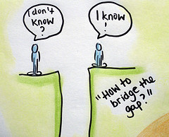
Why ECKM matters to us
1
Our most critical technical knowledge remains siloed in the organisation – or worse, is heading out the door
2
Our people work at different locations and are geographically dispersed. Knowledge sharing across the department becomes more challenging. People are not learning from each other and are reinventing the wheel

Slide 7
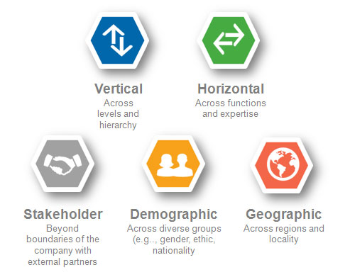
SILOS result in
lack of trust, limited communication and isolation
http://www.chrisernst.org/why-boundary-spanning-networks/activate-the-network/

Slide 8
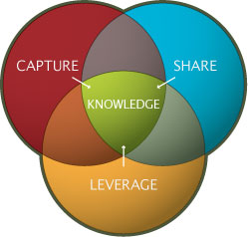
How KM can improve the organisational performance
Easy to find experienced individuals
Enterprise wide knowledge at our finger tips
Improve communication and break down silos
Generate new ideas that can be incorporated into innovative products and processes
Improve productivity by reusing “what we know

Slide 9
ISO 9001:2015 -Clause 7.1.6
Organisations need to determine and manage its knowledge to ensure the operation of its processes and that it can achieve conformity of products and services

Slide 10
GIVING THE BEST KNOWLEDGE TO THE RIGHT PEOPLE AT THE RIGHT TIME
WILL NOT ONLY
PROVIDE PERFORMANCE SUPPORT FOR EMPLOYEES TO DO THEIR JOB MORE EFFICIENTLY AND EFFECTIVELY BUT WILL ALSO ENHANCE THE INNOVATION CAPACITY OF THE DEPARTMENT

Slide 11
KNOWLEDGE ASSETS

Slide 12
WHAT ARE YOUR KNOWLEDGE ASSETS?
WHERE ARE THEY LOCATED?
ARE THEY
EASILY ACCESSIBLE?

Slide 13
WHO ARE THE KNOWLEDGEABLE PERSONS?
HOW MANY OF THEM WILL BE RETIRING/LEAVING THE DEPARTMENT?
QSIC 2016 - 25 August 2016
13

Slide 14
DATA/ DOCUMENT
METHODS
SKILL
EXPERIENCE
RELATION-SHIP
TALENT

Slide 15
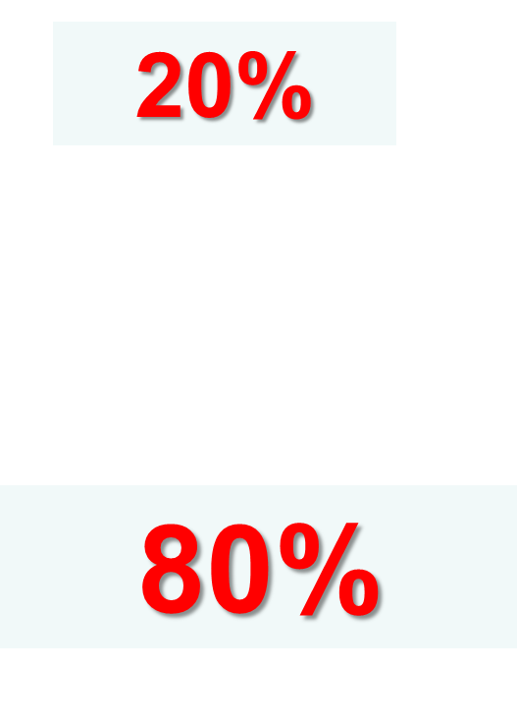
Types of Knowledge

Slide 16
RISK
ACCESSIBILITY
GAP
ANALYSIS
KNOWLEDGE AUDIT

Slide 17
GROUP WORK:
WHAT ARE THE KNOWLEDGE ASSETS THAT YOU NEED?

Slide 18
IDENTIFY THE KNOWLEDGE ASSETS
TO HELP YOU
MANAGE PROJECTS EFFECTIVELY
NEGOTIATE A CONTRACT
FINALISE ACCOUNT
DESIGN A ROAD

Slide 19
KNOWLEDGE ASSETS FOR MANAGING PROJECTS EFFECTIVELY
EXAMPLE
DOCUMENT | METHOD | SKILL | EXPERIENCE | RELATIONSHIP | TALENT

Slide 20
EXPLICIT vs TACIT KNOWLEDGE
How to create and transfer
explicit and tacit Knowledge?

Slide 21
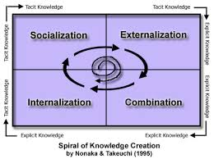

Slide 22
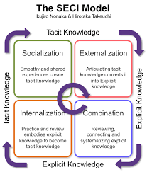

Slide 23
KNOWLEDGE CAFÉ SESSION
FOR EACH QUADRANT, SUGGEST TOOLS/ APPROACHES THAT CAN BE USED TO CREATE AND TRANSFER KNOWLEDGE

Slide 24
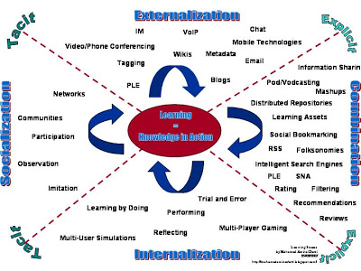

Slide 25
Knowledge Managers Roles & Responsibilities
Accountable for improving the circulation of knowledge throughout the organization.
Responsible for applying new knowledge to improve behaviors.
Responsible for creating awareness and conducting at least five knowledge sharing sessions per year.
Act as resources to help manage/leverage knowledge content
Implement and monitor KM strategy and activities
Promote awareness and understanding of KM
Improve processes and practices for collection, safekeeping, disseminating and sharing of knowledge assets to ensure their quality and availability
Reports to J/K Pelaksanaan dan Pemantauan Pembudayaan Ilmu on knowledge and learning activities conducted at the Branch/State level

Slide 26
The KM Agenda
To cultivate knowledge sharing and learning culture across department
through the use of proven effective knowledge sharing tools
MAJOR KM INITIATIVES (since 2008)
1
JPedia, an online repository to share knowledge-in-context)
2
Communities of Practice to share domains of knowledge
3
JCoP, an online platform to ask and discuss
4
5
Project Lessons Learned System to share key project learnings
KM Toolbox, set of tools and techniques to capture and share insights and ideas
6
JKR Yellow Pages to locate experts within the department
7
E-Learning to provide 24 x 7 learning environment

Slide 27
JKR Knowledge Transfer
Strategies and Initiatives
Communities of Practice
JCoP
JKR Yellow Pages
Personalisation Strategy
Uses technology to provide information of “Who knows what?” and to stimulate personal contacts via collaborative means.
Connecting
People to People
Codification Strategy
Detaches knowledge from the knowledge bearers by articulation and electronic storage so the knowledge becomes explicit.
JPedia
E-Learning
Project Lessons Learned
Connecting
People to Content
Notes:
There are 2 strategies
Personalisation Strategy: This is done via collaborative means., communities of practice, JCoP Yellow Pages. The focus is on connecting People to People through face to face or virtual interactions.
Codification Strategy: This is converting the tacit knowledge to explicit knowledge by articulation and use of electronic storage, as in Jpedia, e-learning, project lessons learned. Since we know more that we can tell, the use of technology such as podcast, videos will help a lot.

Slide 28
The KM Agenda
To cultivate knowledge sharing and learning culture across department
through the use of proven effective knowledge sharing tools
MAJOR KM INITIATIVES (since 2008)
1
JPedia, an online repository to share knowledge-in-context)
2
Communities of Practice to share domains of knowledge
3
JCoP, an online platform to ask and discuss
4
5
Project Lessons Learned System to share key project learnings
KM Toolbox, set of tools and techniques to capture and share insights and ideas
6
JKR Yellow Pages to locate experts within the department
7
E-Learning to provide 24 x 7 learning environment

Slide 29
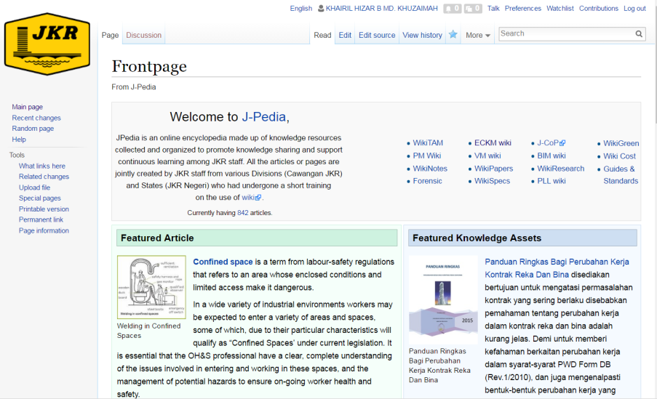
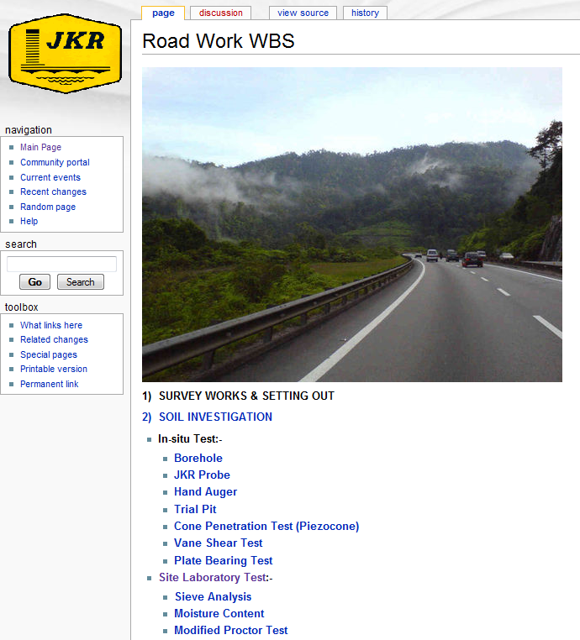
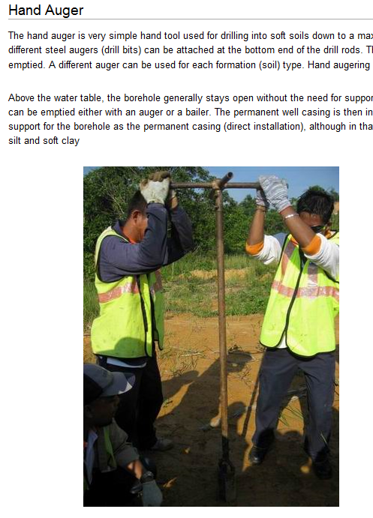
JKR KM Online Tools
JPedia
Online Knowledge Repository
Best Practices
PM Competency Framework
Project Lessons Learned
Technical References and Guides
Presentations
Conference Papers
Share Explicit Knowledge
Connect People to Content

Slide 30
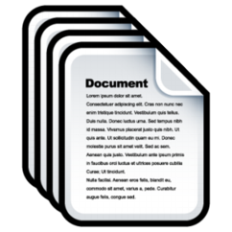
JPedia Statistics
PAGE STATISTICS
60
AVERAGE VISITS/DAY
2,672
9,433
PAGES
REGISTERED USERS
7,444
UPLOADED FILES

Slide 31
Implementation Challenges
JPedia
Why some still have not used JPedia
The majority of participants cites “Tiada arahan khusus daripada ketua saya”, “Tiada kaitan dengan tugas hakiki/KPI saya” and “Tiada masa” as three main reasons
Source: JPedia Survey 2017 (612 respondents out of 7,088 individuals with registered JKR email account (8.6%))

Slide 32
The KM Agenda
To cultivate knowledge sharing and learning culture across department
through the use of proven effective knowledge sharing tools
MAJOR KM INITIATIVES (since 2008)
1
JPedia, an online repository to share knowledge-in-context)
2
Communities of Practice to share domains of knowledge
3
JCoP, an online platform to ask and discuss
4
5
Project Lessons Learned System to share key project learnings
KM Toolbox, set of tools and techniques to capture and share insights and ideas
6
JKR Yellow Pages to locate experts within the department
7
E-Learning to provide 24 x 7 learning environment

Slide 33
JKR CoPs
Peer networks of practitioners within JKR who help each other to perform better by sharing knowledge and experience.
Through this collaborative environment, new knowledge is created and will help spark innovation

Slide 34
CoP Domains @ JKR
Stakeholder Management
Human Resource Management
Structure
BIM
Green
Contract Management
Project Management
Assets and Facilities Management
Technical and Contract Administration

Slide 35
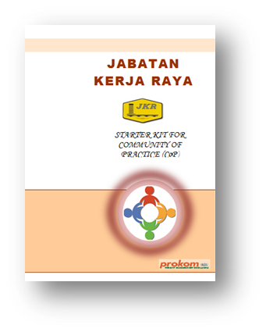
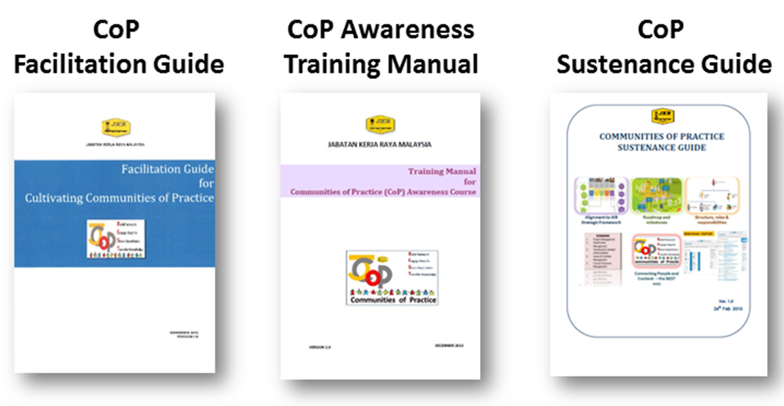
CoP Publications
CoP Starter Kit

Slide 36
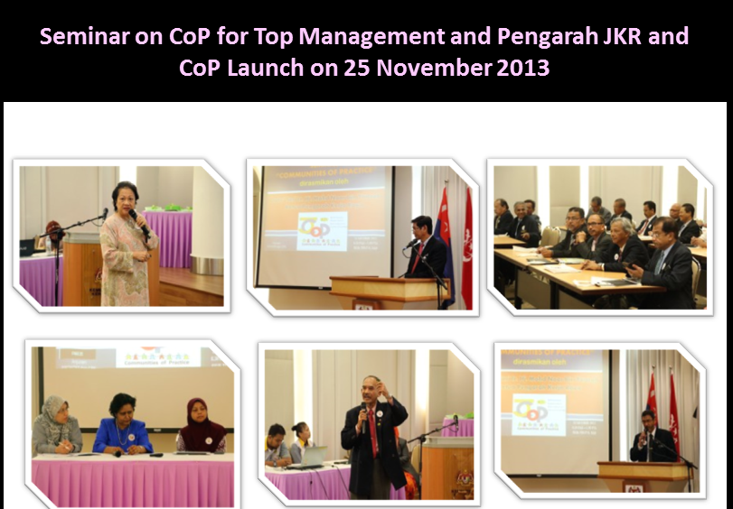

Slide 37
Connecting People – The BEST Way
JKR KM Online Tools
JCoP
Virual Communities of Practice
CoP Domains
Subject Matter Experts Profile
Ask and Discuss Online Platform
Share Tacit Knowledge
Connect People to People

Slide 38
Connecting People and Content – The BEST Way!
collaborative tool enables people to share data, information and knowledge in real time
facilitate exchange of ideas and solutions as well as track members’ participation

Slide 39
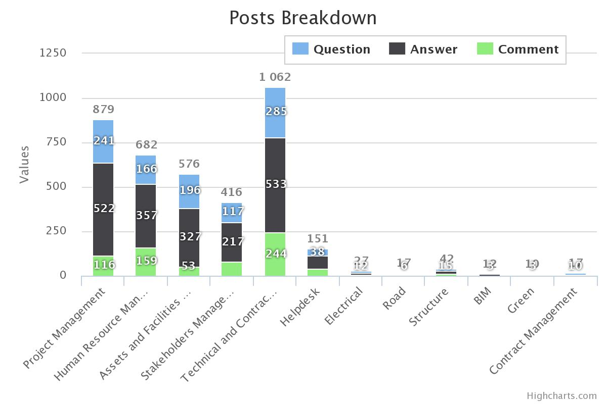
JCoP Statistics – Posts Breakdown
3,895 posts

Slide 40
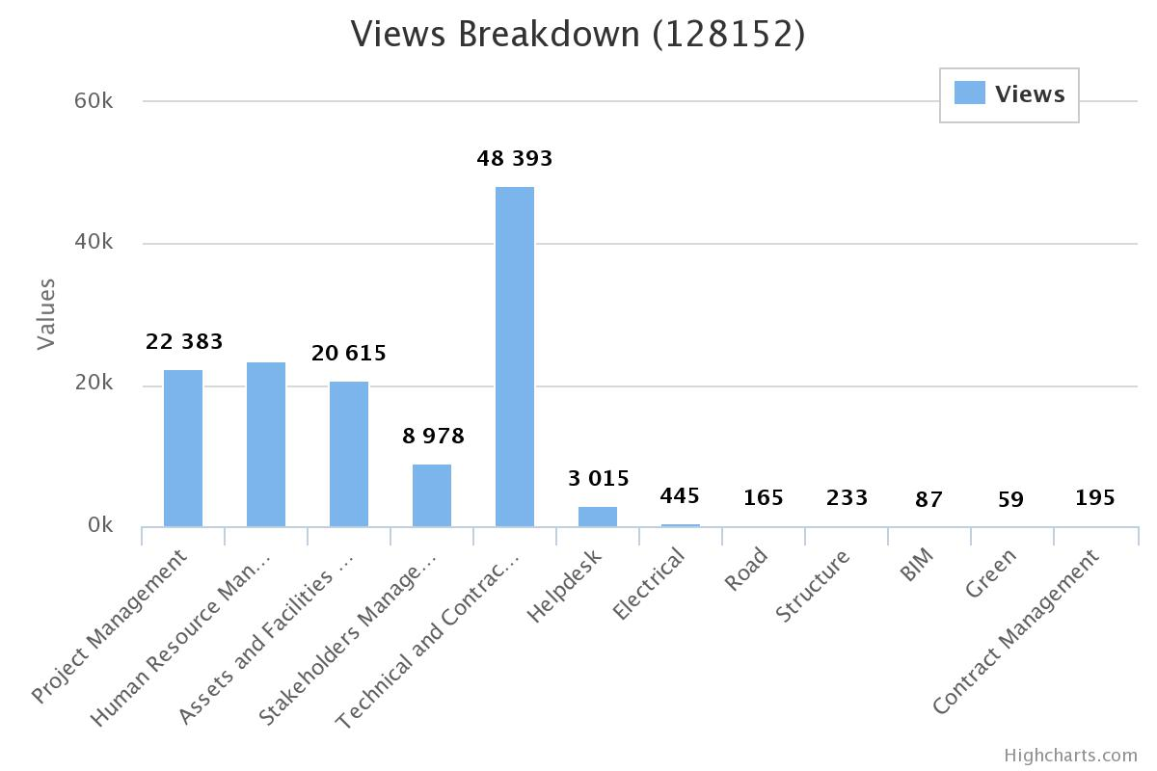
JCoP Statistics – Views Breakdown
128,152 views

Slide 41
JCoP Statistics – Quick Stats
1,093
QUESTIONS
2,211
2,085
ANSWERS
717
COMMENTS
REGISTERED USERS

Slide 42
Implementation Challenges
JCoP
What strongly limit users to participate in JCoP?
The majority of participants give being unable to allocate time as the main reason, and not being part of their job as the second reason
Source: JCoP Survey 2014 (153 respondents out of 586 individuals with registered with JCoP Portal (26.1%))

Slide 43
JCoP Statistics – Posts Breakdown
3,895 posts

Slide 44
JCoP Statistics – Views Breakdown
128,152 views

Slide 45
JCoP Statistics – Quick Stats
1,093
QUESTIONS
2,211
2,085
ANSWERS
717
COMMENTS
REGISTERED USERS

Slide 46
Implementation Challenges
JCoP
What strongly limit users to participate in JCoP?
The majority of participants give being unable to allocate time as the main reason, and not being part of their job as the second reason
Source: JCoP Survey 2014 (153 respondents out of 586 individuals with registered with JCoP Portal (26.1%))

Slide 47
The KM Agenda
To cultivate knowledge sharing and learning culture across department
through the use of proven effective knowledge sharing tools
MAJOR KM INITIATIVES (since 2008)
1
JPedia, an online repository to share knowledge-in-context)
2
Communities of Practice to share domains of knowledge
3
JCoP, an online platform to ask and discuss
4
5
Project Lessons Learned System to share key project learnings
KM Toolbox, set of tools and techniques to capture and share insights and ideas
6
JKR Yellow Pages to locate experts within the department
7
E-Learning to provide 24 x 7 learning environment

Slide 48
Project Lessons Learned

Slide 49
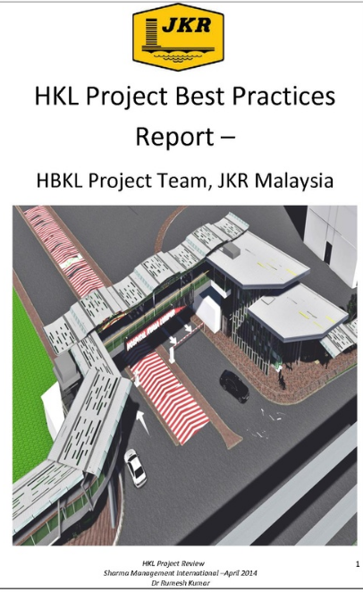
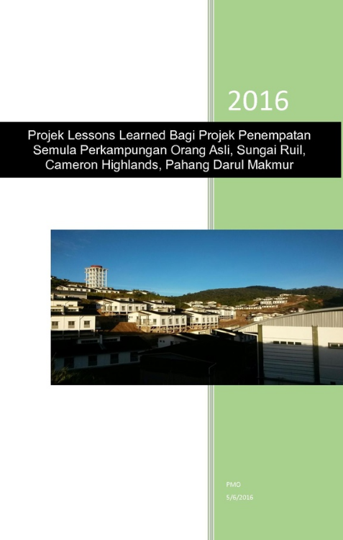
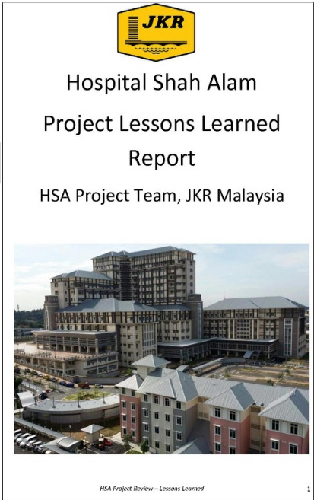
Project Lessons Learned Reports

Slide 50
PROSES PLL
Kenalpasti (at any point during the asset life cycle)
Dokumen dan kumpul
Tentusah dan analisis
Sebar/kongsi
Dapatkan maklumbalas
Kenalpasti tindakan
Buat Susulan
Terapkan dalam amalan kerja dan prosedur
Kemaskini dokumen berkaitan
Arkib bersama-sama data sokongan dan dokumentasi lain yang relevan
Simpan dalam repositori pusat

Slide 51
TANGGUNGJAWAB PIHAK YANG TERLIBAT
Pasukan Projek
Kenalpasti dan capture PLL
Pejabat PO (CPAB Cawangan dan Negeri)
Koordinasi penyediaan PLL
Mudahcara bengkel PLL
Pejabat Portfolio (CPAB)
Semak dengan SME bagi menentusah PLL
Analisis trend/pattern PLL
Angkat naik isu kritikal ke mesyuarat JPP untuk keputusan
SME
Semak (verify) PLL
Kenalpasti penambahbaikan proses/prosedur sediaada
Rujuk kepada pemilik proses
Pengguna
Beri maklumbalas
Aju pertanyaan
Pemilik Proses
Putuskan samada dokumen/ proses/ prosedur sediaada perlu dipinda/tambahbaik

Slide 52
The KM Agenda
To cultivate knowledge sharing and learning culture across department
through the use of proven effective knowledge sharing tools
MAJOR KM INITIATIVES (since 2008)
1
JPedia, an online repository to share knowledge-in-context)
2
Communities of Practice to share domains of knowledge
3
JCoP, an online platform to ask and discuss
4
5
Project Lessons Learned System to share key project learnings
KM Toolbox, set of tools and techniques to capture and share insights and ideas
6
JKR Yellow Pages to locate experts within the department
7
E-Learning to provide 24 x 7 learning environment

Slide 53
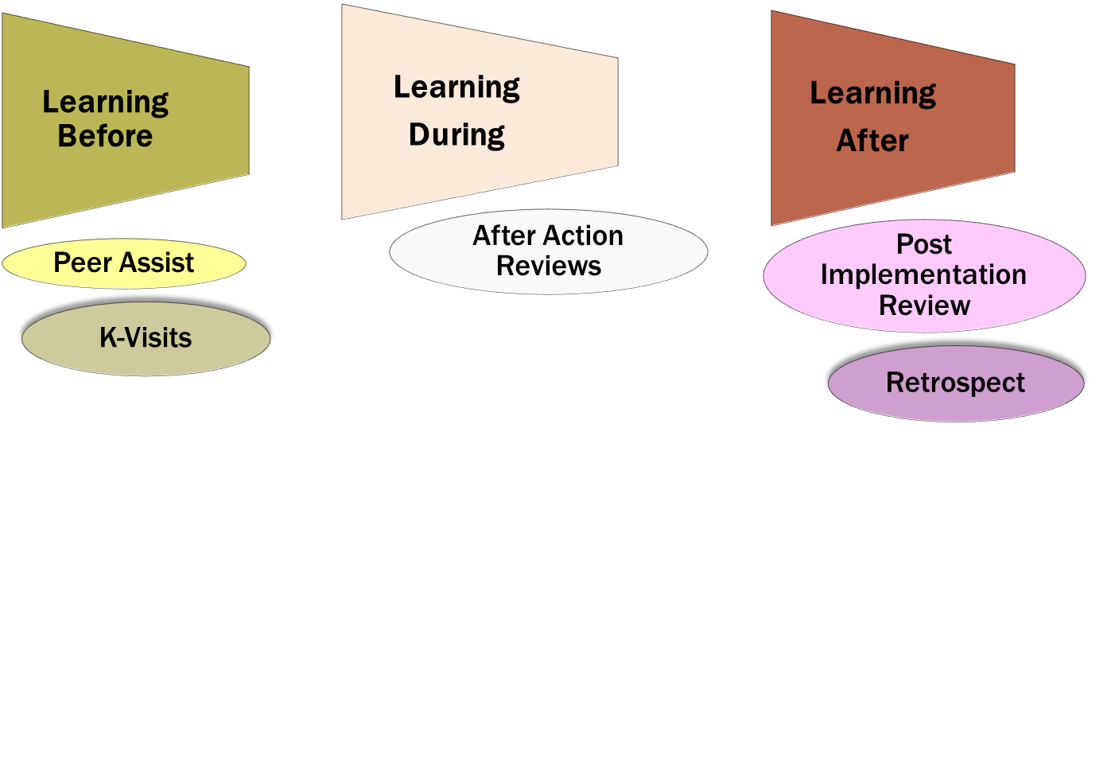
Tools to capture/harvest Knowledge

Slide 54
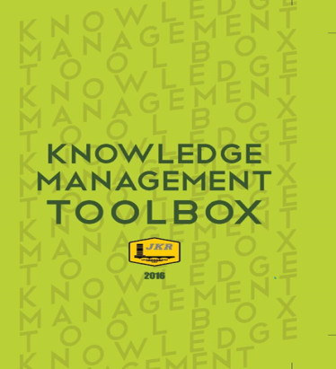
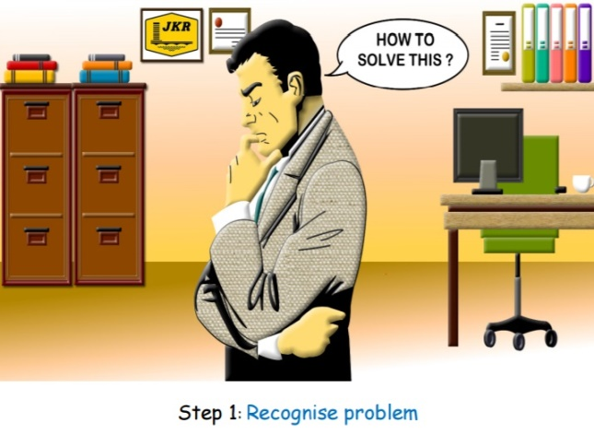
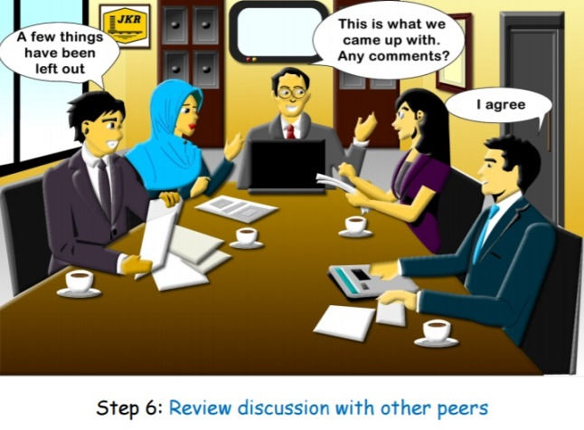
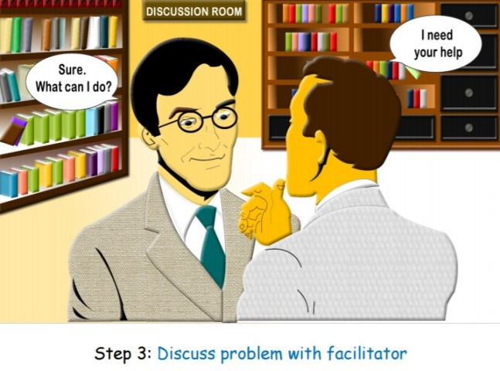
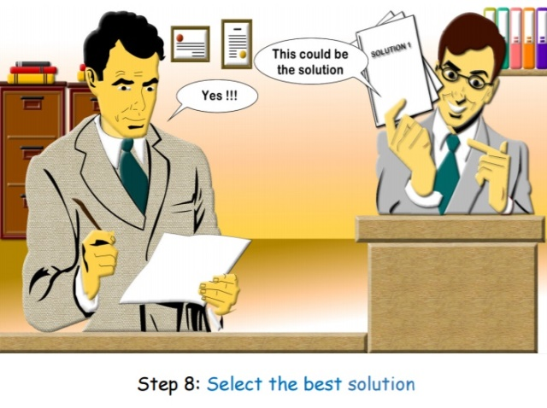

Slide 55
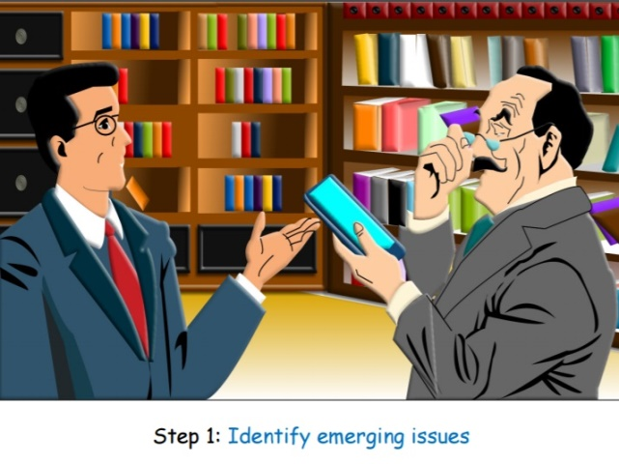
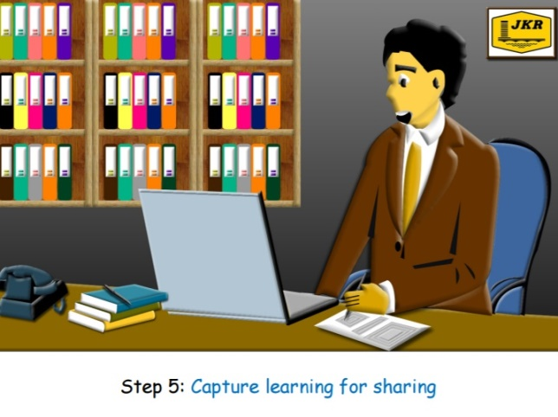
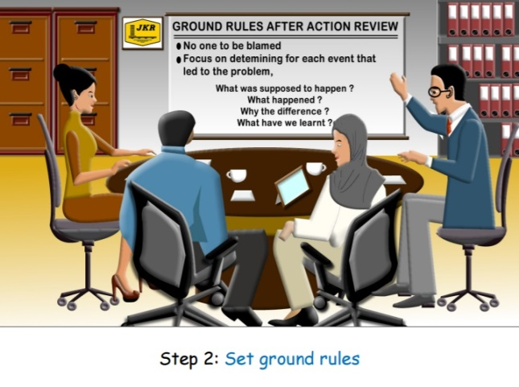
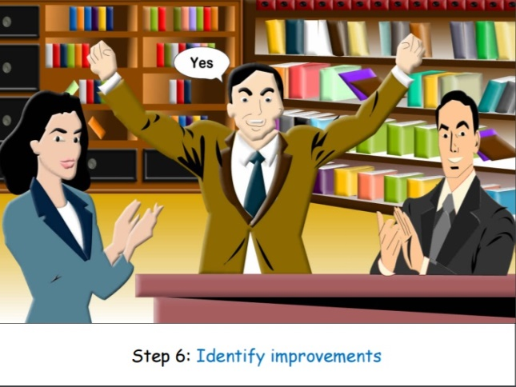

Slide 56
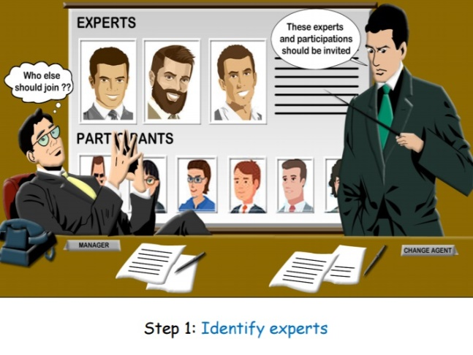
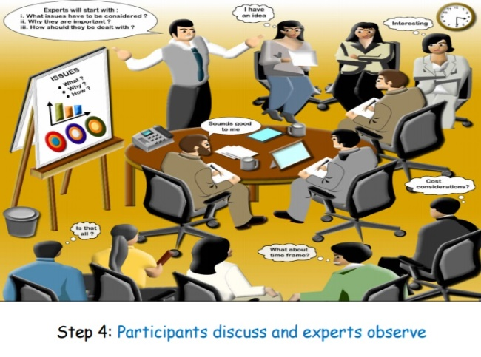
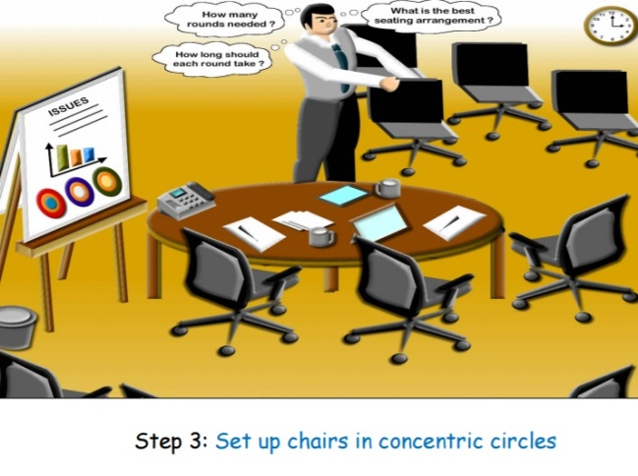

Slide 57
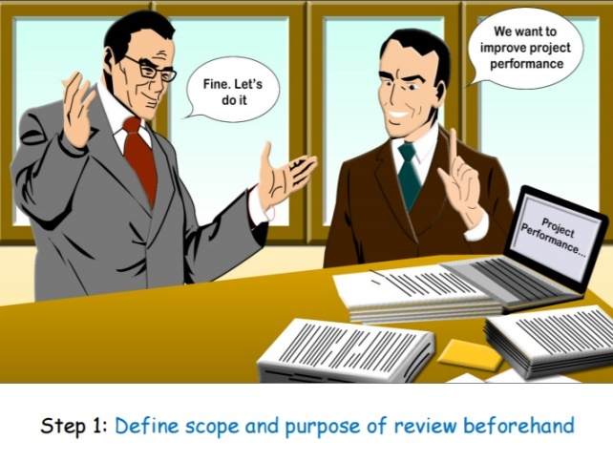
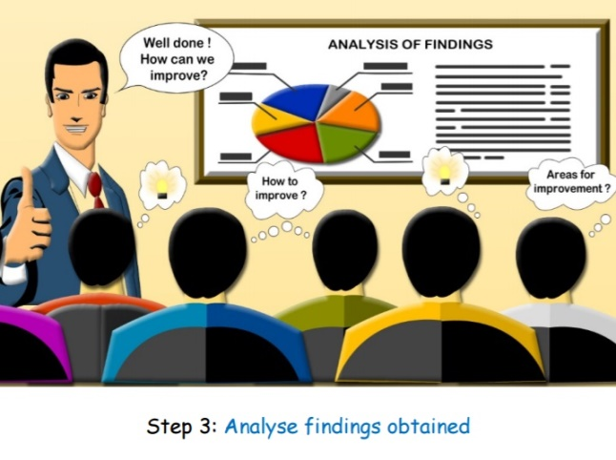
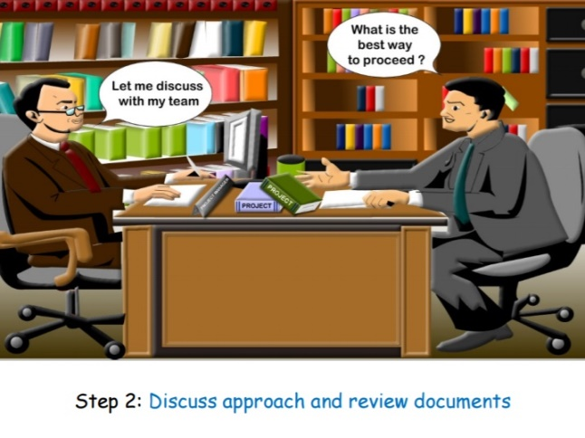

Slide 58
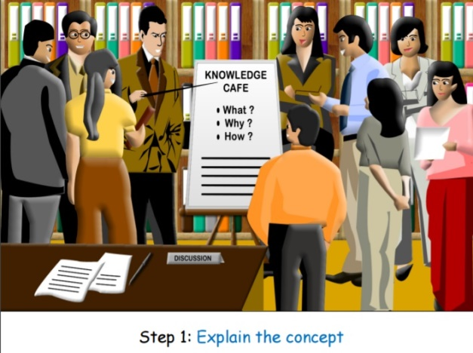
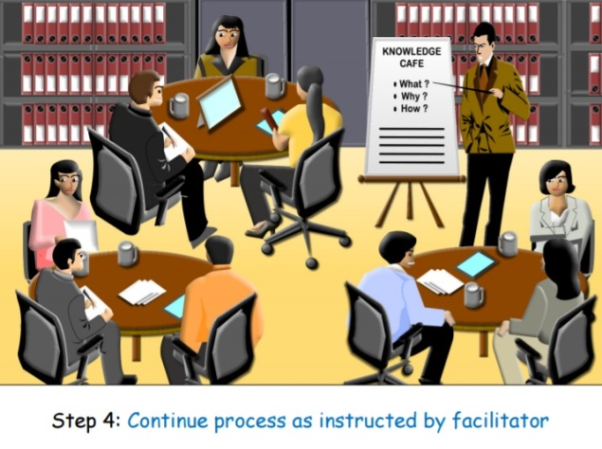
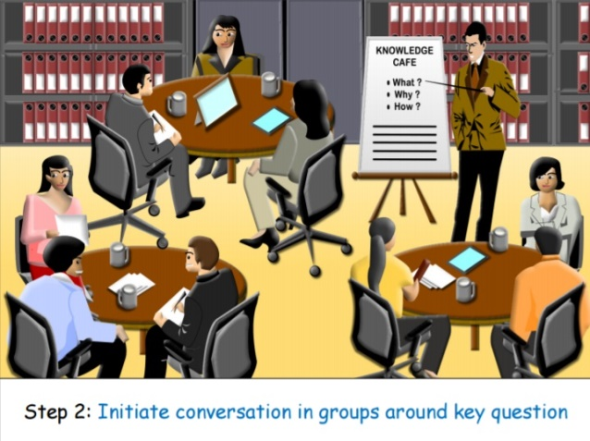

Slide 59
The KM Agenda
To cultivate knowledge sharing and learning culture across department
through the use of proven effective knowledge sharing tools
MAJOR KM INITIATIVES (since 2008)
1
JPedia, an online repository to share knowledge-in-context)
2
Communities of Practice to share domains of knowledge
3
JCoP, an online platform to ask and discuss
4
5
Project Lessons Learned System to share key project learnings
KM Toolbox, set of tools and techniques to capture and share insights and ideas
6
JKR Yellow Pages to locate experts within the department
7
E-Learning to provide 24 x 7 learning environment

Slide 60
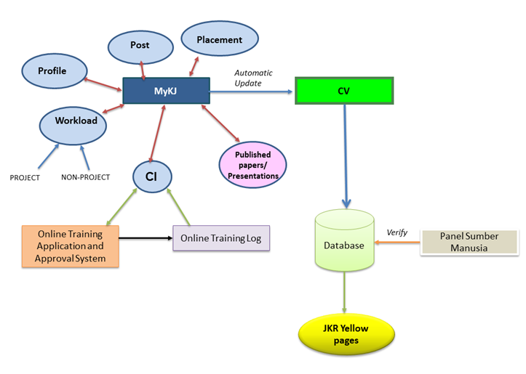
Systems under development
JKR Yellow Pages: Expert Directory

Slide 61
The KM Agenda
To cultivate knowledge sharing and learning culture across department
through the use of proven effective knowledge sharing tools
MAJOR KM INITIATIVES (since 2008)
1
JPedia, an online repository to share knowledge-in-context)
2
Communities of Practice to share domains of knowledge
3
JCoP, an online platform to ask and discuss
4
5
Project Lessons Learned System to share key project learnings
KM Toolbox, set of tools and techniques to capture and share insights and ideas
6
JKR Yellow Pages to locate experts within the department
7
E-Learning to provide 24 x 7 learning environment

Slide 62
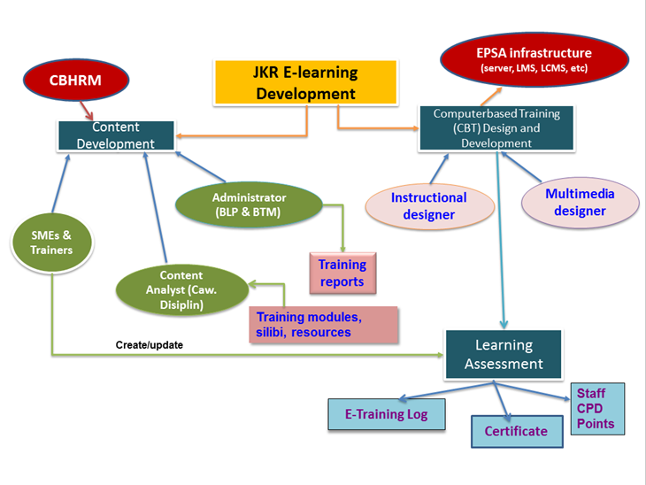
Systems under development
E-Learning

Slide 63
Systems under development

Slide 64
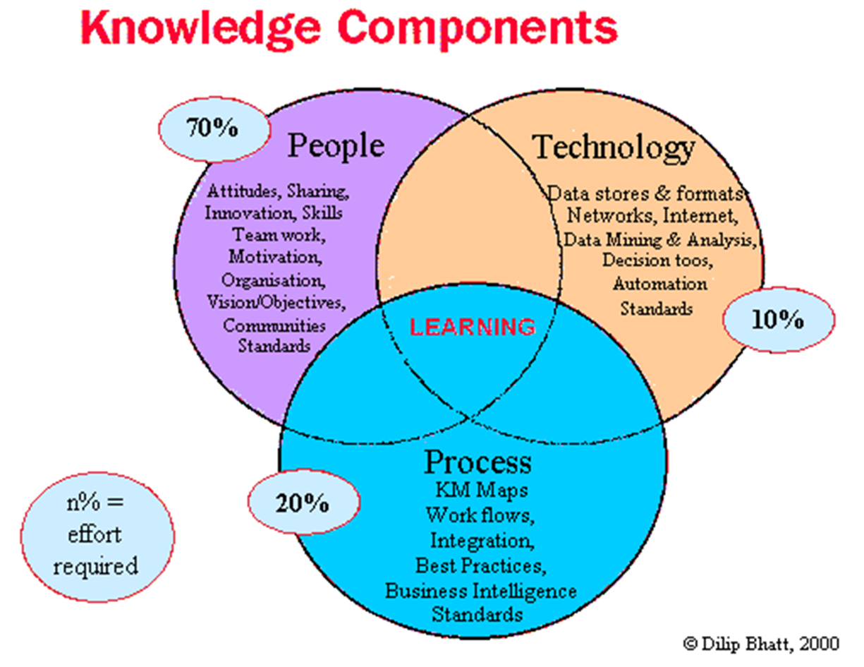

Slide 65
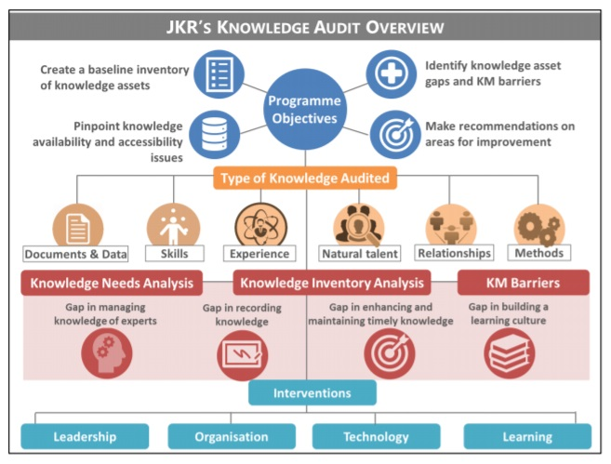
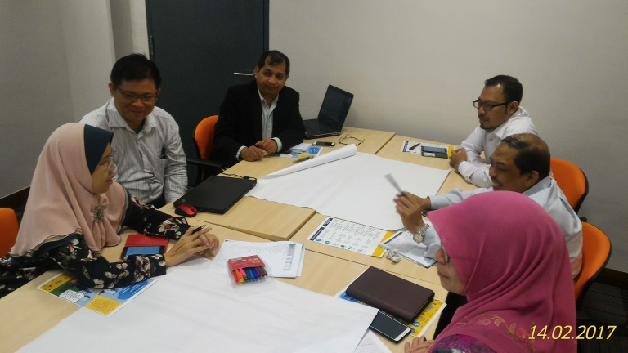
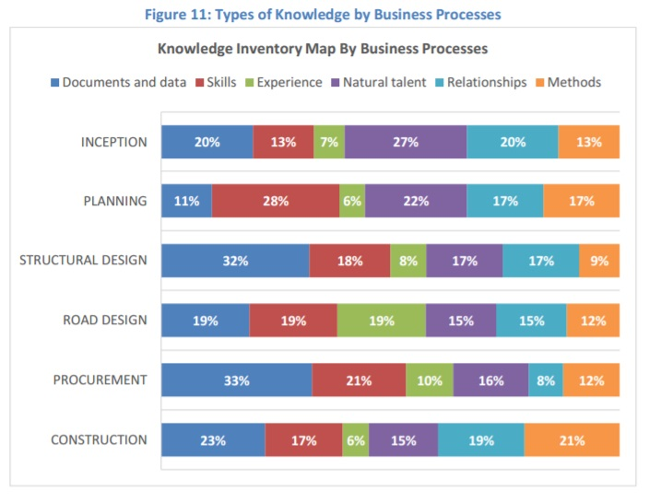
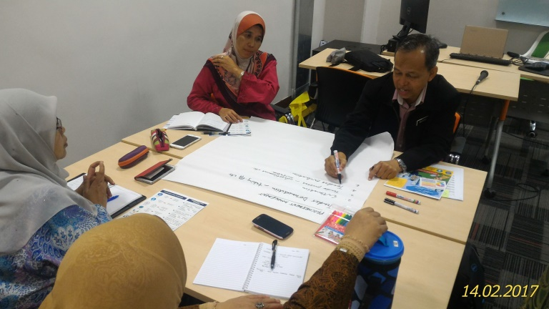
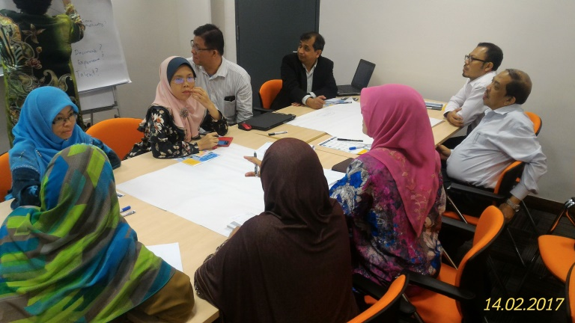
KM Events & Activities
KM Audit Workshop 13 – 14 Feb 2017

Slide 66
KM Events & Activities
Bengkel & Mesyuarat Project Lessons Learned

Slide 67
KM Events & Activities
Mesyuarat JKPPPI

Slide 68
KM Events & Activities
Program K-Visit

Slide 69
KM Events & Activities
Program Persada Minda JKR

Slide 70
Thank you for your attention
Mobile- 019 603 6464
roznita@jkr.gov.my

