Slide 1


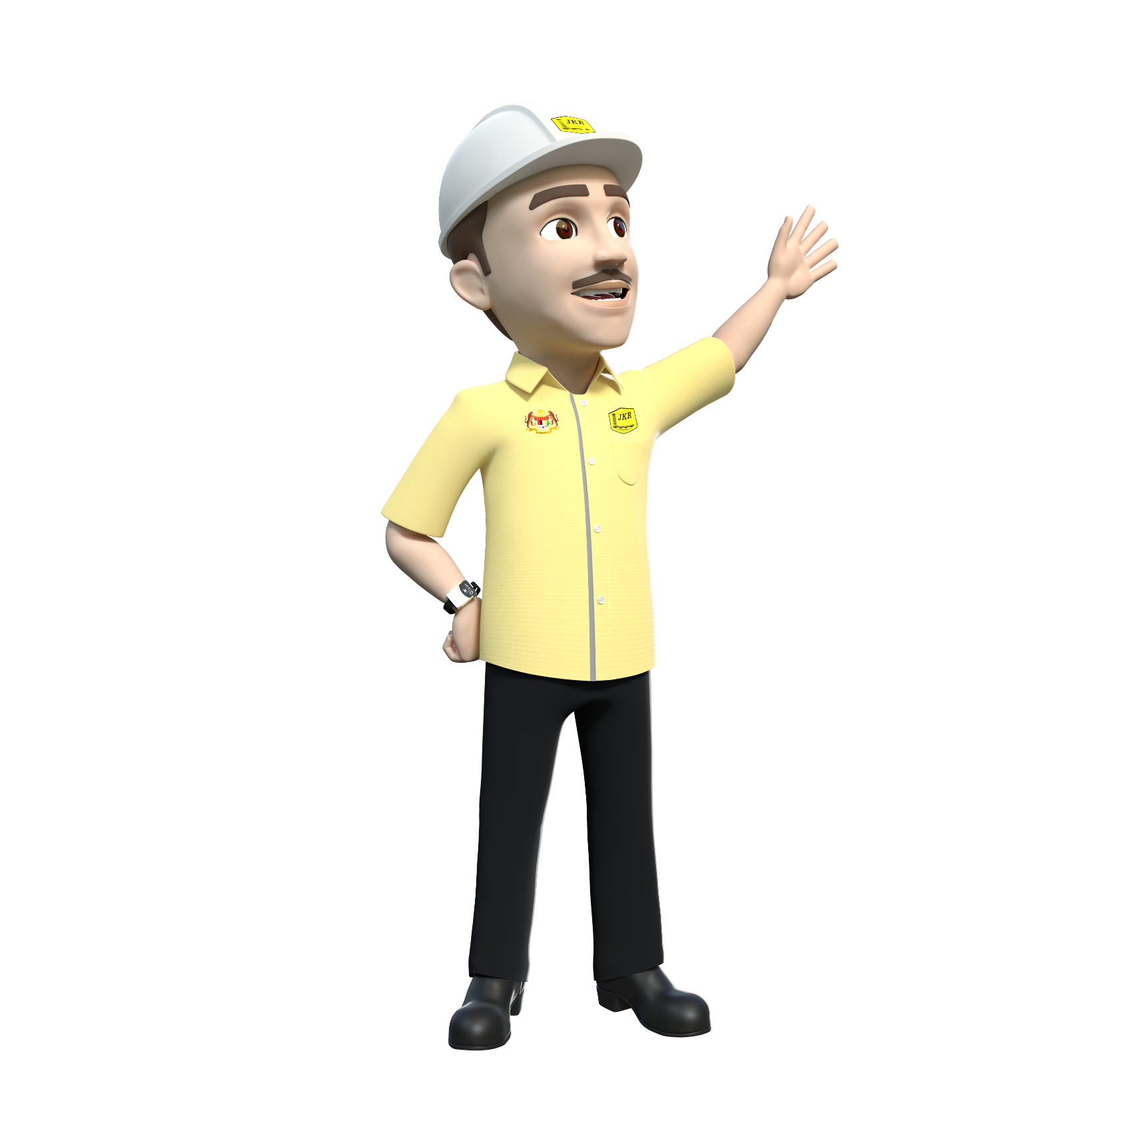
UNIT ECKM
BAHAGIAN PENGURUSAN PROJEK KOMPLEKS
CAWANGAN PERANCANGAN ASET BERSEPADU
BENGKEL
PROJECT LESSONS LEARNED
CAWANGAN KERJA PENDIDIKAN
JABATAN KERJA RAYA
15 & 17 SEPTEMBER 2021
(Rabu-Jumaat)

Slide 2
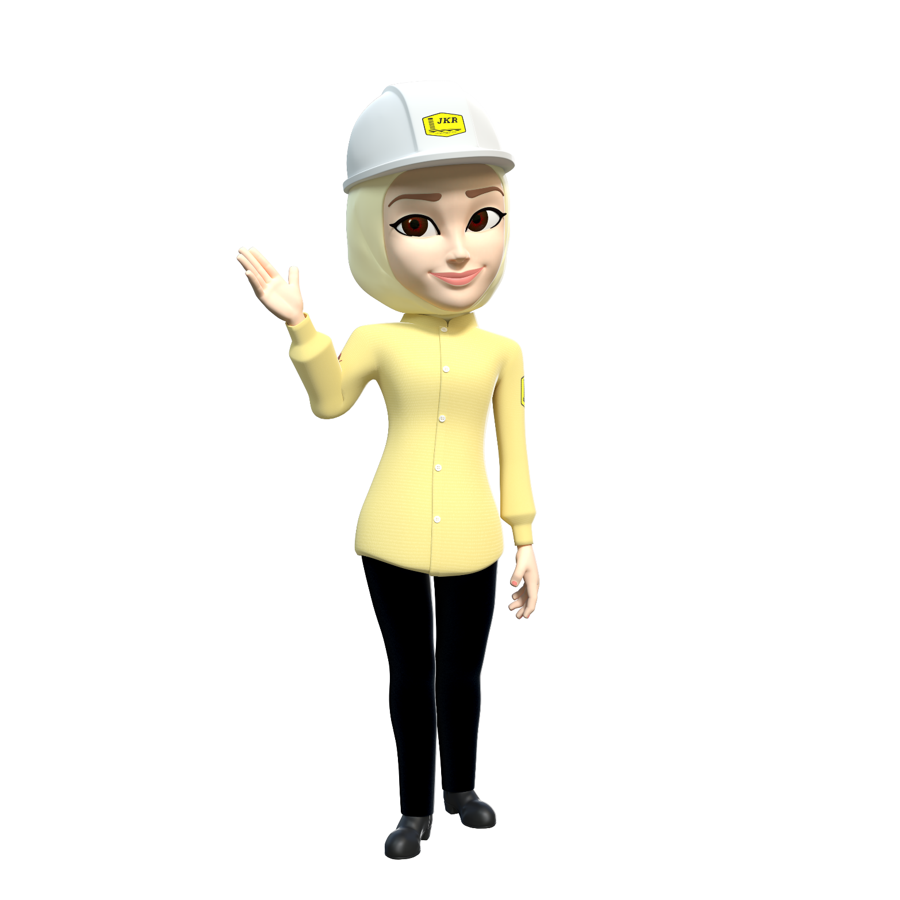
CONTENT
WHAT IS PROJECT LESSONS LEARNED (PLL)?
WHY PLL ARE INEFFECTIVE?
PLL PROCESS
ROLES AND RESPONSIBILITIES
HOW TO EFFECTIVELY CAPTURE PLL
02
#bengkelprojectlessonslearned

Slide 3

WHAT IS PLL?
Project Lessons Learned (PLL) :
ACTIVITY
is the learning gained
from the process of performing
a task or an activity
activity
review
follow best
practice
Learned the
good practices
Avoid the
repeats of
bad practices
NEW
LESSONS
BEST PRACTICES
To promote
the recurrence
of desirable
outcomes
To prelude
the recurrence
of undesirable
outcomes
process
improvement
NEW KNOWLEDGE AND NEW LEARNING
are identified through activity & review, and incorporated into future work practices
03
#bengkelprojectlessonslearned

Slide 4
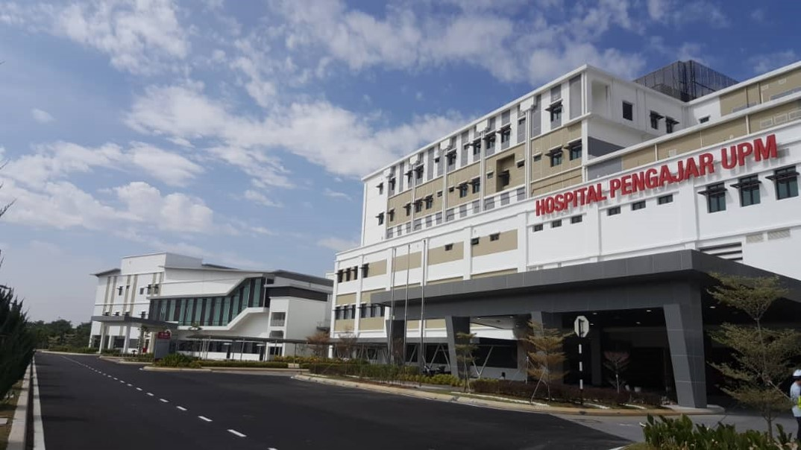
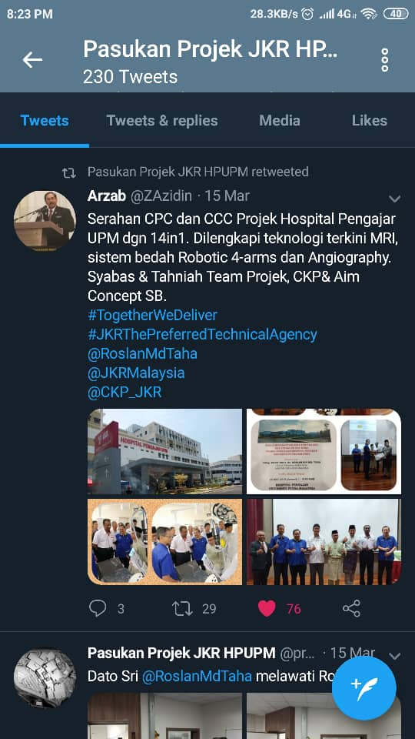
BEST PRACTICE
PROJEK PEMBINAAN HOSPITAL PENGAJAR UNIVERSITI PUTRA MALAYSIA (HPUPM)
Penyiapan Projek 14 dalam 1
2
Lukisan Siap
Bina (As-Built
Drawing)
7
Skor IBS
80.5 > 70
(column, beam
half slab,
AAC bricks)
3
Penyata Akaun
Muktamad
(SOFA)
1
Sijil Perakuan
Siap Kerja
(CPC)
9
Pengiktirafan
QLASSIC
Oleh CIDB
14
Coffee Table Book
Aspire – The
Determination
To Succeed
6
Fire Certificate
Diterima
Sebelum CPC
4
Projek Siap
2 Minggu
Awal
10
Pengiktirafan
4 Bintang pHJKR
Oleh
CASKT JKR
8
Pengiktirafan
4 Bintang
SHASSIC
Oleh CIDB
5
Asset Tagging
Bagi 90,250
Bil. Aset
13
Penjimatan Kos
Kontrak
(pelanggan dapat
membuat pembelian
tambahan peralatan
perubatan)
11
Zero Major
Defects
12
Lost Time
Injuries (LTI):
Tiada
Kemalangan
Besar Dilaporkan
04
#bengkelprojectlessonslearned

Slide 5
ISU BERULANG DALAM
LAPORAN KETUA AUDIT NEGARA
Projek
Lewat Disiapkan
Kelewatan Tandatangani Dokumen Kontrak
01
07
Kualiti Tidak Menepati Spesifikasi
Kelemahan Penyenggaraan Bangunan Pejabat di Putrajaya
02
Tidak Mematuhi Penyediaan Perkhidmatan Kenderaan & Peralatan Melalui Kontrak
08
Pelantikan Semula Kontraktor Yang Telah Ditamatkan
03
09
Ketidak-seragaman Penentuan Bon, WJP, Insurans
Kelemahan Pengurusan Wang Pendahuluan
04
10
Lukisan Siap Bina Berbeza Dari Sebenar, Lewat Dihantar
05
EOT Diluluskan Di Luar Tempoh Yang Dibenarkan
06
05
#bengkelprojectlessonslearned

Slide 6

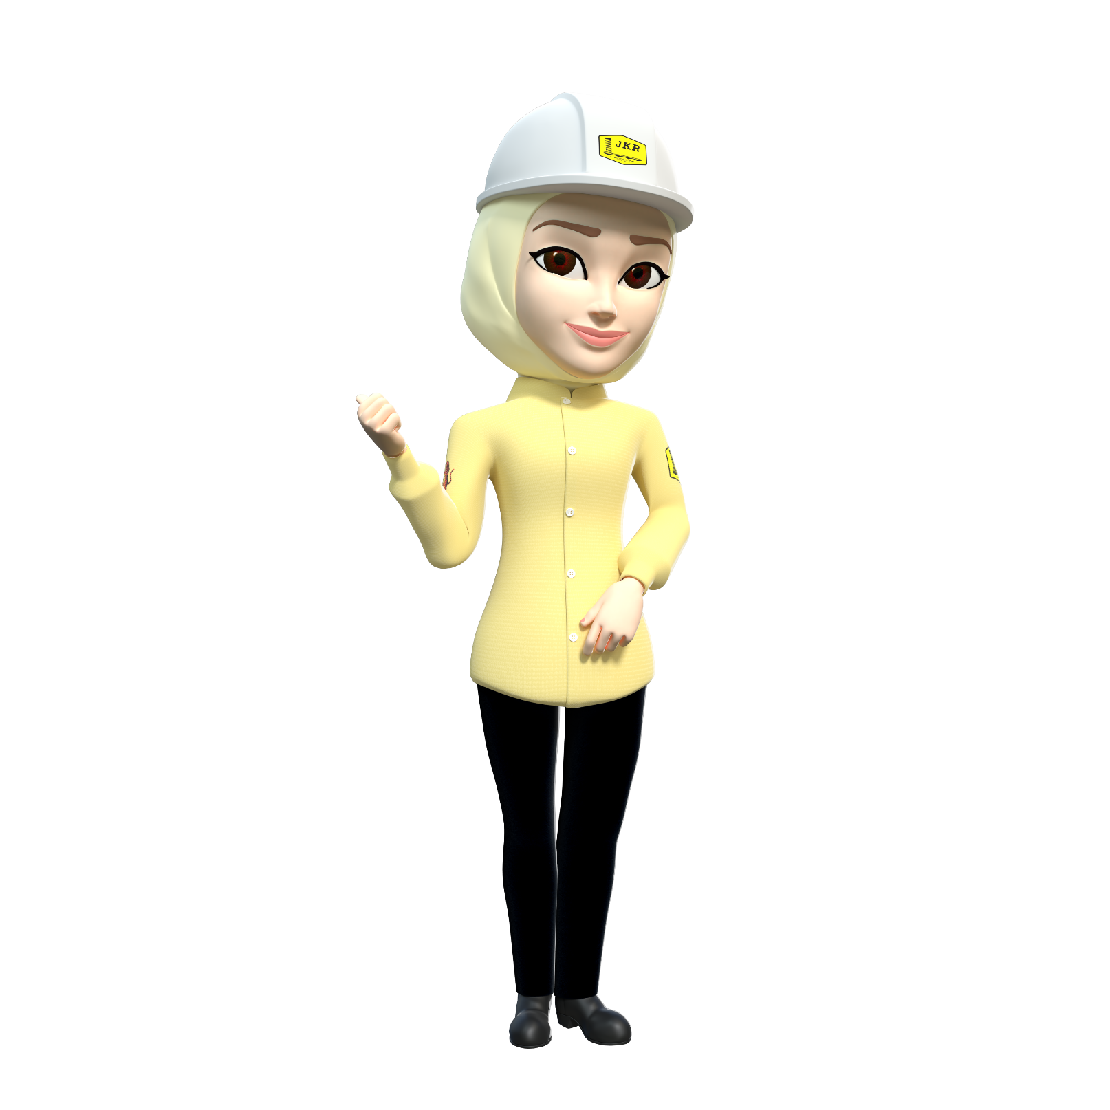
BUKU MERAH UPE, JPM
06
#bengkelprojectlessonslearned

Slide 7
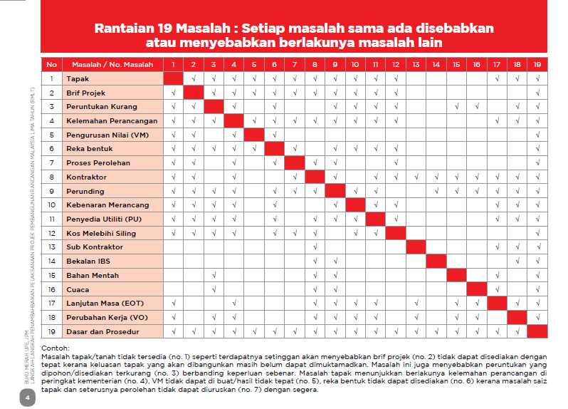
BUKU MERAH UPE, JPM
07
#bengkelprojectlessonslearned

Slide 8
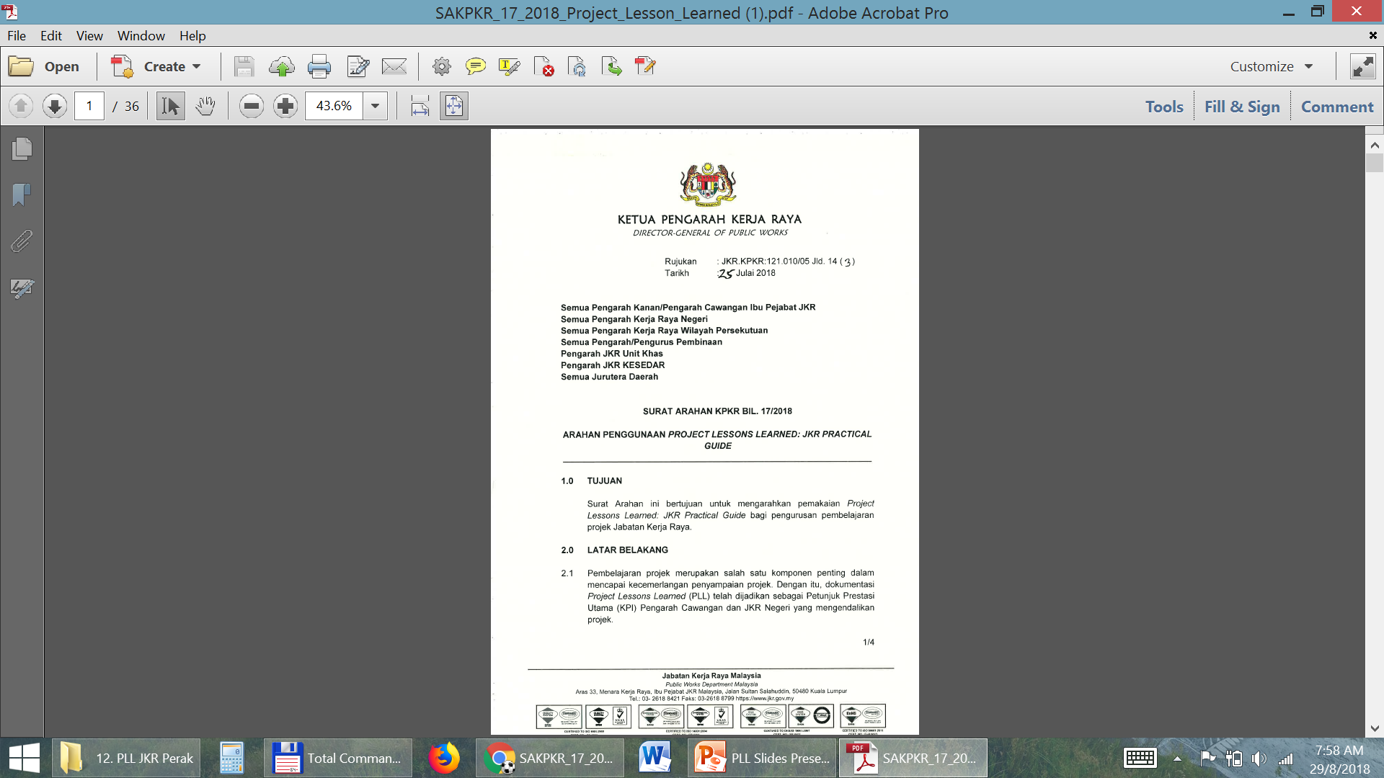
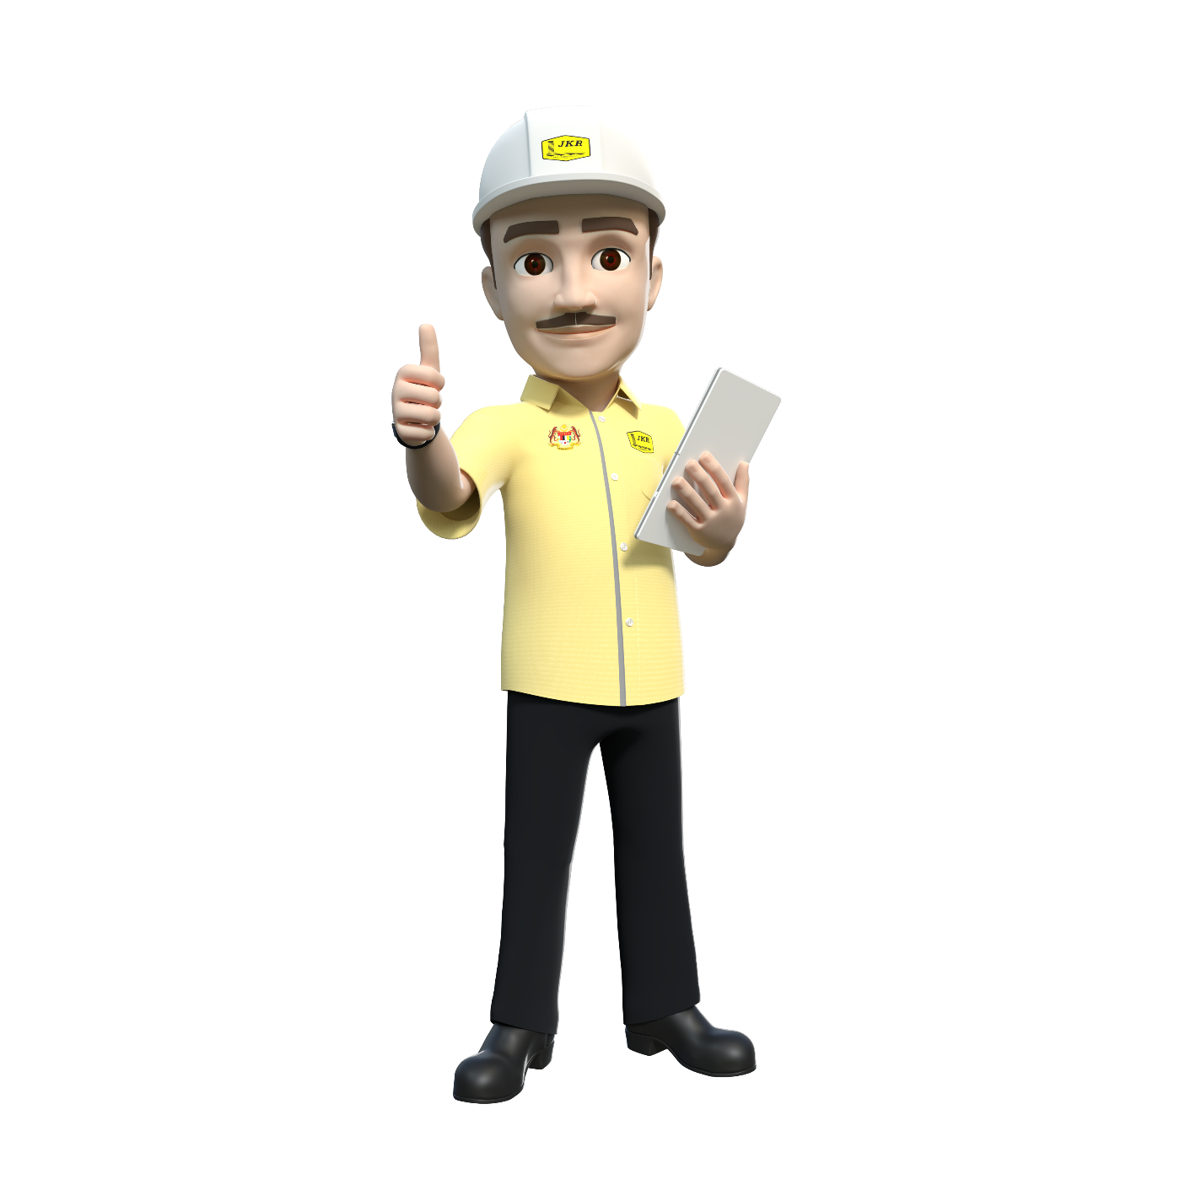
SA KPKR BIL.17/2018
PENGGUNAAN PLL : JKR GUIDE
12
#bengkelprojectlessonslearned

Slide 9
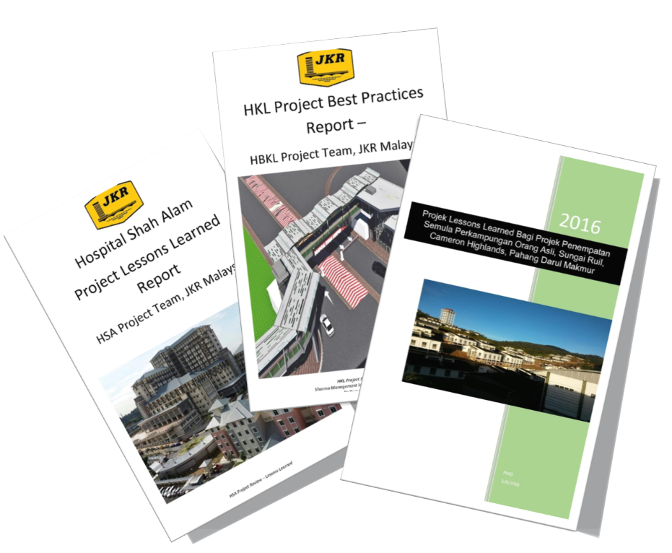


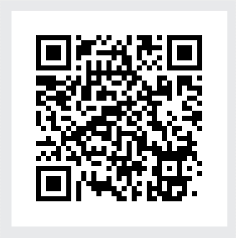
PLL REPORTS
2018 - 2019
PROJECT
LESSONS LEARNED REPORTS
Portal JPedia
Domain PLL Wiki
08
#bengkelprojectlessonslearned

Slide 10
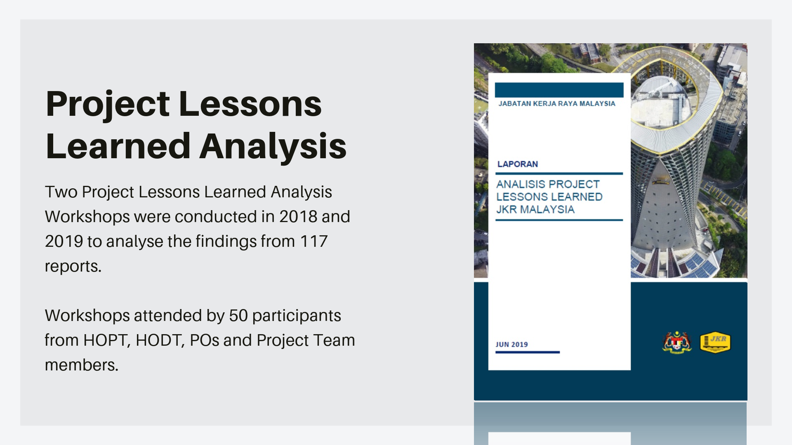
ISSUES & ELEMENTS
Project Lessons Learned
PLL ANALYSIS
2019
Two PLL Analysis Workshops were conducted in 2018 and 2019 to analyse the findings from 117 reports.
2018
Both workshops attended by 50 participants from HOPT, HODT, PO’s and Project Team members.
09
#bengkelprojectlessonslearned

Slide 11
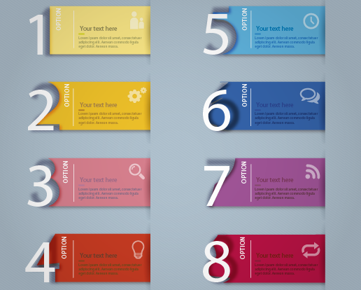
WHAT WHEN WELL
IN PROJECT IMPLEMENTATION
Sistem
Komunikasi
Berkesan
Penggunaan
PM Tools
Jadual
Perancangan Lengkap/
Komprehensif
Sistem Pengurusan
Rekod
Sistematik
Komitmen Tinggi
Pihak
Berkepentingan
Ahli Pasukan
Kompeten & Berpengalaman
Mesyuarat Tapak/
Penyelarasan
Berkala
Bayaran Interim
Berkala
10
#bengkelprojectlessonslearned

Slide 12
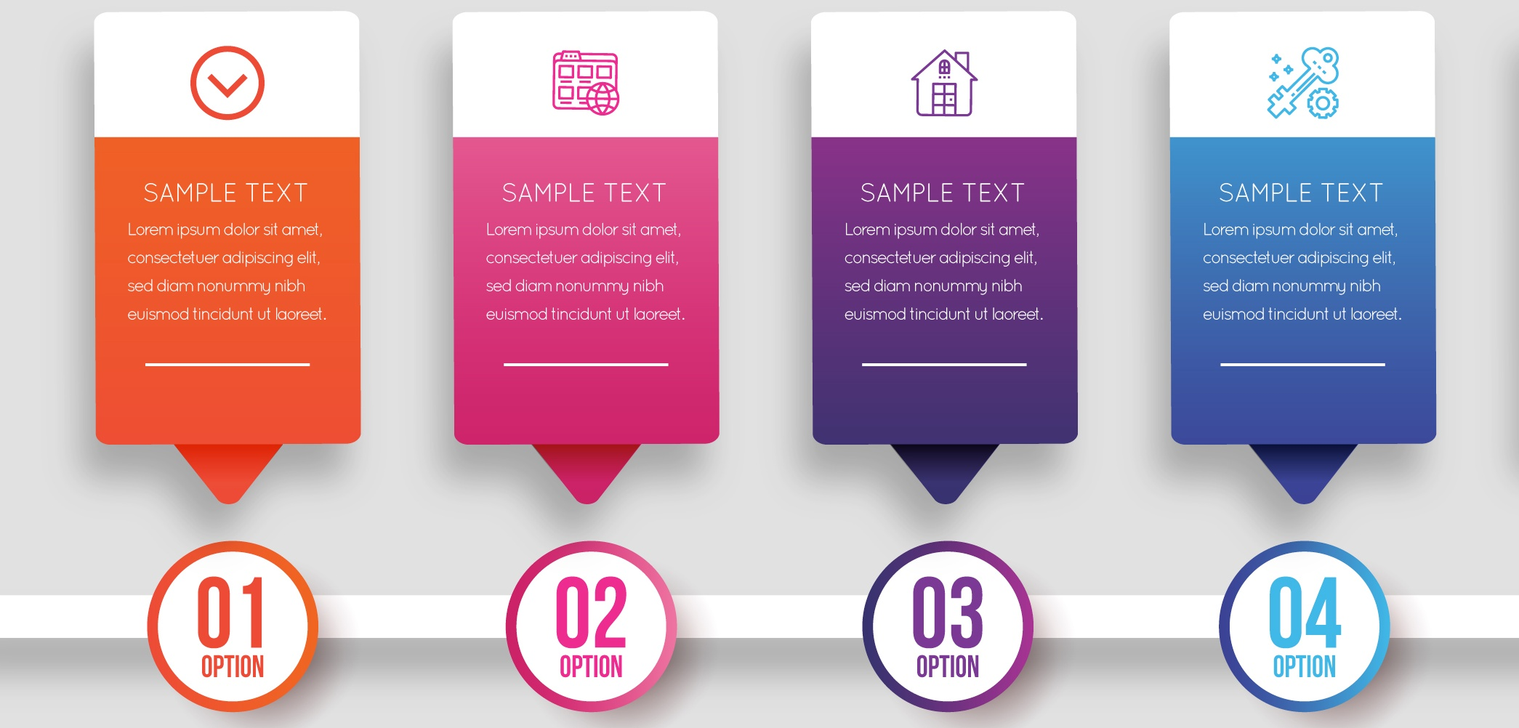
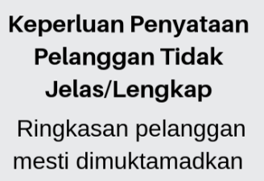
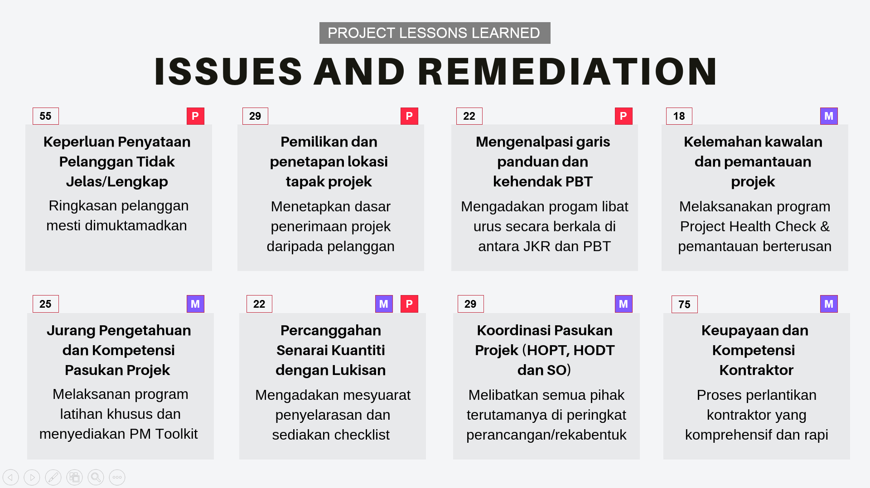
ISSUES AND REMEDIATION
IN PROJECT IMPLEMENTATION
P
P
P
M
55
29
22
18
M
M
P
M
M
25
22
29
75
11

Slide 13











PLL ACTIVITIES
Document &
Compile
Store in central
repisotary
Identify (at any
point the asset
life cycle)
Capture
Reuse
Apply
Verify & validate
Project Learning
Disseminate/
distribute
Solicit Feedback
Archive with
supporting data &
releven documents
Update related
documents
Incorporate in
work process
Identify Action
13
#bengkelprojectlessonslearned

Slide 14

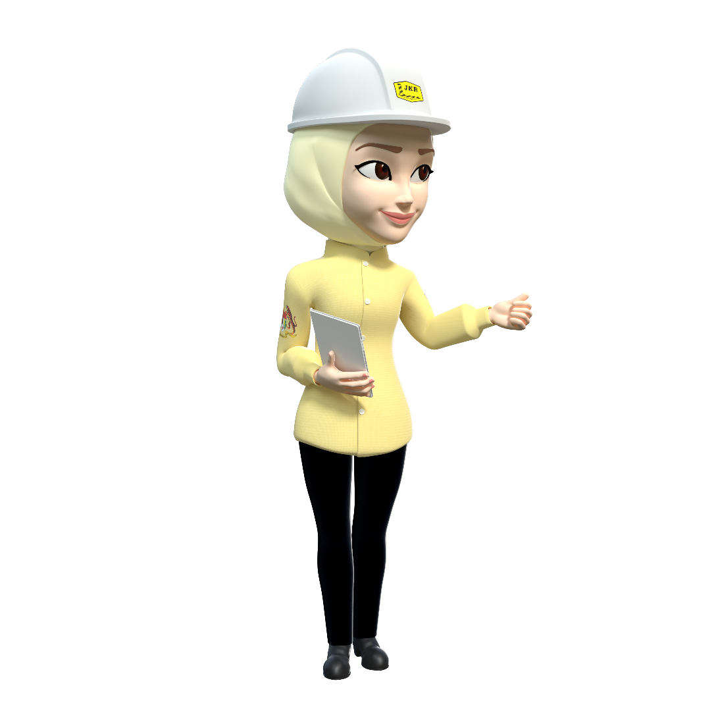

GROUP DISCUSSION
REFER TEMPLATES GIVEN :
Discuss in group this 3 items below
APA BOLEH
DILAKUKAN
DENGAN LEBIH
BAIK?
What Could Have
Been Done
Better?
APA
BERLAKU
DENGAN BAIK?
What Went
Well?
PEMBELAJARAN UTAMA
(Key Learnings)
14
#bengkelprojectlessonslearned

Slide 15
PLL FORMAT REPORT
Summarize the methodology, key issues & key lessons learned.
Exsecutive
Summary
If documented properly, lessons learned provide a powerful method of sharing ideas for improving work processes, operation, quality, safety and cost effectiveness, etc. and helps improve management decision making and worker performance through every phase of a project.
Provide an overview or description of the project.
Project
Background
Step used for capturing, analyzing, validating and communicating PLL.
Methodology
Summarize all the key issues found from data collections through questionnaire, interview, etc.
Key
Issues
List all key lessons learned captured.
Key Lessons
Learned
Summarize the challenges the team identified for the project.
Primary
Challenges
Conclude and provide the top recommendations Lessons Learned of the project.
Conclusion &
Recommendations
15
#bengkelprojectlessonslearned

Slide 16
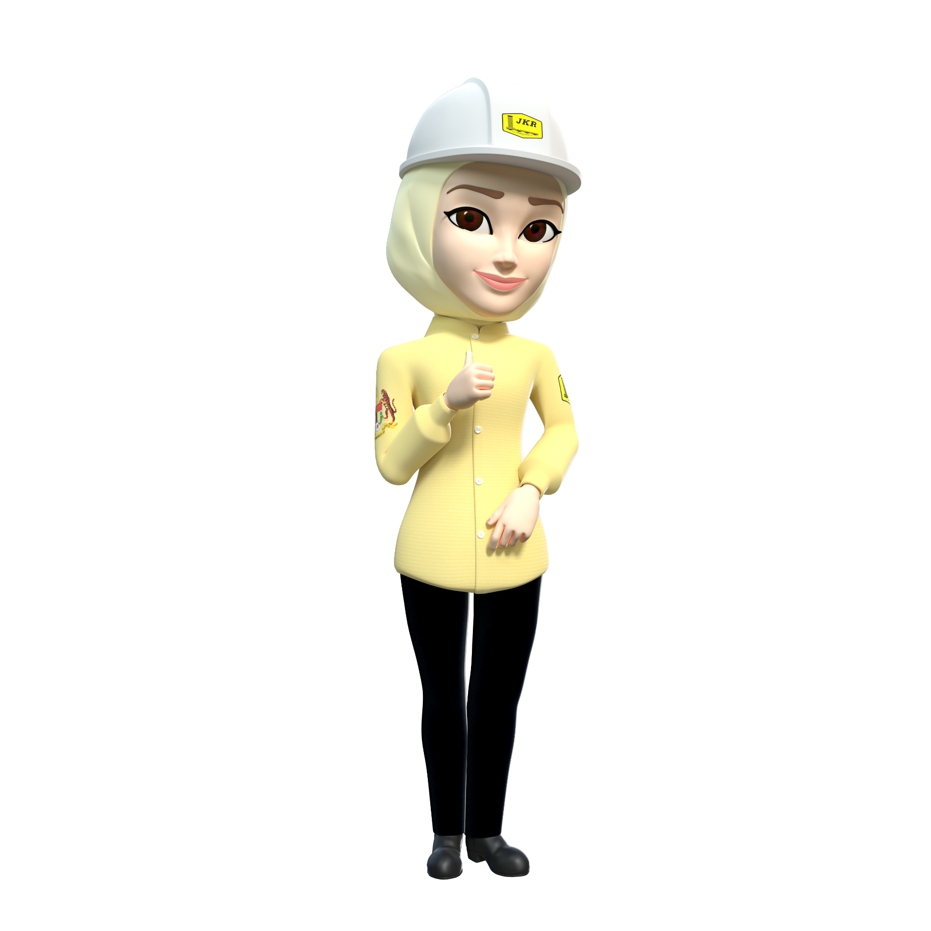
UNIT ECKM
BAHAGIAN PENGURUSAN PROJEK KOMPLEKS
CAWANGAN PERANCANGAN ASET BERSEPADU
BENGKEL
PROJECT LESSONS LEARNED
SEKIAN TERIMA KASIH

