Slide 1
Laporan Status CoP & JCoP (sehingga 5 September2017)

Slide 2
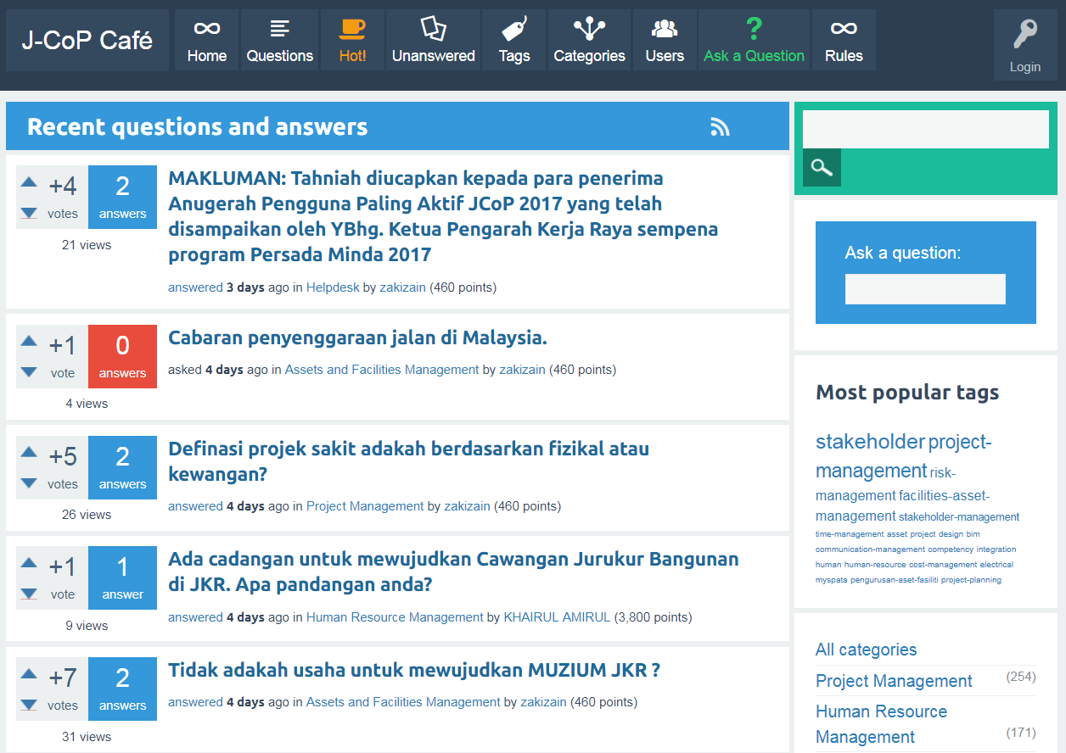
Statistik JCoP

Slide 3
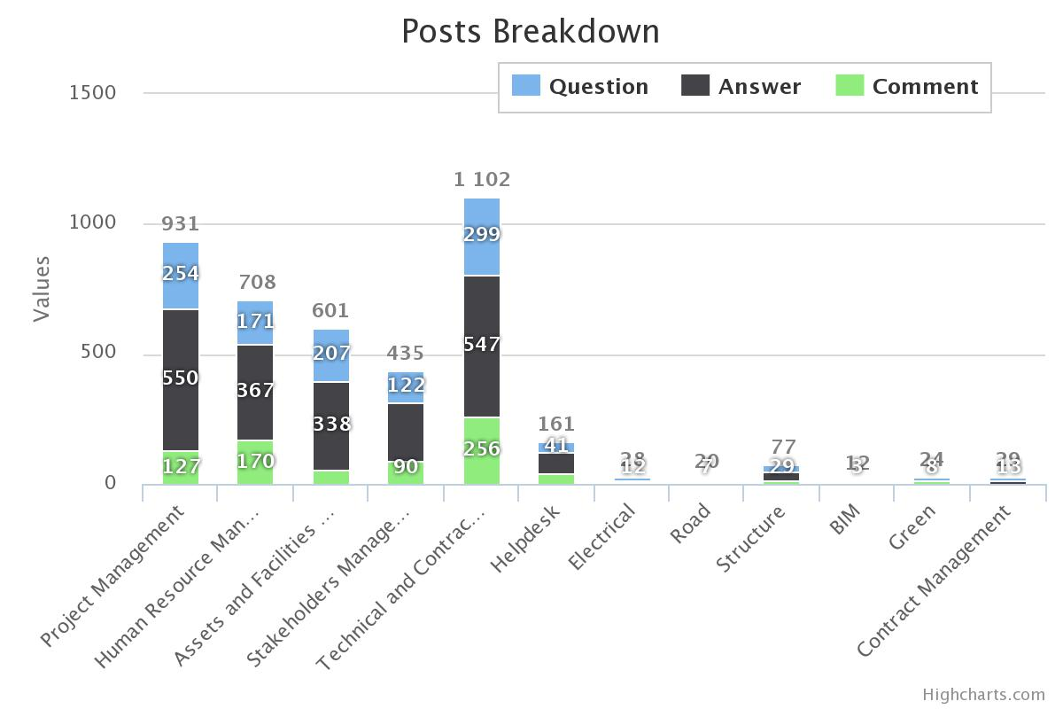
Statistik JCoP (# postings)
4,128 posts

Slide 4
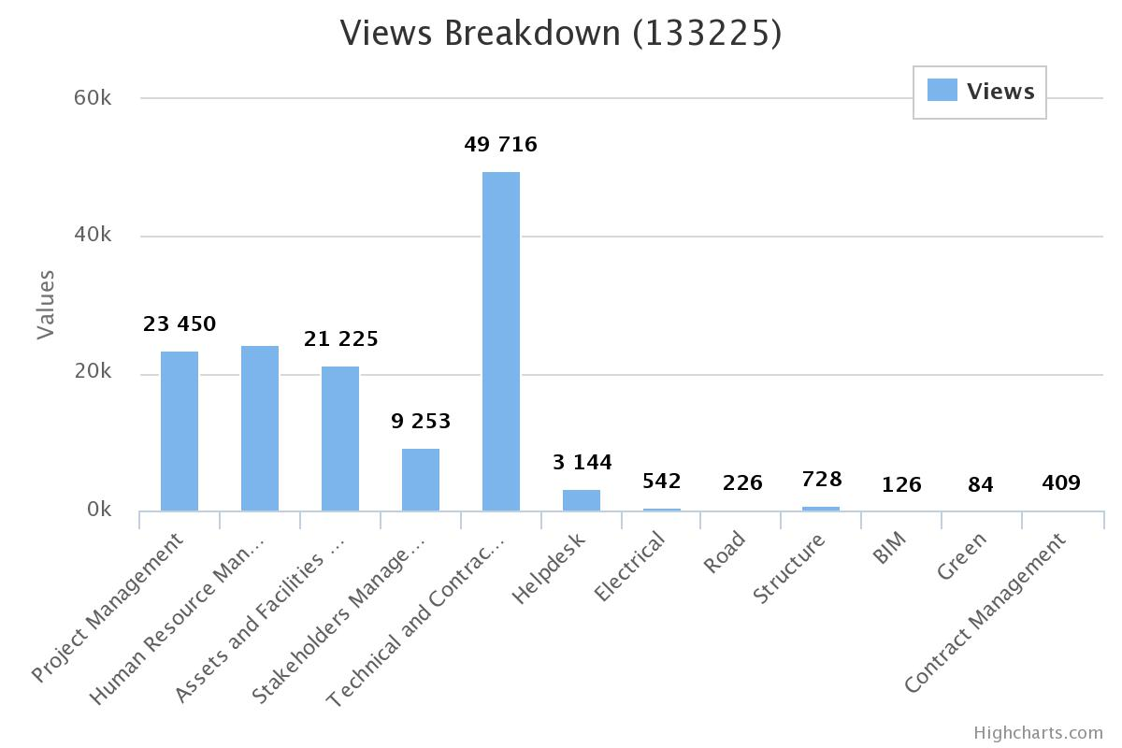
Statistik JCoP (page views)
133,225 views

Slide 5
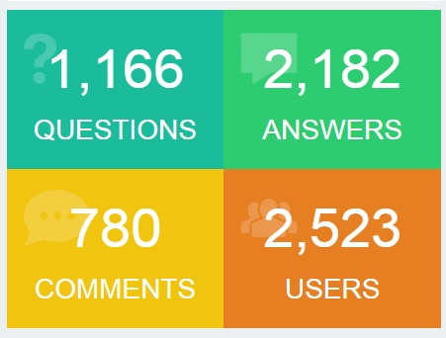
Statistik JCoP (# postings and Users)

Slide 6
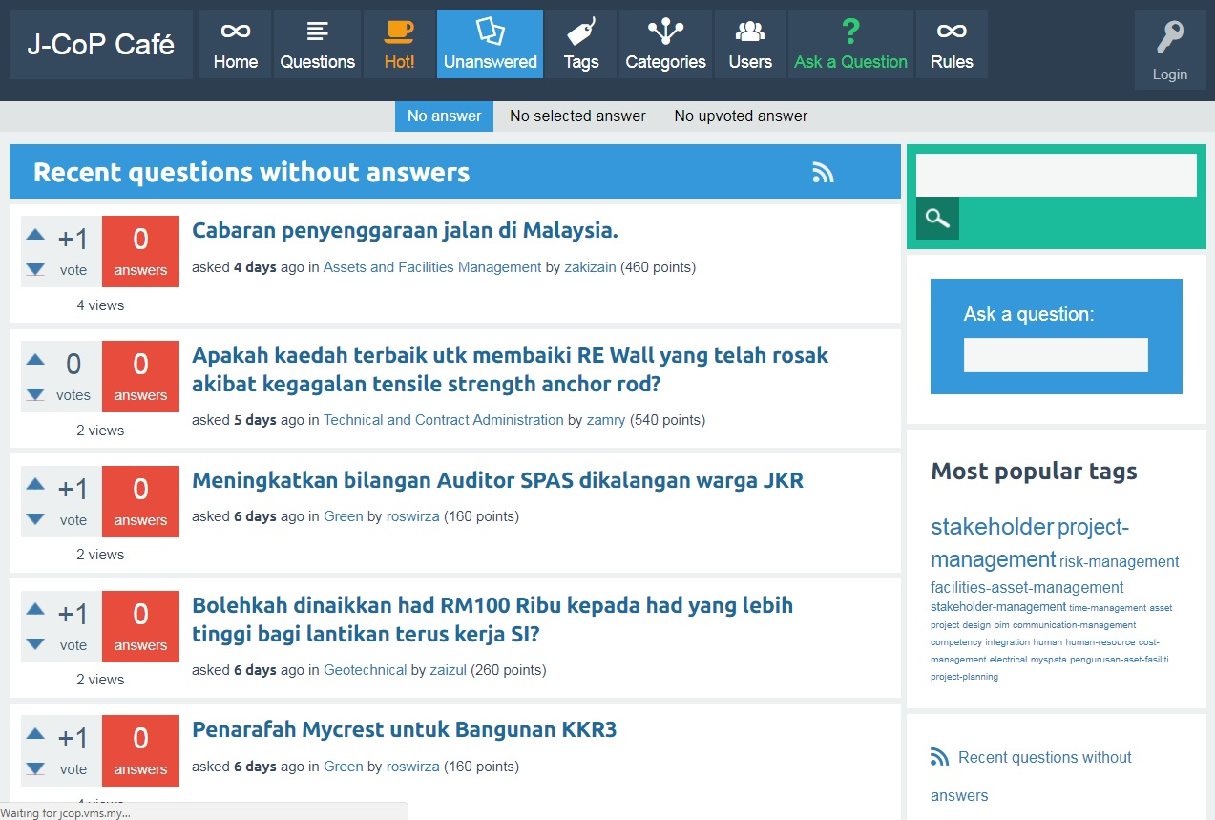
Unanswered Questions
82 soalan

Slide 7
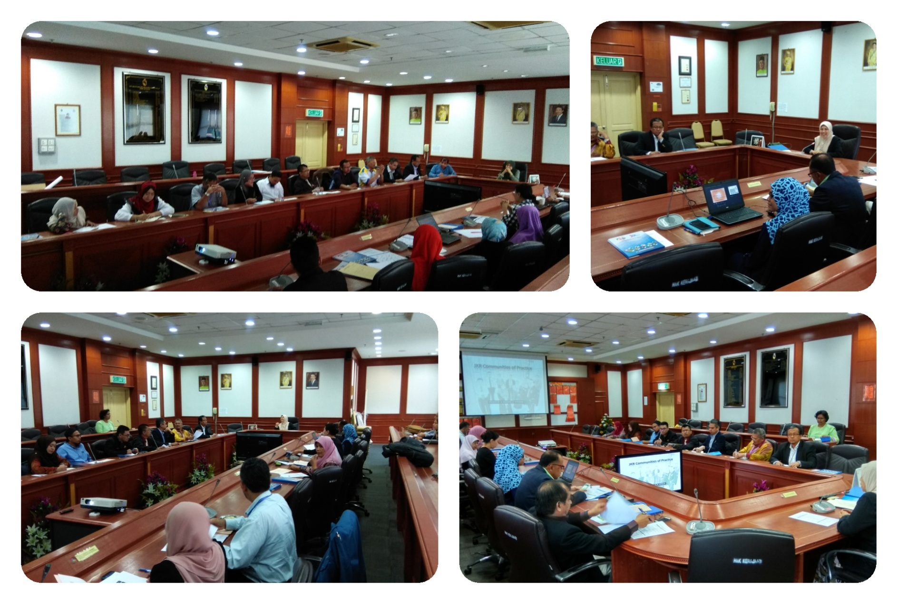
Bengkel CoP Health Check 20 – 21 Julai 2017, Port Dickson, Negeri Sembilan

Slide 8
Bengkel CoP Health Check 20 – 21 Julai 2017, Port Dickson, Negeri Sembilan
Senarai CoP
Hasil Bengkel
CoP Project Management
CoP Structure
CoP Green
CoP Assets and Facilities Management
CoP Contract Management
CoP Leader, Coordinator & Members
CoP Objectives
CoP Terms of References
CoP Deliverables
CoP Action Plan
CoP KPIs

