Slide 1

Seminar Pengurusan Fasiliti Sektor Awam
FACILITY PERFORMANCE MANAGEMENT
28 October 2015
Presented by:
Rusman Md Lizah
Operations Director

Slide 2
PRESENTATION CONTENT
INTRODUCTION
KPI
HOW TO ACHIEVE THE KPI
SYSTEM
CHALLENGES
CONCLUSION

Slide 3
INTRODUCTION

Slide 4
What is Performance Management?
Performance management is the use of performance measurement information to effect positive change in organisational culture, systems and processes, by helping to set agreed performance goals.
Involves a set of processes and activities that assesses, identifies and drives performance improvement and efficiency through organizations and supply chains in line with their respective corporate goals and functional strategies
  A powerful management tool
  Basis of contracts
  A driver for great results

Slide 5
What is Performance Measurement?
Performance measurement is the set of data and information that provides reliable feedback to facilitate effective management decisions at all levels – strategic, tactical and operational.
“Measurement is the first step that leads to control and eventually to improvement. If you can’t measure something, you can’t understand it. If you can’t understand it, you can’t control it. If you can’t control it, you can’t improve it.” J. H. Harrington

Slide 6
KPI

Slide 7
Performance Measurement
Performance measured and monitored periodically using agreed set of Key Performance Indicators (KPI).
KPI - statements of measurement standards to define actual work delivery against agreed objectives - quantified value.
KPI’s criteria selection
S – Simple and Specific
M - Measurable
A - Achievable
R – Relevant & Realistic
T – Time bound

Slide 8
Why Measure Performance?
The main reasons for measuring performance are to:
Learn and improve
Report internally and externally
Demonstrate compliance
Provide information to help managers make better informed decisions
Comply with external reporting regulations and information requests

Slide 9
Performance Measurement System
It was found that a large amount of respondents (60%) have no implementation of performance measurement system (PMS) for their FM service delivery, as opposed to 40% who do implement PMS.
One survey participant responded that the reason why PMS is not implemented is to avoid a strict key performance indicator in the service performance.
(N. Elyna Myeda & M Pitt, 2014)

Slide 10
KPI and Ascertained Performance Deduction (APD)
Level of Performance
“The Contractor shall perform the Services according to the provision of the Contract and comply with the standard specified in the Key Performance Indicators…………”
APD
“Hence, the Parties agree that if the Contractor fails to meet the standard in KPI, the Government shall (without prejudice to its other remedies in and arising out of this Contract) deduct a sum calculated…………”

Slide 11
KPI
KPI No. | PERFORMANCE KPI | BASED KPI
1 | Planned PM, Housekeeping, Landscaping & Pest Control Scheduling. Scheduling Corrective Maintenance | Performance Based KPI
2 | Service Request
3 | Customer Satisfaction
4 | Complaint on Services
5 | Recurring Complaint on attended WO
6 | Quality of Service Delivery Workmanship
7 | Timely and Accurate Submission of Reports
8 | Injury Due to Improper Maintenance
9 | Toilet / Water Supply | Services Availability Based KPI
10 | Toilet Asset | Asset Availability Based KPI

Slide 12
Current Contract – BSI Contract’s KPI ( page 1 of 2 )
ITEM | DESCRIPTION | PERFORMANCE MEASUREMENT | TARGET VALUE (KPI)
1A | Planned Preventive Maintenance for Civil & Structure, Housekeeping, Landscaping & Pest Control Scheduling, Scheduled Corrective Maintenance | Completion of monthly PPM for Civil & Structure | 100% Completion
1B |  | Completion of monthly Housekeeping, Landscaping & Pest Control Scheduling | 100% Completion
1C |  | Completion of Scheduled Corrective Maintenance | 100% Completion
2A | Service Requests | Response Time by Appropriate Personnel | General: 30 minutes Urgent: 15 minutes Emergency: < 5 minutes
2B |  | Execution Time | General: 3 days Urgent: 24 hours Emergency: 3 hours, except Lift Entrapment: < 15 minutes
3 | Customer Satisfaction | Customer Satisfaction | Customer Satisfaction Survey (Quarterly) ≥ 3
4 | Complaint on Services | Resident Users Complaint Public Complaint | ≤ 10 No. of Complaint
5 | Recurring Complaint on Attended Work Order | No. of Recurring Complaint | Zero Recurring Complaint

Slide 13
Current Contract – BSI Contract’s KPI ( page 2 of 2 )
ITEM | DESCRIPTION | PERFORMANCE MEASUREMENT | TARGET VALUE (KPI)
6 | Quality of Service Delivery or Workmanship | Satisfactory Executed Work | 100% Compliance
7A | Reports | Timely Submission of Reports | 100% Compliance to Submission Date
7B |  | Accuracy of Reports | ≤ 40 No. of Statistical Error
8 | Injury due to Improper Maintenance | No. of Incident due to Improper Maintenance | Zero Incident
9 | Toilet / Water Supply | Supply Availability During Office Hours | 100% Available During Office Hours
10 | Toilet Asset | Asset Functioning / Good Working Condition / Meet Specification at All Times | 100% Available at All Times

Slide 14
HOW TO ACHIEVE
THE KPI

Slide 15
ACTION PLAN
Supply Chain
  Standby Resources
  In-Stock Items/Materials
Appointed Subcontractors
Detail Checklist of O&M Activities
Relationship with End Users
HSE Personnel (Risk Management)

Slide 16
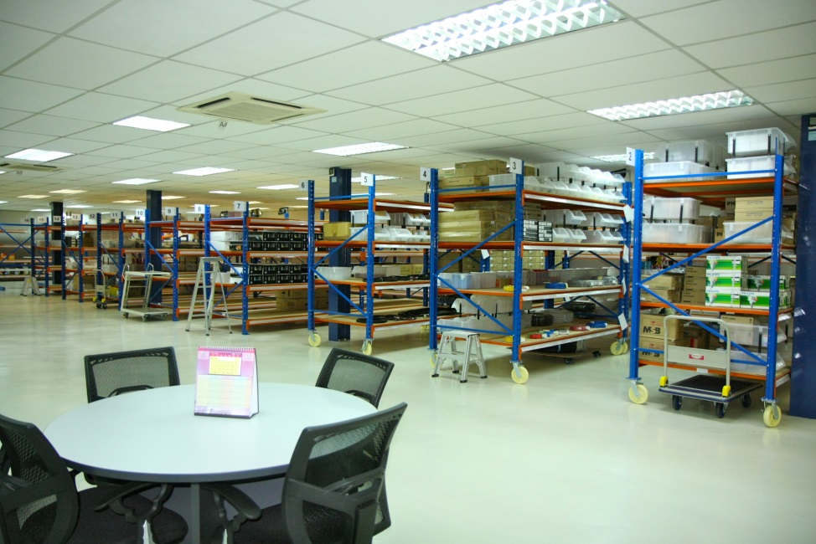
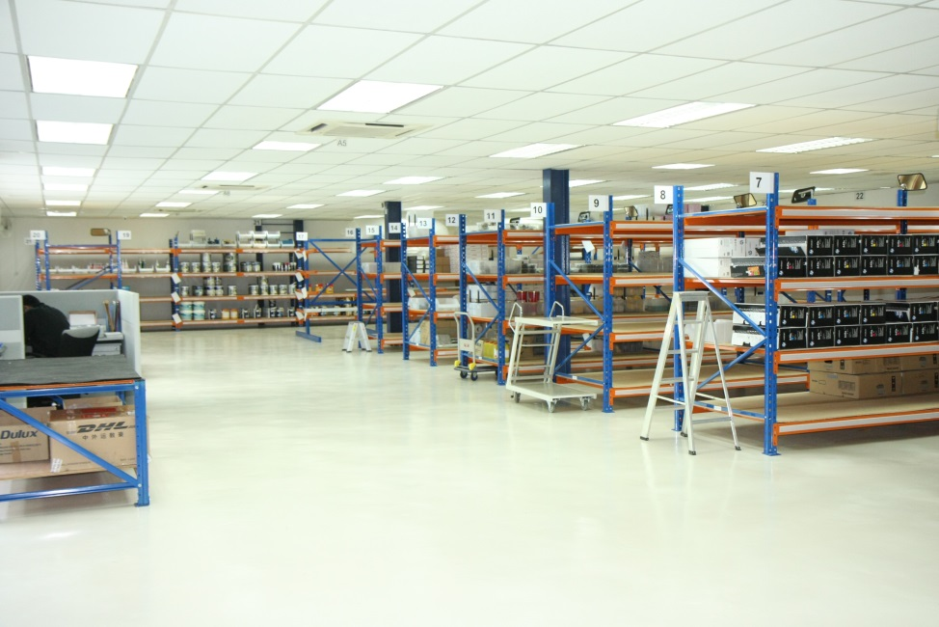
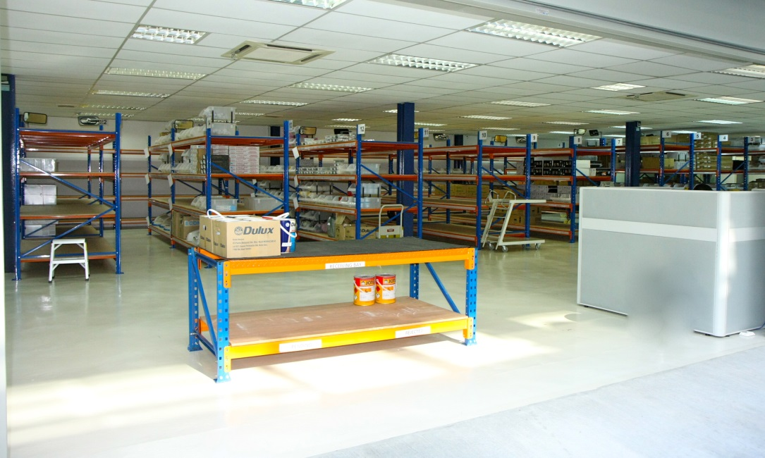

SUPPLY CHAIN – In-Stock Items/Materials

Slide 17
ACTION PLAN
Supply Chain
  Standby Resources
  In-Stock Items/Materials
Appointed Subcontractors
Detail Checklist of O&M Activities
Relationship with End Users
HSE Personnel (Risk Management)

Slide 18
Continuous Human Capital Development
Technology

Slide 19
SYSTEM

Slide 20
How to Monitor KPI
System
CMMS
CAFM
KPI Monitoring

Slide 21
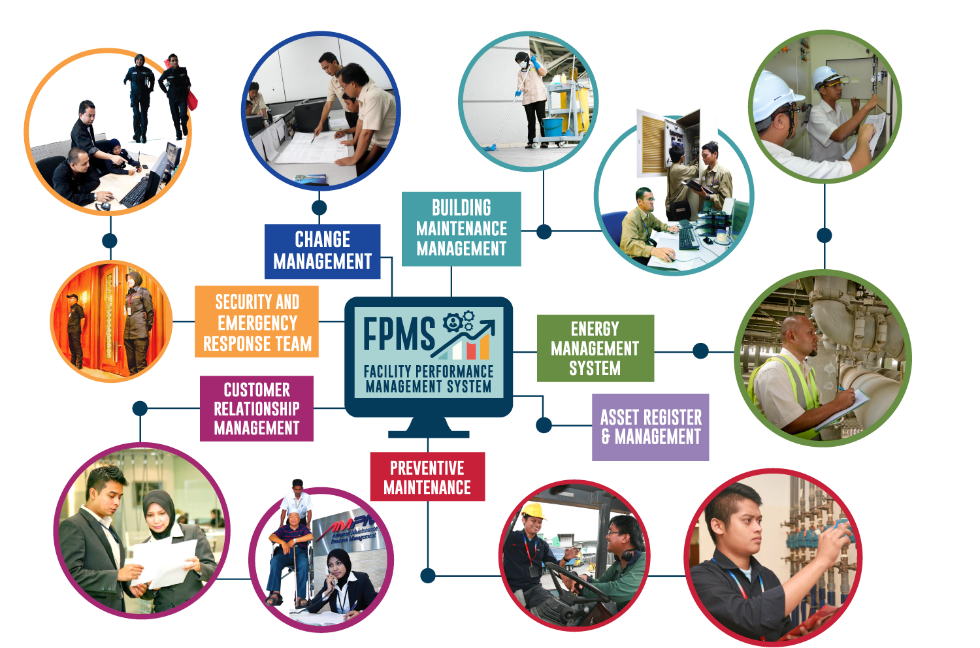
Facility Performance Management System
PERFORMANCE MANAGEMENT SYSTEM – KPI Monitoring

Slide 22
KPI Monitoring - FPMS
Powerful Management & Monitoring Tool (System)
  Operation Management
  Maintenance Management
  Asset Management
  Human Resource Management
Failure Code for Root Cause Analysis (RCA)
Individual/Component Asset Coding for Trending Analysis
Customisation and User Friendly

Slide 23
KPI Monitoring - FPMS
FPMS WORKFLOW
A
Receive Request / Complaint
No
Immediate Action?
Tag Equipment
Log & Generate Work Request (WR)
provide customer with WR No.
Yes
Perform Task
Plan/Prepare Resource
No
Valid WR ?
Close WR
No
Customer Satisfy?
Yes
Help Desk to convert WR to Work Order (WO)
Yes
Verify & Rate WO
Job Planning by Supervisor
Close WO
A
Filing

Slide 24
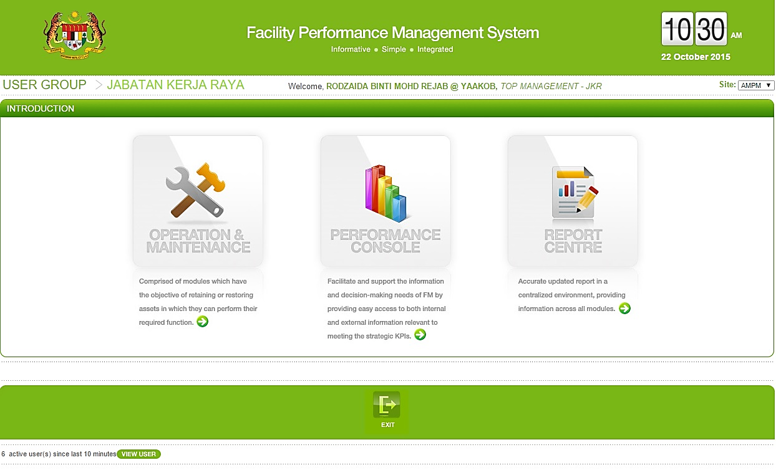
FPMS MAIN COMPONENTS

Slide 25
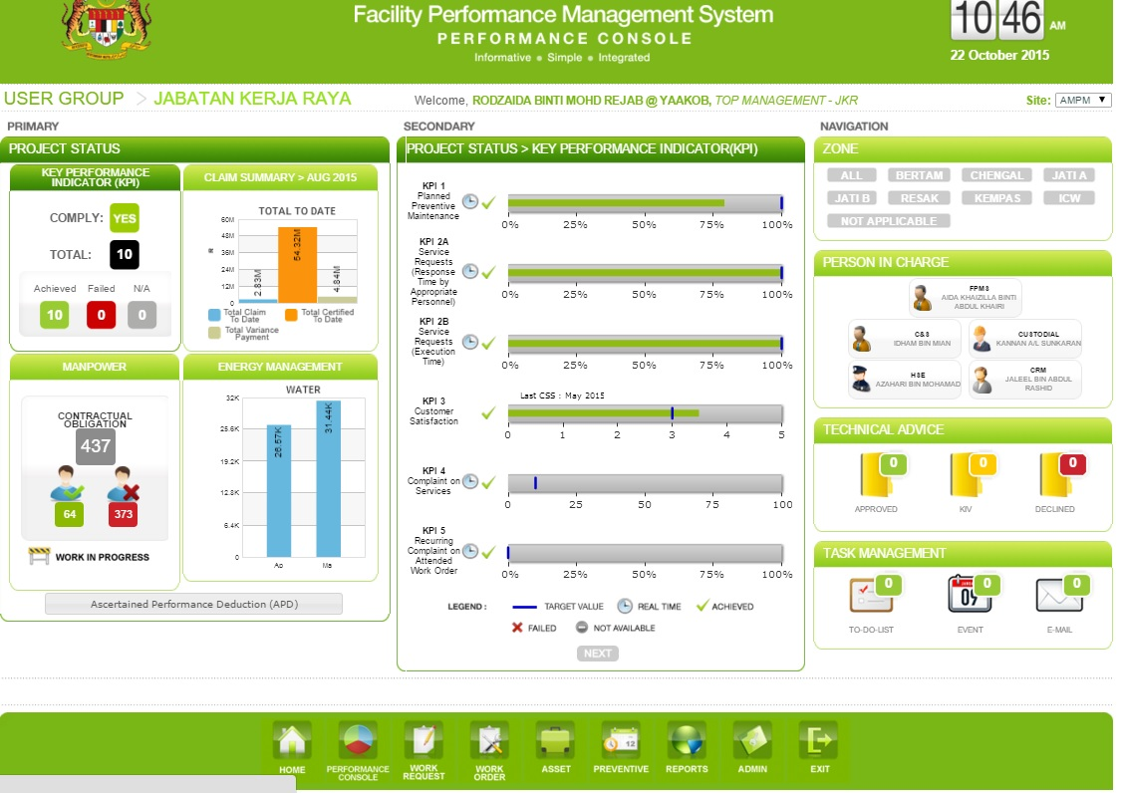
PERFORMANCE CONSOLE

Slide 26
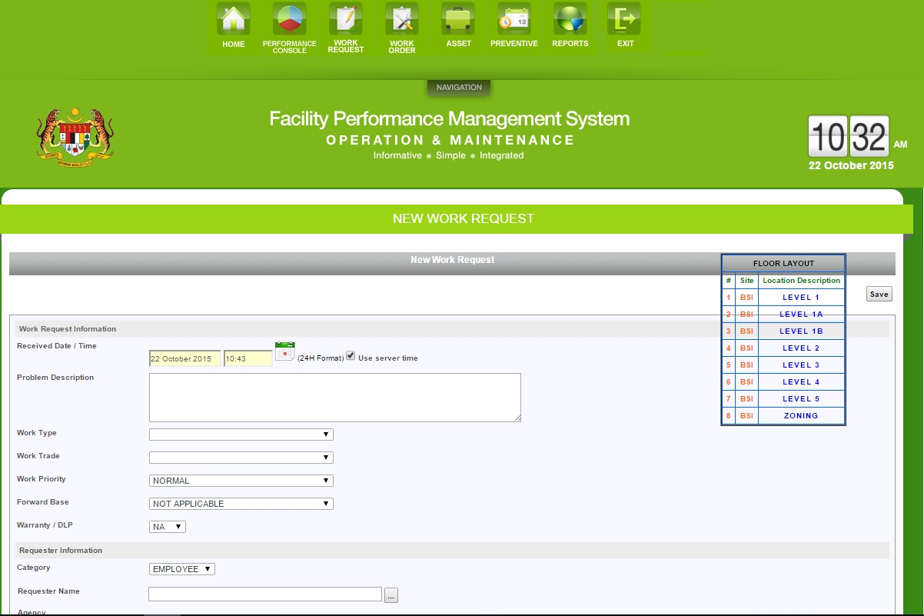
O&M - WORK REQUEST

Slide 27
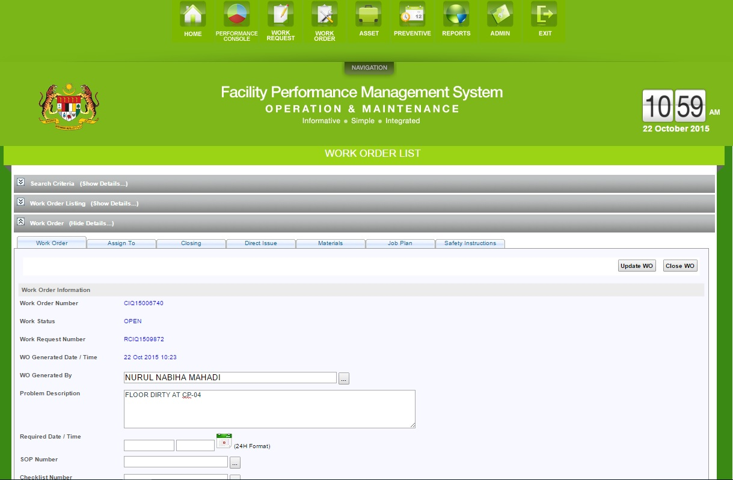
O&M - WORK ORDER

Slide 28
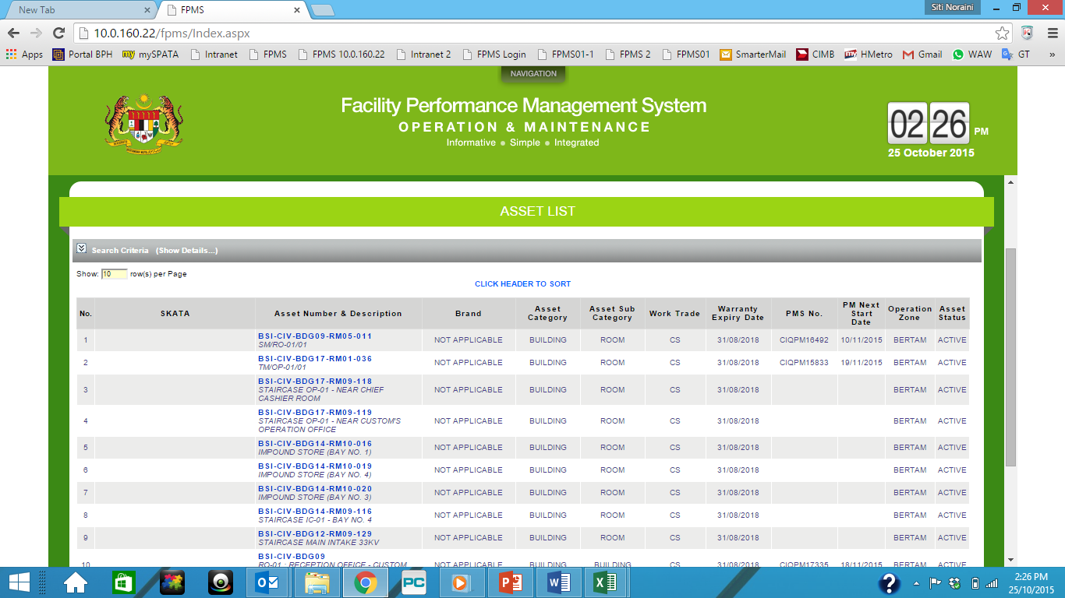
O&M – ASSET MANAGEMENT

Slide 29
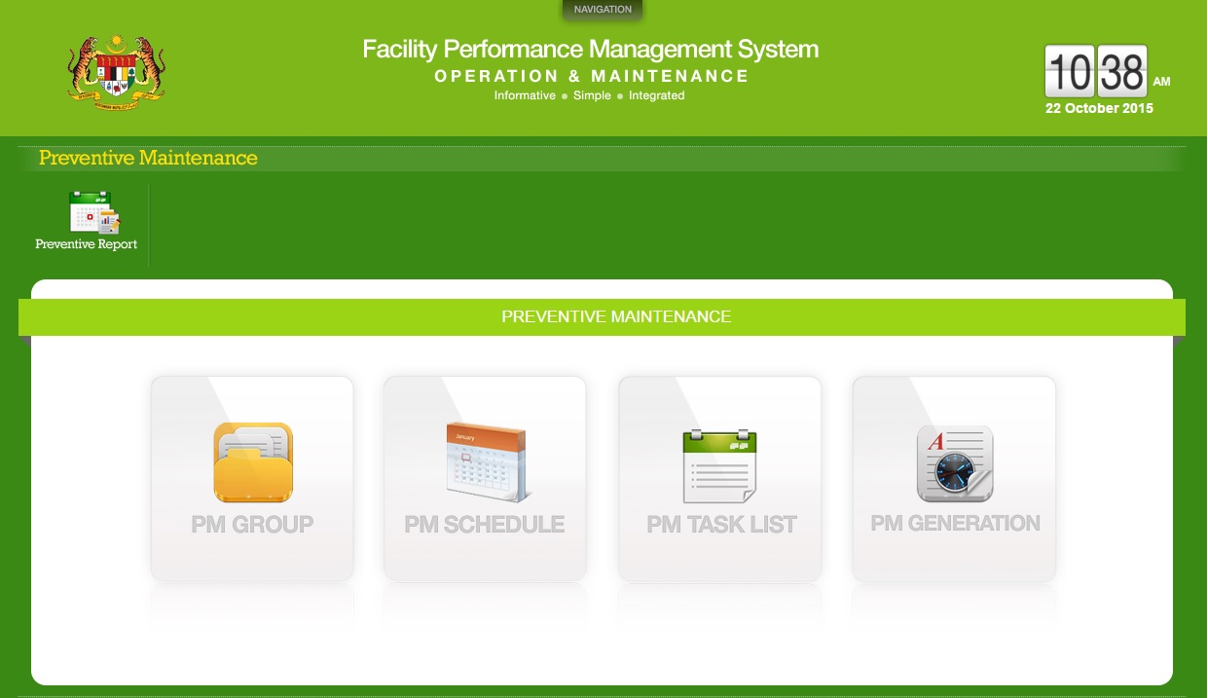
O&M - PREVENTIVE MAINTENANCE

Slide 30
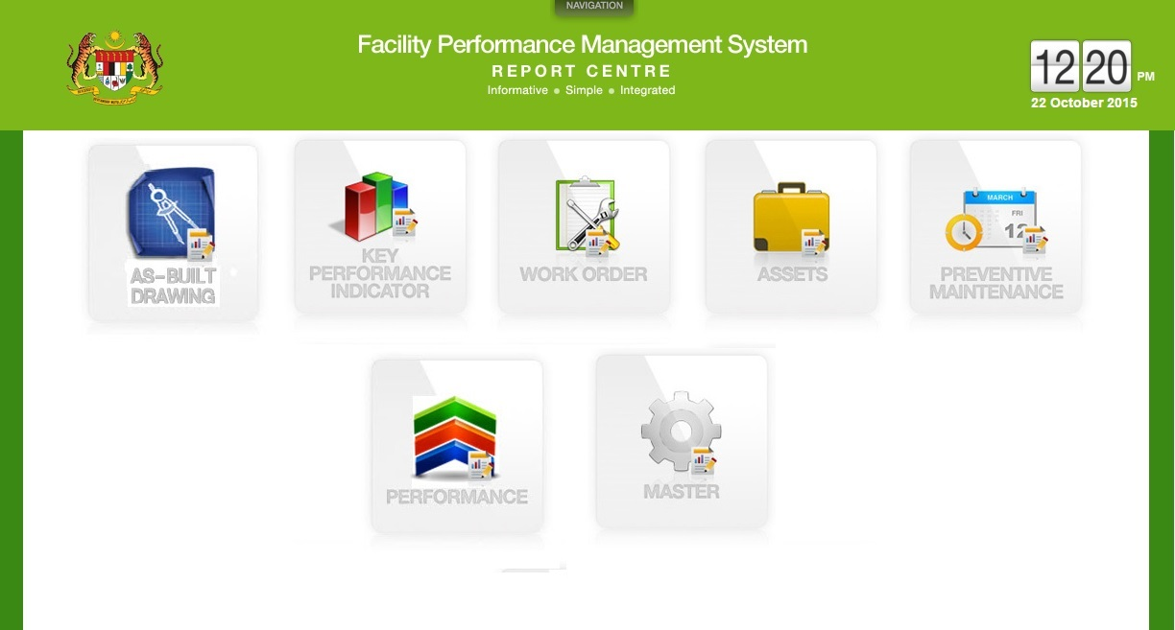
REPORT CENTRE

Slide 31
CHALLENGES

Slide 32
CHALLENGES
Understanding of KPI
No proper guideline
Technical boundaries
Increase of usage of the facility
Competency of staff
Other reasons
“Not everything that can be counted counts, and not everything that counts, can be counted.”

Slide 33
CONCLUSION

Slide 34
CONCLUSION
Facility Performance Management is vital in todays FM contracts as performance-based contracting is the way forward worldwide.
As such, awareness, policy and guidelines, standards and competency development of the Facility Performance Management are important for the FM industry, both in private and public sectors, as well as to the contractors and clients.
Best practice benchmarking globally on Facility Performance Management can help guide the development of the similar practice in Malaysia.
Leveraging on the ever-growing ICT technology would provide the right synergy for effective Facility Performance Management, hence the importance of the Facility Performance Management System (FPMS).

Slide 35
Terima Kasih
Thank You
Corporate Office MALAYSIA :
3, Jalan 222, Petaling Jaya 46100, Selangor, Malaysia
T. +6 03 7957 8890 F. +6 03 7957 0931
Operations Office MALAYSIA :
Level 4, North Wing, Bangunan Sultan Iskandar
Jalan Lingkaran Dalam, 80300 Johor Bahru, Johor, Malaysia
T. +6 07 218 8181 F. +6 07 226 8010
Operations Office KINGDOM OF SAUDI ARABIA :
Level P4, Abraj Al Bait Towers
Development of King Abdul Aziz Endowment
Makkah, Kingdom of Saudi Arabia
T. + 966 12 571 9191 F. + 966 12 571 8428
rusman@ampmsb.com.my

