Slide 1

EMPOWERING SUSTAINABILITY: Architect BEYOND DESIGN
Mesyuarat Arkitek Malaysia 2020

Slide 2

CONTENT
INTRODUCTION
Current Policies
Architect’s Role & Responsibilities
PART I
Green Building & Passive Strategies
Universal Design
PART II
Buildings Conservation & Building Maintainability

Slide 3

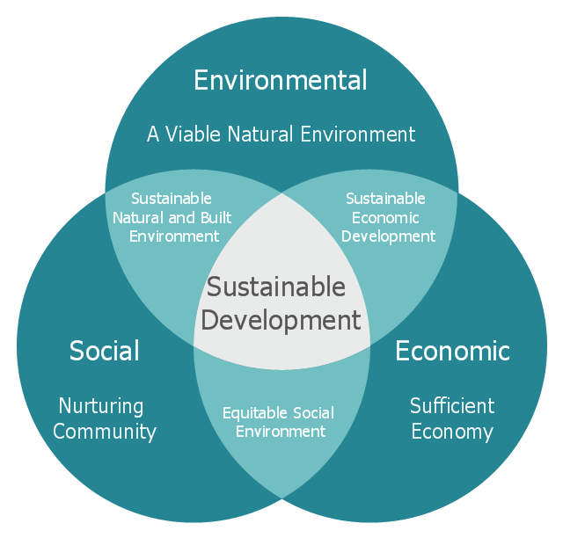

INTRODUCTION
Sustainability is achieved through attaining A balance between inter-dependant social, environmental and economic factors
The Sustainable Development Goals (SDGs), also known as the Global Goals, were adopted by all United Nations Member States in 2015. Designing buildings consistent with the SDGs ensures creation of healthier places and, therefore, healthier people, communities, and societies

Slide 4
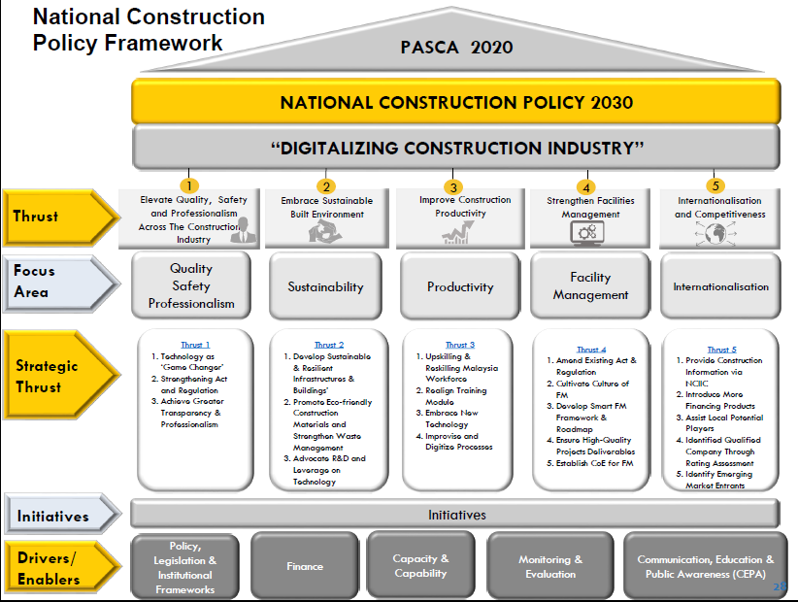

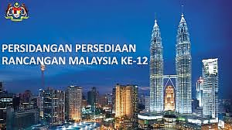



INTRODUCTION
2021-2025
TEMA 4: MEMACU KELESTARIAN

Slide 5
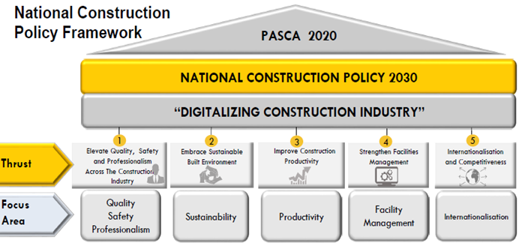
2021-2025
TEMA 4: MEMACU KELESTARIAN

Slide 6

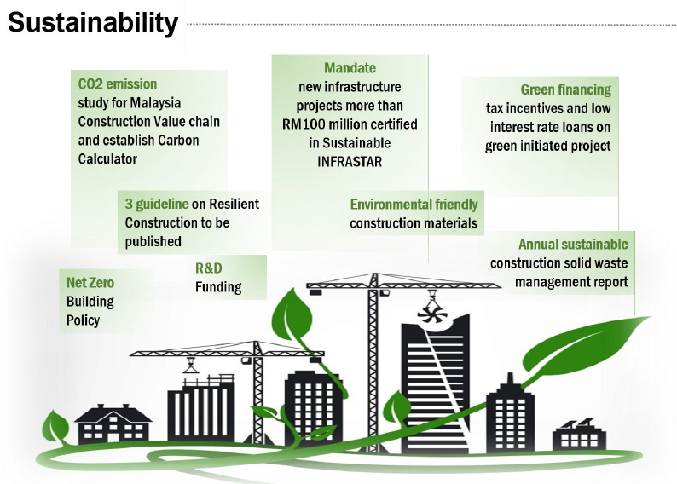
NATIONAL CONSTRUCTION POLICY 2030

Slide 7
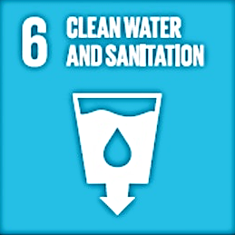


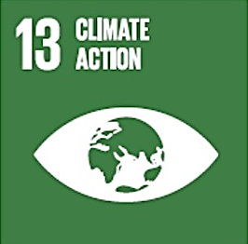
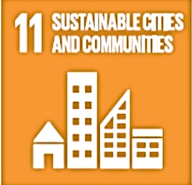







JKR STRATEGIC PLAN: LEADING SUSTAINABILITY 2021-2025
Customer Value Proposition
SUSTAINABLE INFRASTRUCTURE AND BUILDING DEVELOPMENT
ECONOMY
ENVIRONMENT
SOCIAL
OPTIMUM MAINTENANCE & OPERATIONAL COST
CONDUCIVE ENVIRONMENT
MINIMISE ENVIRONMENTAL IMPACT
INCLUSIVE DESIGN
HEALTH &WELL BEING

Slide 8
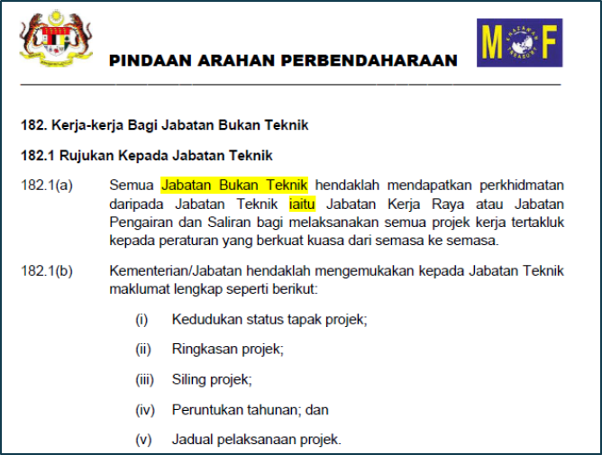
ARCHITECT’S ROLE & RESPONSIBILITIES
Play leadership role in the field of sustainability
Embrace sustainability in the entire design and construction processes
MEMPERKASA AP 182 - JKR telah di beri mandat dan tanggungjawab yang lebih besar untuk melaksanakan semua projek-projek kerajaan.

Slide 9
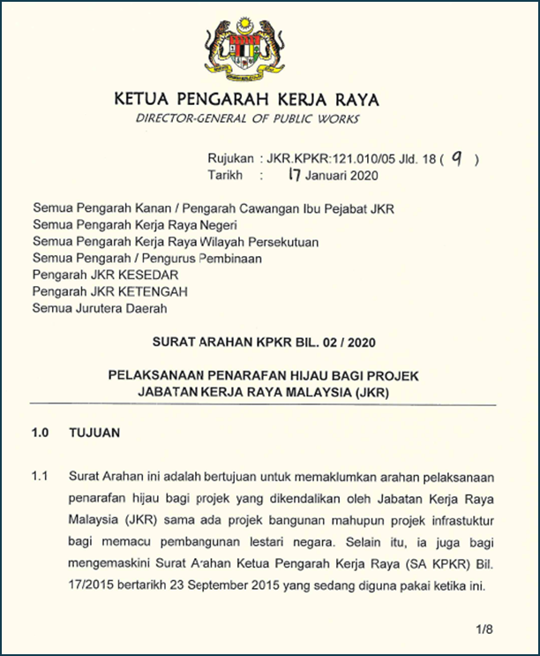
ARCHITECT’S ROLE & RESPONSIBILITIES
Use green rating pHJKR/ MyCREST for all projects
Work strongly together with other professionals at every phase of the design process to determine sustainability
MENERAJU KELESTARIAN – Surat arahan KPKR dalam pelaksanaan penarafan hijau bagi projek JKR bernilai RM 20 juta ke atas

Slide 10

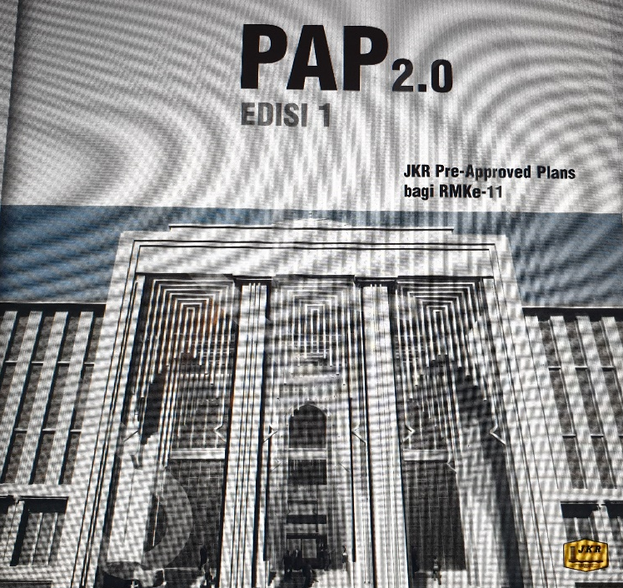
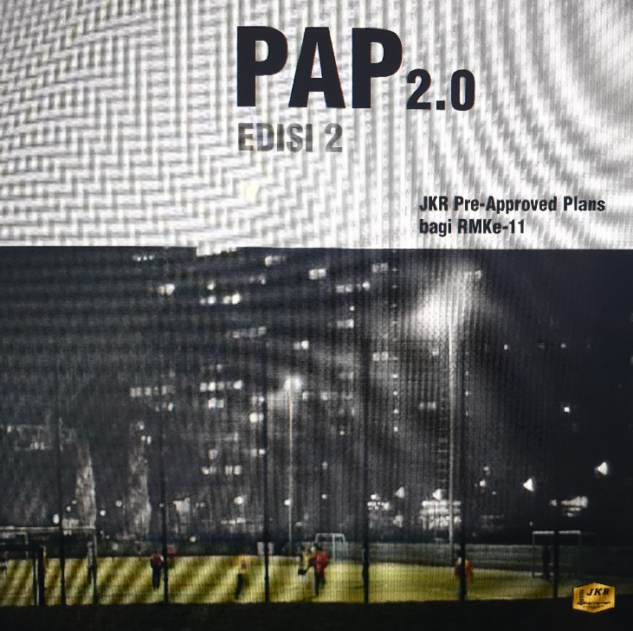
ARCHITECT’S ROLE & RESPONSIBILITIES
GREENING THE PAP’s

Slide 11
ARCHITECT’S ROLE & RESPONSIBILITIES
BIM INTEGRATION
OF GREEN ELEMENTS

Slide 12
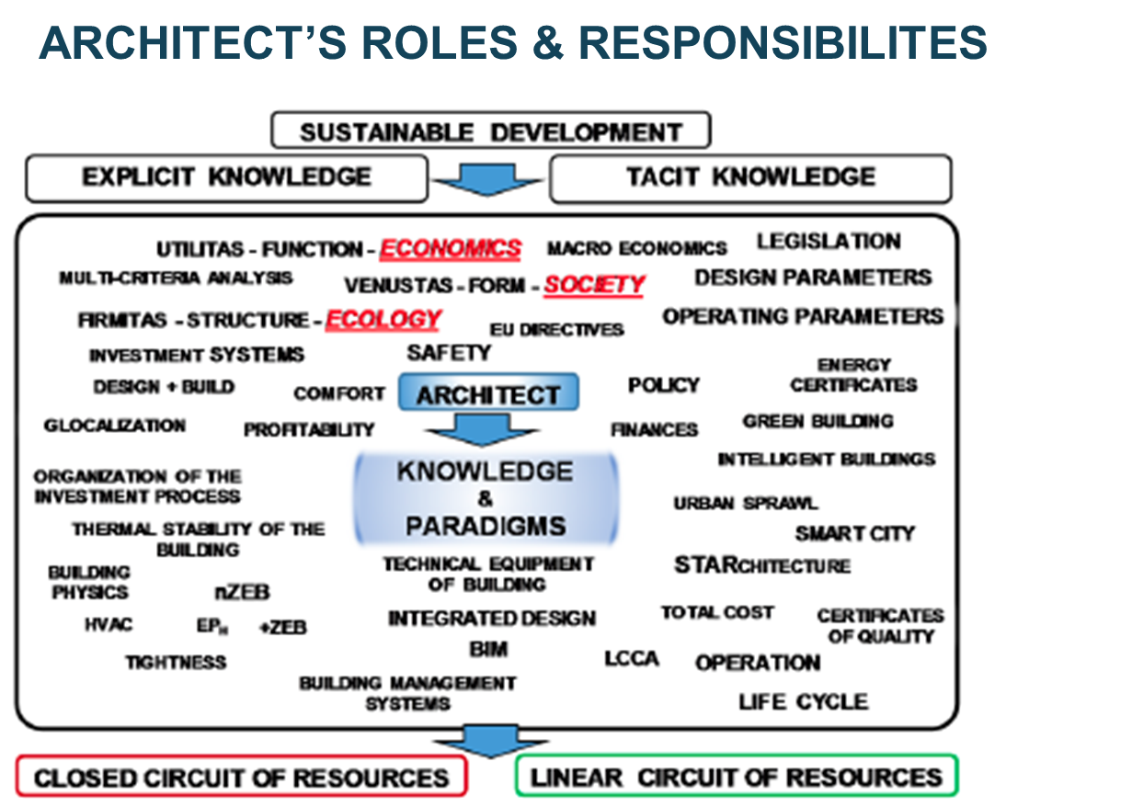
ARCHITECT’S ROLE & RESPONSIBILITIES
ACQUIRED KNOWLEDGE
SKILLS & CREATIVITY
Architect’s perspective must always be wider and multidimensional
THINK BEYOND DESIGN

Slide 13

ARCHITECTs
ARE YOU READY TO TAKE OFF?

