Slide 1
PENCAPAIAN PELAN STRATEGIK JKR
(TEMA 1)
BAGI TAHUN 2017
MESYUARAT PEJABAT PORTFOLIO (MPO)
BIL. 1/2017
TARIKH : 26 FEBRUARI 2017
LOKASI :JKR PERAK, IPOH, PERAK

Slide 2
KANDUNGAN
Persembahan Slaid
Pengenalan Ringkas Pelan Strategik JKR
Scorecard KPKR (Tema 1)
Proses Pelaporan
Laporan Pencapaian 2017
Hasil Semakan Semula

Slide 4
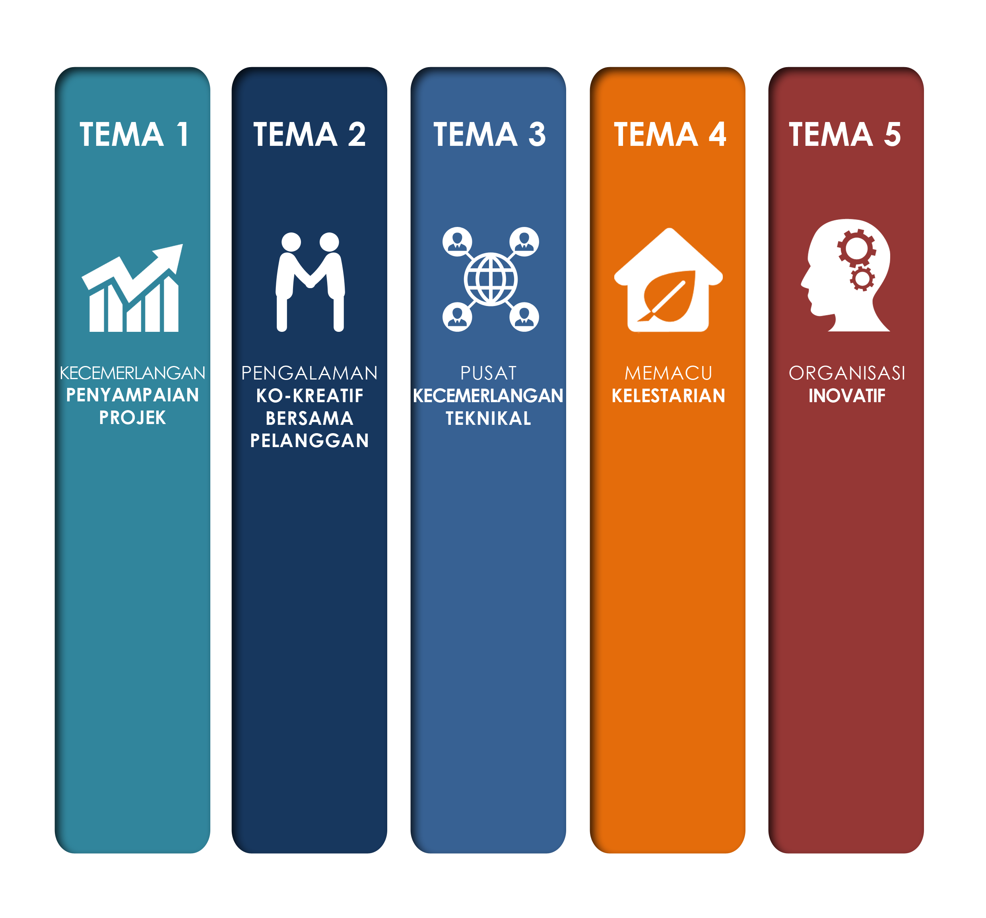
TEMA STRATEGIK
KECEMERLANGAN PELAKSANAAN PROJEK
PELANGGAN
YANG AMAT
BERPUASHATI
JKR SEBAGAI
PUSAT RUJUKAN
TEKNIKAL
KELESTARIAN
INFRASTRUKTUR
SOLUSI
INOVATIF

Slide 5
TEMA STRATEGIK
PENERAJU TEMA
KECEMERLANGAN PELAKSANAAN PROJEK
PELANGGAN
YANG AMAT
BERPUASHATI
JKR SEBAGAI
PUSAT RUJUKAN
TEKNIKAL
KELESTARIAN
INFRASTRUKTUR
SOLUSI
INOVATIF
CPAB
CKBA1
CKAS
CA
CKE

Slide 7
TEMA 1: Kecemerlangan Penyampaian Projek
Objektif Strategik
Definisi & Huraian Ringkas
Kecemerlangan pelaksanaan projek perlu mempunyai atribut berikut: Penyampaian dalam masa yang tepat Memenuhi/melangkaui keperluan pelanggan Kos yang efektif Produk/aset memenuhi jangkaan dan menepati tujuan Produk/aset yang boleh dan senang disenggara
T 1.1
Kecemerlangan Pelaksanaan Projek
Customer
T 1.2
Menambahbaik Persekitaran Pengurusan Projek
Internal Process
Learning & Growth
T 1.3
Membentuk Kompetensi Pengurusan Projek

Slide 8
SCORECARD KPKR

Slide 9
Theme 1 : Outstanding Project Delivery - KPKR
Strategic Objectives
Measures | Targets | Initiatives | Owners
T1.1
T1.1.1 % of projects handover as per original Q-Plan (internal control) T1.1.2 % of projects handover as per revised Q-Plan T1.1.3 % of contracts with EOT approved based only on utilities, land, antiquities and force majeure (uninsurable/ unrestorable) T1.1.4 % of projects with final cost not exceeding the approved cost. T1.1.5 % of Pre-Approved Plan (PAP) projects tendered within 4 months T1.1.6 % of projects implementing Industrialized Building System (IBS) T1.1.7 Upgrade pavement ride quality to ensure the International Roughness Index less than 3m/km for selected protocol road | 35% 80% <30% 85% 100% 50% 100% (completed upgrade works for 5 selected locations) | Integrated Monitor and Control Programme | TKPKR (ALL) Pengarah Kanan CPAB TKPKR (Bangunan) TKPKR (Infra)
T 1.1
Excellent Project Execution
Customer
T 1.2
Enhance PM Environment
Internal Process
Learning & Growth
T 1.3
Develop PM Competency

Slide 10
Theme 1 : Outstanding Project Delivery - KPKR
Strategic Objectives
Measures | Targets | Initiatives |  | Owners
T1.1
T1.1.9 Percentage of As-Built Drawing and Statement of Final Account handed upon handling over of project T1.1.10 Customer satisfaction index | 50% 8.5 *(Based on latest CSS conducted BKK, CDPK) |  | Integrated Monitor and Control Programme i. Customer Based Programme | TKPKR Infra & Bangunan Pengarah CDPK
T1.2
T1.2.1 Project Management Maturity level (current - level 2.4) | Level 3.0 (increment by 0.1 every year until 2020) |  | PM Maturity Development Programme | Pengarah Kanan CPAB
T 1.1
Excellent Project Execution
Customer
T 1.2
Enhance PM Environment
Internal Process
Learning & Growth
T 1.3
Develop PM Competency

Slide 11
Theme 1 : Outstanding Project Delivery - KPKR
Strategic Objectives
Measures | Targets |  | Initiatives |  | Owners
T1.3
Human Capital
T1.3.1 Number of newly certified officers under JKR CBAS program |  | 15 Officers /year |  | PM Competency On JKR Staff Programme | Pengarah Kanan CPAB
Organizational Capital
T1.3.2 Number of engagement programmes |  | 6 Programmes/year |  | PM Engagement Programme (e.g. : Turun Padang) | Pengarah CDPK
Information Capital
T1.3.3 Accessibility of project information (% of system development) T1.3.4 % increase in PM related postings in JCoP |  | 100% (by Dec 2016) 5% increase / year |  | JKR PM’s Information Programme Main Dashboard Project Level Dashboard Enterprise Content Knowledge Programme JKR Community of Practice (J-CoP) | Pengarah CDPK (BTM) & Pengarah Kanan CPAB Pengarah CLI
T 1.1
Excellent Project Execution
Customer
T 1.2
Enhance PM Environment
Internal Process
Learning & Growth
T 1.3
Develop PM Competency

Slide 12
PROSES PELAPORAN
 |  | TINDAKAN
MENDAPATKAN LAPORAN
1. 2. |  | Bahagian Pengurusan Perubahan dan Prestasi (BPPP), CDPK akan mohon setiap penaraju Tema untuk malaporkan Laporan Pencapaian pada setiap sukuan ( April, Julai, Oktober & Januari) Peneraju Tema akan dapatkan Laporan daripada setiap Cawangan / Negeri yang berkenaan melalui Pegawai Prestasi | - BPPP, CDPK - Peneraju Tema 1 - Peneraju Tema 1 - Pegawai Prestasi
PENERIMAAN LAPORAN
1. 2. 3. |  | Pegawai Prestasi akan menghantar Laporan kepada Peneraju dalam tempoh yang ditetapkan dan diselaraskan Untuk KPI KPKR, Pegawai Prestasi perlu kunci masuk di dalam “MYPRESTASI” (http://si02.mampu.gov.my/) Peneraju akan menghantar Laporan yang telah diselaraskan ke BPPP,CDPK | - Pegawai Prestasi -- Peneraju Tema 1 -Pegawai Prestasi - Peneraju Tema 1 - BPPP, CDPK
PEMBENTANGAN LAPORAN
1. |  | Laporan Pencapaian Dilaporkan di dalam Mesyuarat Jawatankuasa Peneraju Pelan Strategik JKR yang dipengerusikan oleh TKPKR(Infra) | -TKPKR(Infra) -BPPP,CDPK -Peneraju Tema
2. |  | Laporan Pencapaian Dilaporkan di dalam Mesyuarat Jawatankuasa Pemandu Pelan Strategik JKR yang dipengerusikan oleh KPKR | - KPKR - Semua TKPKR -Peneraju Tema

Slide 13
- PENGURUSAN - SEKTOR INFRA - SEKTOR BANGUNAN - SEKTOR PAKAR - NEGERI / WILAYAH - Customer satisfaction index
LAPORAN PENCAPAIAN BAGI TAHUN 2017

Slide 14
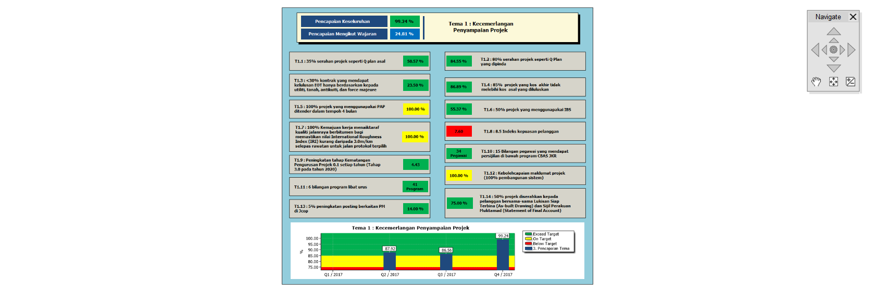

Slide 15
HASIL SEMAKAN SEMULA
 |  | Berdasarkan Mesyuarat Jawatankuasa Peneraju Pelan Strategik JKR yang diadakan pada 9 Februari 2017, terdapat cadangan semakan semula pada scorecard dan sasaran bagi tahun 2018 :-
% of EOT |  |  | Sasaran
1. |  | % of contract with EOT approved based only on utilities, land, antiquitie and force majeure PINDA -% of contract with EOT approved not due to delay caused by utilities, land, antiquitie and force majeure | < 30 % PINDA < 20 %
CBAS
2. |  | Number of newly certified officers under JKR CBAS program | 15 Officers /year PINDA 20 Officers /year
3 in 1
3 |  | Percentage of As-Built Drawing and Statement of Final Account handed upon handling over of project | 50 % PINDA 60 %

Slide 16
HASIL SEMAKAN SEMULA
 |  | Berdasarkan Mesyuarat Jawatankuasa Peneraju Pelan Strategik JKR yang diadakan pada 9 Februari 2017, terdapat cadangan semakan semula pada scorecard dan sasaran bagi tahun 2018 :-
Pavement Ride Quality |  |  | Sasaran
4. |  | Upgrade pavement ride quality to ensure the International Roughness Index less than 3m/km for selected protocol road PINDA Implementation of Performance Based Contract (PBC) on Federal Road maintenance to improve the pavement ride quality | 100% (completed upgrade works for 5 selected locations) PINDA 100% treated location having IRI≤ 2.5m/km

Slide 17
HASIL SEMAKAN SEMULA
 |  | Berdasarkan Mesyuarat Jawatankuasa Peneraju Pelan Strategik JKR yang diadakan pada 9 Februari 2017, terdapat cadangan BARU pada scorecard dan sasaran bagi tahun 2018 :-
 |  |  | Sasaran
1 2 |  | Number of road projects achieving SST milestone as per Q-Plan Percentage of contract document prepared together with SST | 10 nos 10% of total Projects
3 |  | Percentage of physical work progress for Projek Menaiktaraf Lebuhraya Pulau Indah | 100%
4 |  | Percentage completion of Sekolah Daif projects | 100%

Slide 18
Urusetia bagi Tema 1 mengucapkan terima kasih di atas kerjasama yang diberi oleh PO Cawangan/Negeri serta Pegawai Prestasi dalam menyediakan laporan pencapaian
Mohon Maaf Atas Kesilapan Dan Kekurangan Kami
Sekian, Terima kasih

