Slide 1
Bengkel PROJECT LESSONS LEARNED
CAWANGAN KERJA BANGUNAN AM 1
12 – 13 MAC 2018
UNIT ECKM
BAHAGIAN PENGURUSAN PROJEK KOMPLEKS
CAWANGAN PERANCANGAN ASET BERSEPADU

Slide 2
COVERAGE
1. What is Project Lessons Learned (PLL)
2. Why PLL are ineffective?
4. Roles and Responsibilities
3. PLL Processes
5. How to effectively capture PLL

Slide 3
WHAT ARE PROJECT LESSONS LEARNED (PLL)?
PLL is the learning gained from the process of performing a task or an activity
To promote the recurrence of desirable outcomes
To preclude the recurrence of undesirable outcomes
New knowledge and new learnings are identified through activity and review, and incorporated into future work practices
Learn the good practices
Avoid the repeats of bad practices.

Slide 4
Why are lessons learned not captured,
or,
if they are captured, not used?

Slide 5
No management support
No time
Not enough resources
Any guidelines to collect lessons learned?
Where to store and to search lessons learned?
What are processes involved?

Slide 7
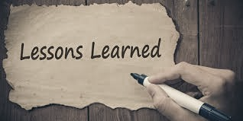
MUST LEAD TO

Slide 8
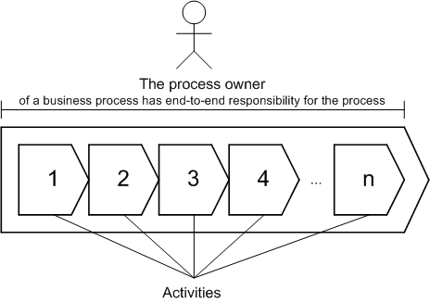
BAGAIMANA MEMASTIKAN KEBERKESANAN PLL
1
2
3
Lessons captured must be accompanied by
an action
identification of the document to be updated
Process owners
validate the lessons
review lessons
update processes that they own
Top management to follow through on learning and actions
4
Once the process or procedure is updated, system administrator
remove lessons from the active lessons database
archive closed lessons

Slide 9
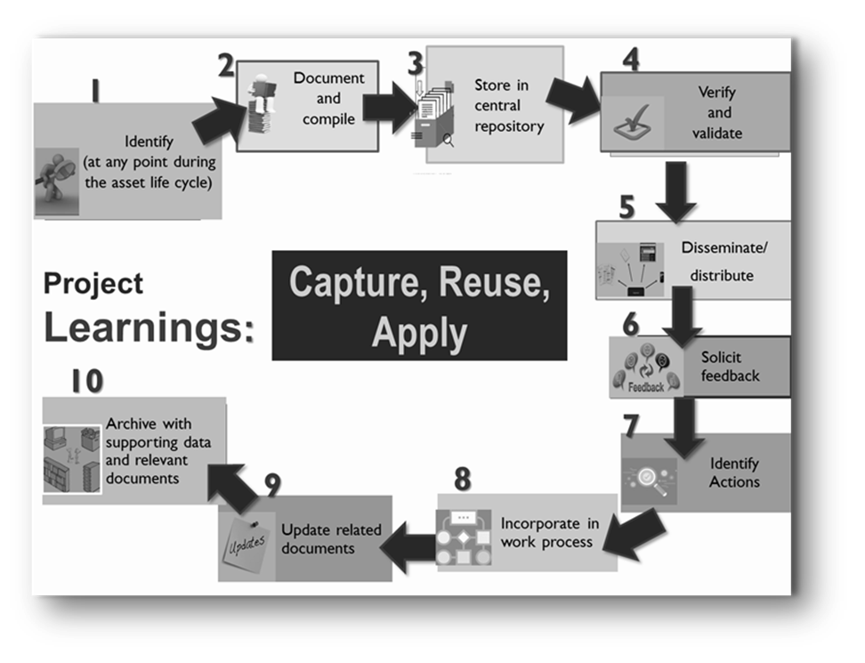
PLL ACTIVITIES

Slide 10
An Improved Approach for Capturing PLL in JKR
Processes
Repository
Search function
Governance
Accountability
Identify
Validate
Roles and responsibilities
Incentive
Disseminate
Analyse and report
Track actions
Update
Quality control
Facilitation
Escalation
Metrics
Documentation
Close out
Components of the new PLL system

Slide 11
Project Knowledge Capture
K-Visits
Learning
After
Retrospect
Learning
During
Peer Assist
Learning Before
Post Implementation Review
After Action Reviews
Techniques
Story telling
Interview
Knowledge Cafe
Coaching & Mentoring
Notes:
Stories provide a richer canvas for people to relate to their own experience. Use metaphors. People will find their own insights
Interviews – we tell more than we can write. Set the context. Right questions must be asked. Capable of generating insights and understanding.
Peer assist – show and tell kind of thing. Highly interactive.

Slide 12
BAGAIMANA MENGENALPASTI PLL
Belajar dari peristiwa (event)
After Action reviews (AAR)
Post Implementation review (PIR)
Aktiviti perkongsian pengetahuan
Pengalaman individu
Tinjauan/pemerhatian
Pemeriksaan luar (external reviews)
Audit
Post mortem
Naziran

Slide 13
Project Learning at “Mission” Speed
Notes:
Acquiring expertise requires learning the explicit knowledge of a field, the practices of its community, and the interplay between the two. And learning all this requires immersion in a community of practice, enculturation in its ways of seeing, interpreting, and acting. Tacit and explicit dimensions of knowledge apply not only to the individual but also to the social mind or the community of practice. It's common for us to think that all knowledge resides in individual heads, but when we factor in the tacit dimension-especially as it relates to practices-we quickly realize how much more we can know than is bounded by our own knowledge. Much of knowing is brought forth in action, through participation-in the world, with other people, around real problems. A lot of our know-how or knowing comes into being through participating in our community of practice.

Slide 14
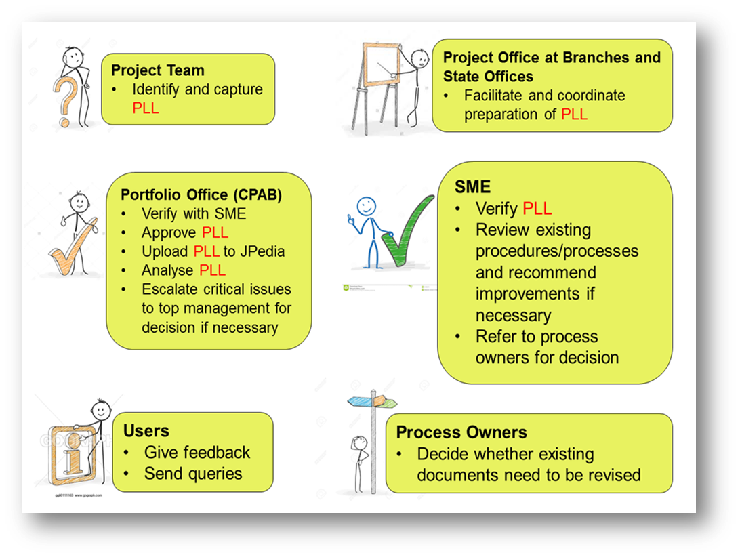
ROLES AND RESPONSIBILITIES

Slide 15
The Ground Rules
Sifat ikhlas dan benar
Mengamal sikap tidak menyalahkan orang lain
Fokus terhadap sumbangan yang di beri dan apa yang dapat di pelajari

Slide 16
Maklumbalas yang positif bertujuan untuk mengkaji mengapa sesuatu berjalan dengan baik, supaya ia boleh dilakukan dengan baik lagi
Maklumbalas negatif bertujuan untuk berkongsi apa yang khusus disebabkan sesuatu untuk mempunyai hasil yang tidak diingini supaya ini boleh dielakkan pada masa akan datang

Slide 17
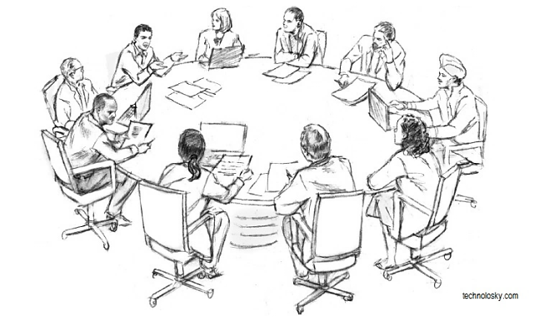
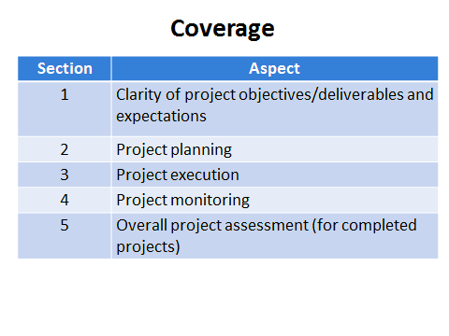
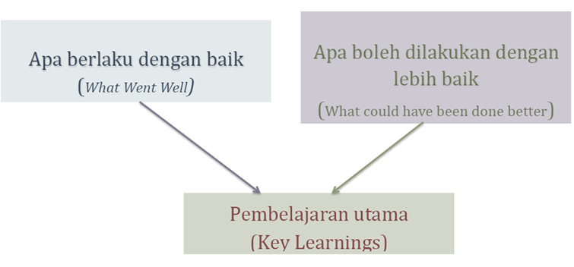
Bincang dengan ahli pasukan projek
Aspek yang perlu dibincangkan
Imbas kembali
insiden dari segi aspek berkaitan

Slide 18
Pembelajaran Projek
Dokumenkan punca isu dan rasional di sebalik tindakan pembetulan yang diambil
Antara pembelajaran projek yang boleh di”captured” :
What was learned about the project in general?
What was learned about project management?
What was learned about communication, budgeting, procurement?
What was learned about working with sponsors, customers?
What was learned about what went well, what did not go well, what needs to change?
How will/was this incorporated into the project?

Slide 19
Apa berlaku dengan baik ? - Contoh
Terdapat penyelarasan yang baik
Mesyuarat mingguan selama 15minit yang diadakan di antara bahagian perolehan dan perancangan telah dapat menangani isu-isu berkaitan dengan skop, masa, kualiti dan kos projek

Slide 20
Apa boleh dilakukan dengan lebih baik ? - Contoh
Keperluan baru PBT diterima lewat menyebabkan kos tambahan
Maklumat terkini mengenai keperluan PBT tidak diketahui dengan tepat semasa peringkat rekabentuk

Slide 21
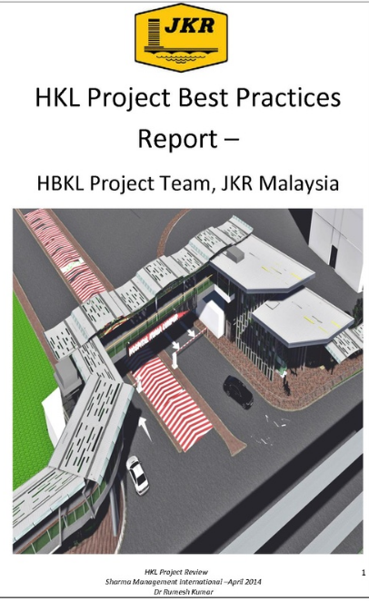
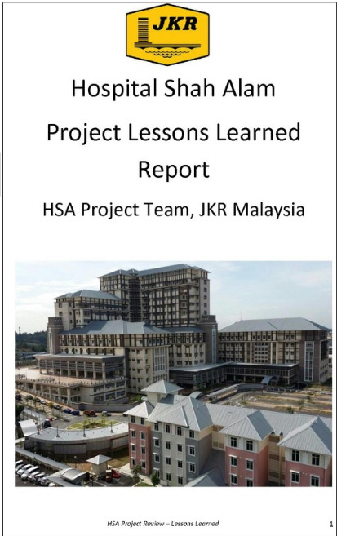
PROJECT LESSONS LEARNED REPORTS

Slide 22
If documented properly, lessons learned provide a powerful method of sharing ideas for improving work processes, operation, quality, safety and cost effectiveness, etc. and helps improve management decision making and worker performance through every phase of a project.
Struktur Laporan PLL
Executive Summary | Summarize the methodology, Key Issues and Key Lessons Learned
Project Background | Provide an overview or description of the project
Methodology | Steps used for capturing, analyzing, validating and communicating PLL
Key Issues | Summarize all the key issues found from data collections through Questionnaire, Interview etc.
Key Lessons Learned | List all key lessons learned captured
Primary Challenges | Summarize the challenges the team identified for the project
Conclusion and Recommendations | Conclude and provide the top recommendations Lessons Learned of the project

Slide 23
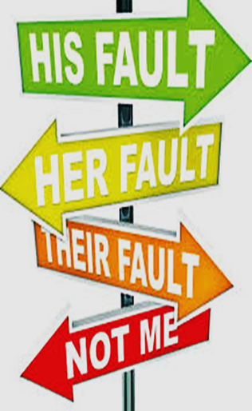
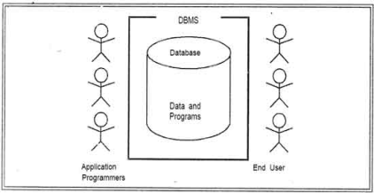
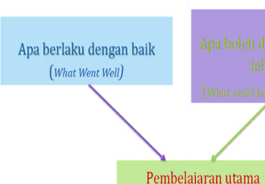
Making It Happen
AWARENESS TALKS
PLL WORKSHOPS
KPI
PLL COMPILATION
EMBEDDING PLL IN WORKFLOW
PLL GUIDE
Stop the Blame Game!
X

