Slide 1
SOUND & ACOUSTIC
Introduction to Sound & Acoustic

Slide 2
SOUND
Definition
What is Sound? Apa itu Bunyi? ..
We hear sound through our ears. What actually is sound?
What we hear as sound is a class of physical kinetic energy called acoustical energy. Acoustical energy consists of fluctuating waves of pressure in a physical medium - usually air
A single complete cycle of an acoustical pressure wave consists of one half-cycle of compression (higher pressure) of the air molecules, followed by one half-cycle of rarefaction (lower pressure) of the molecules. Sounds of higher amplitude (louder) compress and rarefy the air molecules to a greater extent than do lower amplitude (softer) sounds.
The rate of air pressure fluctuation is called the frequency of the wave.

Slide 3
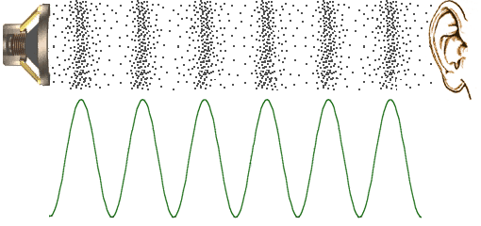
SOUND
What?
What is Sound?
Graphically shown as
Air movement with compression and rarefaction
Source rate of fluctuation became the frequency (f)
Separation between same event became wavelength (λ)

Slide 4
SOUND
What?
What is Sound?
How fast the disturbance travelled is the speed of sound (ν)
Speed of sound in air is ~ 340 m/s (compare speed of light ~ 300 x 10⁶ m/s)
Equation, ν = λ*f
What can you understand from this equation? Discuss
The audible frequency range is 20Hz – 20,000 Hz, bass & treble?

Slide 5
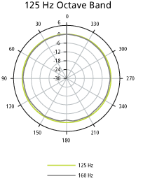
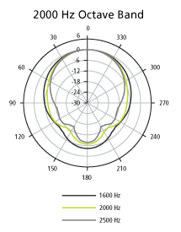
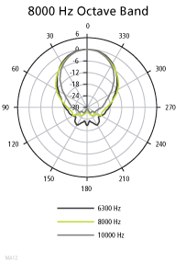
SOUND
What?
What is Sound?
Sound directivity
Low freq omnidirectional, high freq directional
Did you notice this?

Slide 6
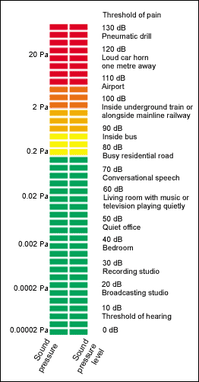
SOUND
How?
How to measure Sound?
Remember the definition of sound, keyword is pressure
We measure sound by measuring its pressure, hence the term ‘sound pressure level’ or SPL
The sound pressure is referenced to 20 μPa, measured in logarithmic scale as decibel
SPL will be reduced by 6dB (20*log 2) for every doubling of distance due to inverse square law
SPL will be increased by 3dB (10*log 2) for every doubling of power

Slide 7
SOUND
How?
The behaviour of Sound?
Since sound is a pressure wave, it behaves like a wave
It can reach you directly (direct path) or indirectly (reflected), just like a light fitting
It can also be absorbed and blocked
Why is it that when you speak in different room, the sound can be rather different?
Finally why is sound and vibration are inseparable?

Slide 8
ACOUSTIC
Definition
What is Acoustic?
Related to the study of sound and hearing, and their properties
Also properties of a room that determine the behaviour of sound
Acoustic study is important to determine especially in our case:-
Quality of sound
Sound insulation
Room acoustic study will be the combination of these two.

Slide 9
ACOUSTIC
What
Quality of Sound?
Sound quality is not just about loudness (or SPL). We can have a situation where the sound is loud enough to be heard but can’t be understood. Quality sound must have enough loudness and be understood by the listener, i.e intelligible.
Loudness or SPL is almost entirely determined by the loudspeaker properties.
Room acoustic on the other hand determines whether a listener can understood the content of the sound.
Remember that sound is a wave that travelled in all direction. So the sound we hear consists of direct and reflected components.

Slide 10
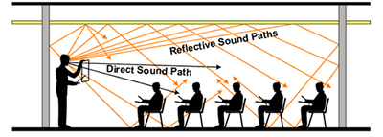
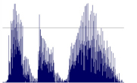
ACOUSTIC
What
Quality of Sound?
There are many reflected sound paths and they arrive later than the direct sound. They are reverberated sound. Too much reverberated sound will make the original sound cannot be understood.

Slide 11
ACOUSTIC
What
Quality of Sound?
The reverb duration is called reverberation time or RT₆₀
RT₆₀ is derived from the Sabine equation
RT₆₀ = 0.161V/Sα
where V is the room volume in m3
S is total surface area of room
α is average absorption coefficient of room surfaces
(Sα is also total absorption, sabins)

Slide 12
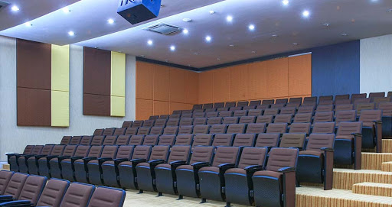
ACOUSTIC
What
Quality of Sound?
From the equation it can be seen that to reduce the RT₆₀, absorption need to be increased. This is acoustic treatment. Room with high RT60 is treated by introducing absorption material on its surfaces (floor, wall or ceiling).

Slide 13
ACOUSTIC
What
Quality of Sound?

Slide 14
ACOUSTIC
What
Sound Insulation?
Why do we need sound insulation?

Slide 15
ACOUSTIC
What
Sound Insulation?
To block external sound from coming into room:-
Noise pollution (e.g: production studio)
To block internal sound from coming out from the room:-
Privacy
Confidential (e.g: meeting room, interrogation room)
Room walls, floor or ceiling are constructed from materials having minimum sound reduction values to fulfill the requirement

Slide 16
ACOUSTIC
What
Sound Insulation?

Slide 17
Unit Perunding Akustik
Thank You For Listening

