Slide 1

Managing Knowledge in a Project Environment
Talk @CKBA1 17 May 2017
Sr Roznita Othman
Dr. Khairil Hizar Md. Khuzaimah

Slide 2





KM is a KEY component in JKR Strategic Framework 2016-2020
OUTSTANDING
PROJECT DELIVERY
CO-CREATIVE CUSTOMER EXPERIENCE
CENTRE OF TECHNICAL EXCELLENCE
LEADING SUSTAINABILITY
INNOVATIVE ORGANIZATION
KM Initiatives
T1.3 Develop PM Competency
JCoP as platform for sharing knowledge
Lessons Learned documentation
T2.3 Develop Customer Centric Workforce
Knowledge Sharing competency development
T3.4 Identity and Develop Experts
SME Profile Page
T4.4 Develop Sustainable Champion
WikiGreen and WikiTAM in Jpedia
T5.3 Enrich Organisational Knowledge Base
&
T5.4 Develop Innovative Centric Workforce
Enhance ECKM,, Governance, e-Learning, CoP Sustenance,

Slide 3
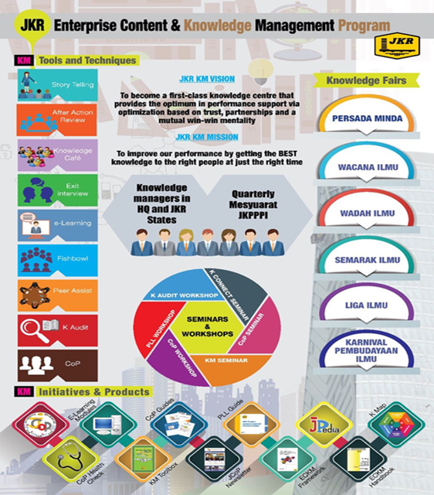
Our KM Implementation at Organisational Level

Slide 4
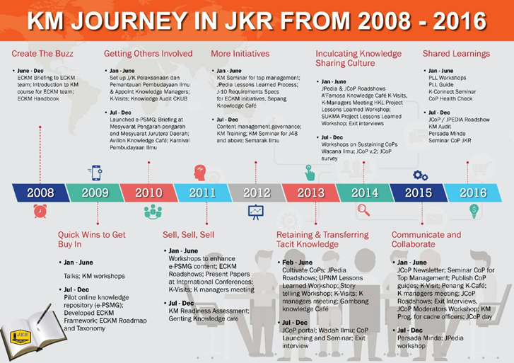

Slide 5
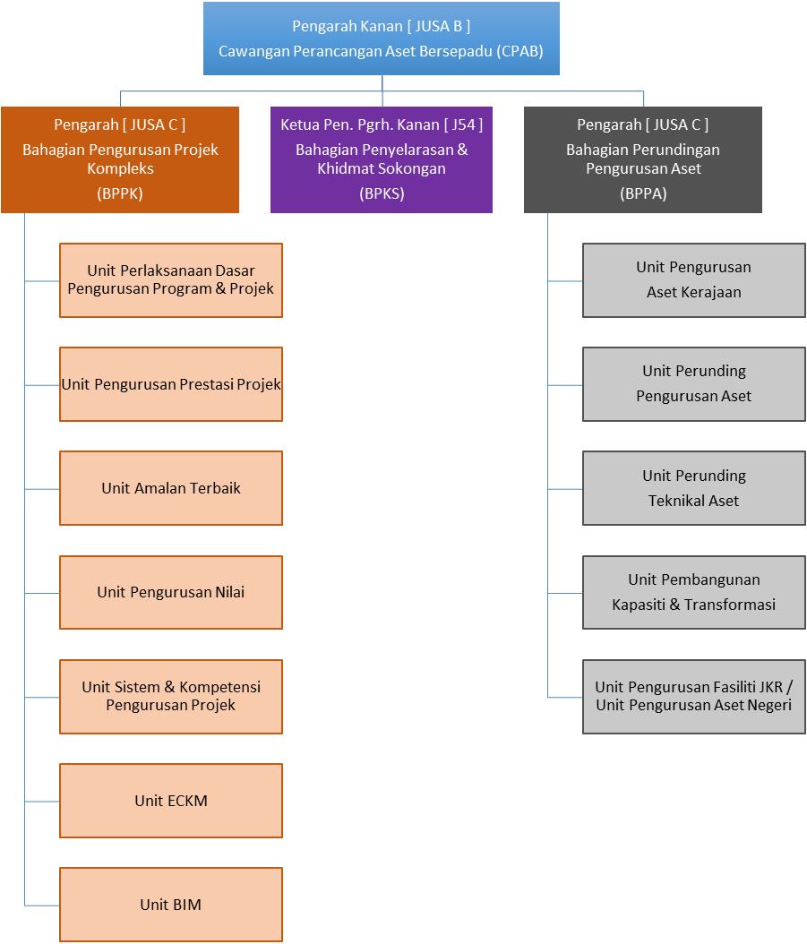
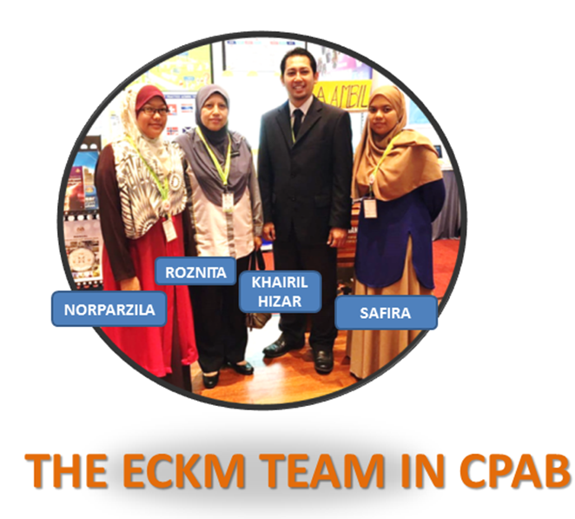
ECKM Office Team
Sr. Roznita Othman
Pengarah Kejuruteraan (Komunikasi)
Juruukur Bahan
J48 (JUB)
Khairil Hizar Md. Khuzaimah
J41 (Awam)
Norparzila Abd. Ghaffar
J41 (Awam)
Safira Aiza Ahmad
Khairunnisa Mohd Hairuddin
J29 (Awam)
Unit ECKM

Slide 6

The KM Agenda
To cultivate knowledge sharing and learning culture across department through the use of proven effective knowledge sharing tools
MAJOR KM INITIATIVES (since 2008)
1
JPedia, an online repository to share knowledge-in-context)
2
Communities of Practice to share domains of knowledge
3
JCoP, an online platform to ask and discuss
4
5
Project Lessons Learned System to share key project learnings
KM Toolbox, set of tools and techniques to capture and share insights and ideas
6
JKR Yellow Pages to locate experts within the department
7
E-Learning to provide 24 x 7 learning environment

Slide 7
JKR Knowledge Transfer Strategies and Initiatives
Communities of Practice
JCoP
JKR Yellow Pages
Personalisation Strategy
Uses technology to provide information of “Who knows what?” and to stimulate personal contacts via collaborative means.
Connecting
People to People
Codification Strategy
Detaches knowledge from the knowledge bearers by articulation and electronic storage so the knowledge becomes explicit.
JPedia
E-Learning
Project Lessons Learned
Connecting
People to Content
Notes:
There are 2 strategies
Personalisation Strategy: This is done via collaborative means., communities of practice, JCoP Yellow Pages. The focus is on connecting People to People through face to face or virtual interactions.
Codification Strategy: This is converting the tacit knowledge to explicit knowledge by articulation and use of electronic storage, as in Jpedia, e-learning, project lessons learned. Since we know more that we can tell, the use of technology such as podcast, videos will help a lot.

Slide 8
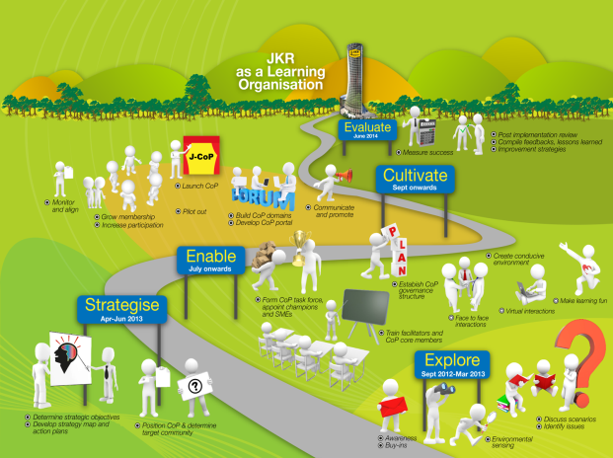

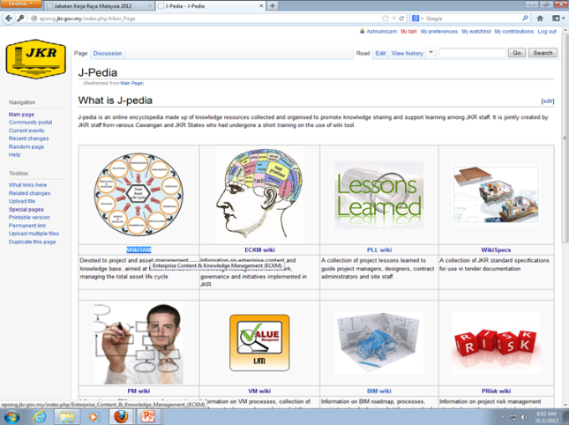

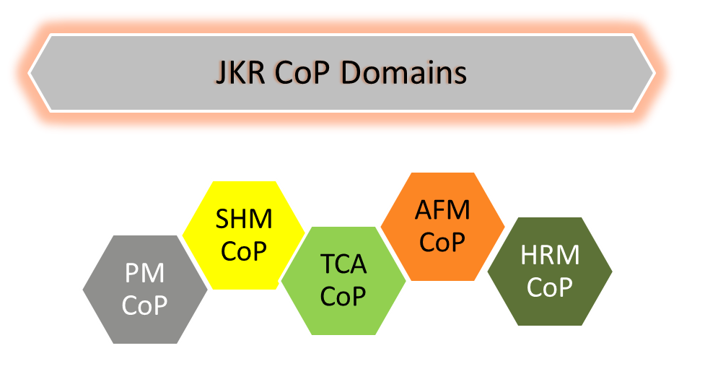
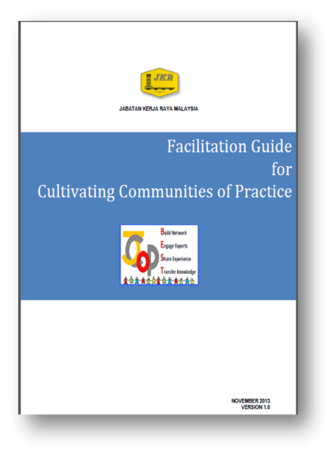
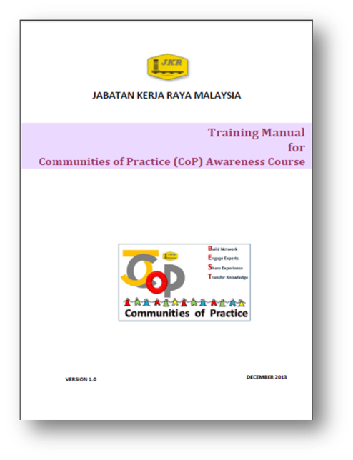
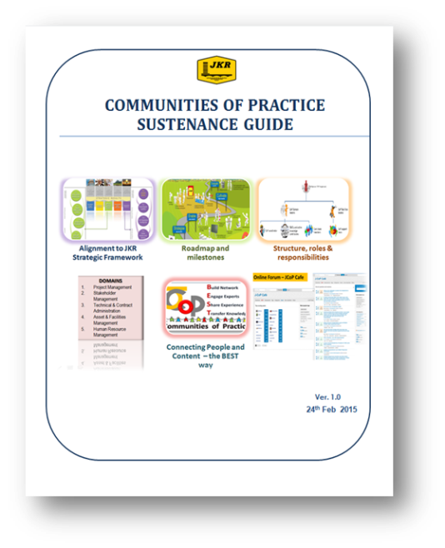
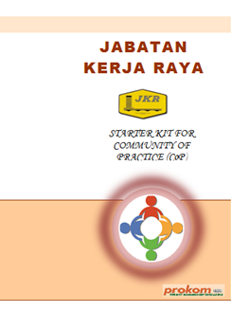
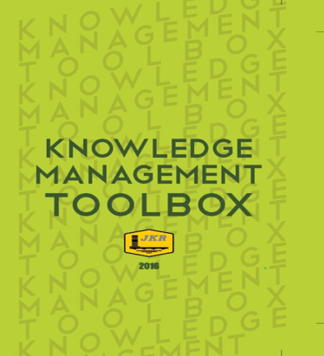
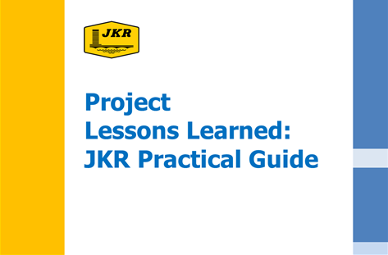
ECKM products
2010 – epsmg
2012 - JPedia
2009
2013
2011 – KM readiness assessment
2013
2014
2013
2015
2016
Contract Mgt CoP
BIM CoP
Structures CoP
Green CoP
?
2016
2016

Slide 9

Why KM matters in project implementation
“
Our most critical technical knowledge remains siloed in the organisation – or worse, is heading out the door
Our people work at different locations and are geographically dispersed. Knowledge sharing across the department becomes more challenging. People are not learning from each other and are reinventing the wheel
Dato’ Ir. Annies Md. Ariff
Former Director General PWD Malaysia
@ KM Seminar for JKR Directors 2012
”
Applying KM at project level will-
make it easier for project teams to find what they need
foster stronger stakeholder relationships and more effective project delivery
increase access to the expertise
Enhance decision making process

Slide 10

KM is a requirement of the new version of ISO9001
ISO 9001:2015 -Clause 7.1.6
Organisations need to determine and manage its knowledge to ensure the operation of its processes and that it can achieve conformity of products and services

Slide 11

Aligning KM to Project delivery goals
To harness the knowledge of over 3,000 JKR professionals into improving project delivery capabilities

Slide 12



Project KM Goals
  Increase use of under-used knowledge
  Enhance knowledge sharing across projects
  Enable capture of tacit knowledge that is not currently shareable
  Improve access to explicit knowledge

Slide 13
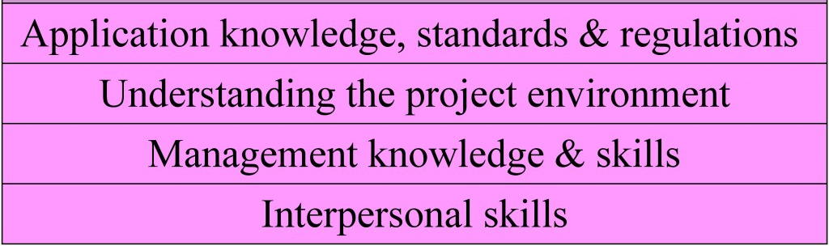
What areas of expertise a project manager should bring to the project team?
Table from Barron & Barron Project Management for Scientists and Engineers,
Source: http://cnx.org/content/col11120/1.4/

Slide 14
What are the Critical Project Knowledge?
Project Management Knowledge
Procedural Knowledge
Technical Knowledge
Knowledge about Clients
Knowledge on Costs
Legal and Statutory Knowledge
Knowledge about Contractors, Consultants, suppliers, etc
Knowledge of who knows what
1
2
3
4
5
6
6
6
Ranking is based on a survey in a research organisation

Slide 15
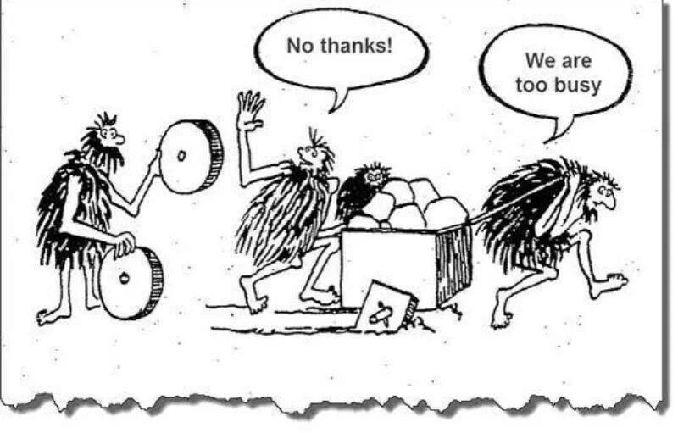
Applying KM at project level means making KM a component part of the project management process
Here.. Apply KM!

Slide 16
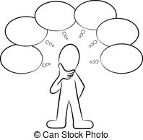
At the project planning phase, the project team need to map out the learning and knowledge needed to successfully deliver the project
Where do the knowledge reside? Are they easily available?
Who has what knowledge? Where are they?
What system of processes, technologies and roles are to be used to manage knowledge within the project?
What knowledge assets are important? What knowledge inputs are needed for the processes?
What knowledge are created from the project? Can they be reused?

Slide 17

Conduct a KNOWLEDGE AUDIT
KNOWLEDGE RISKS
KNOWLEDGE ACCESSIBILITY
KNOWLEDGE GAPS
ANALYSIS

Slide 18
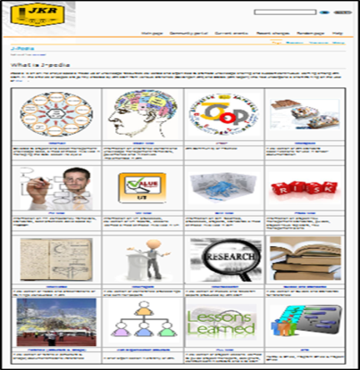

JKR KM Online Tools
JPedia
Online Knowledge Repository
JCoP
Virtual Communities of Practice
Best Practices
PM Competency Framework
Project Lessons Learned
Technical References and Guides
Presentations
Conference Papers
CoP Domains
Subject Matter Experts Profile
Ask and Discuss Online Platform
Connect People to Content
Connect People to People
QSIC 2016 - 25 August 2016

Slide 19

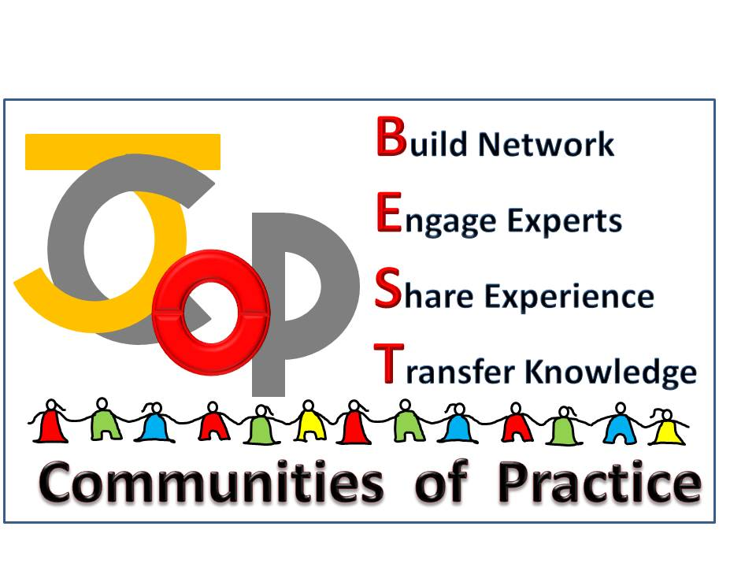
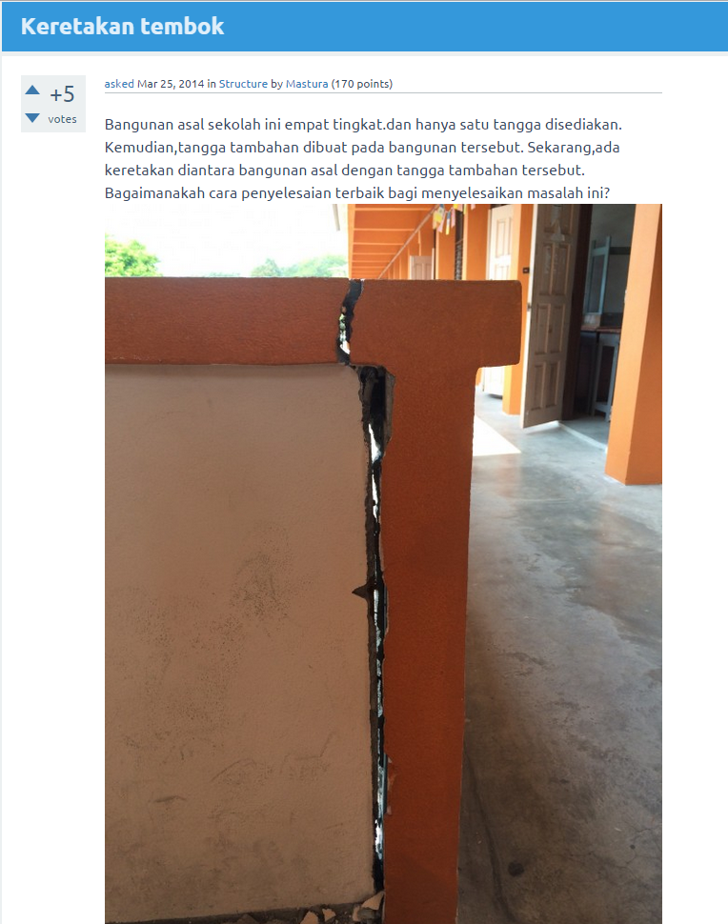
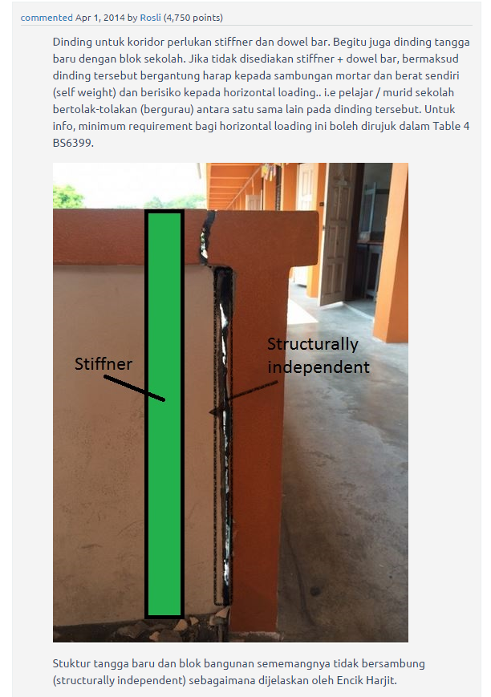
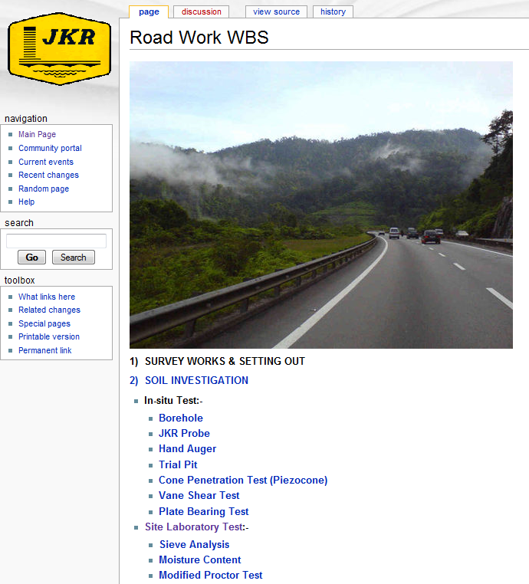
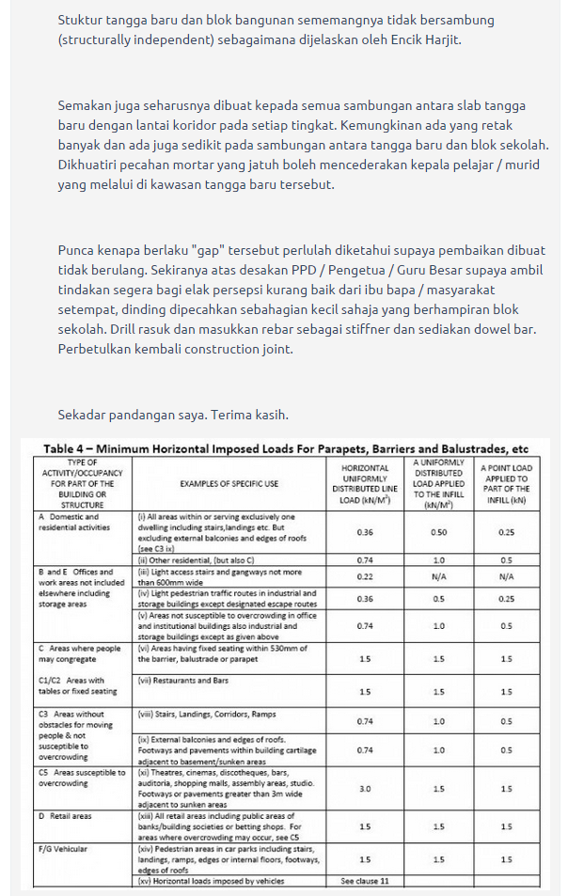
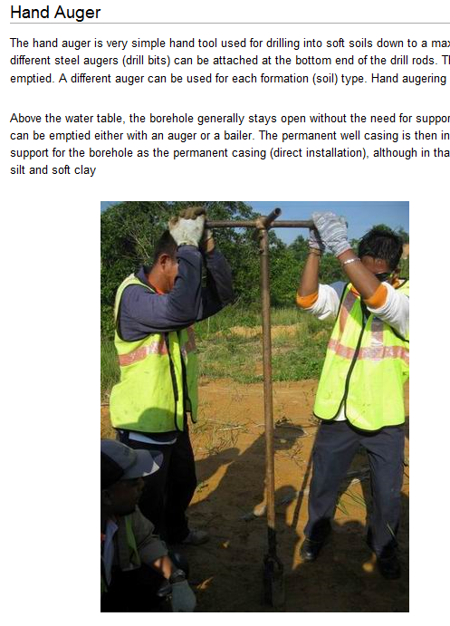
JPedia
Connecting People – The BEST Way
JCoP
Share Explicit Knowledge
Share Tacit Knowledge

Slide 20

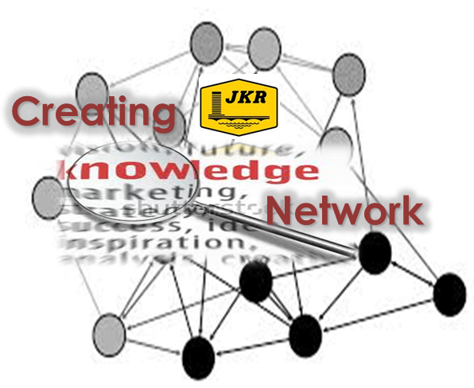

JKR CoPs
Peer networks of practitioners within JKR who help each other to perform better by sharing knowledge and experience.
Through this collaborative environment, new knowledge is created and will help spark innovation

Slide 21
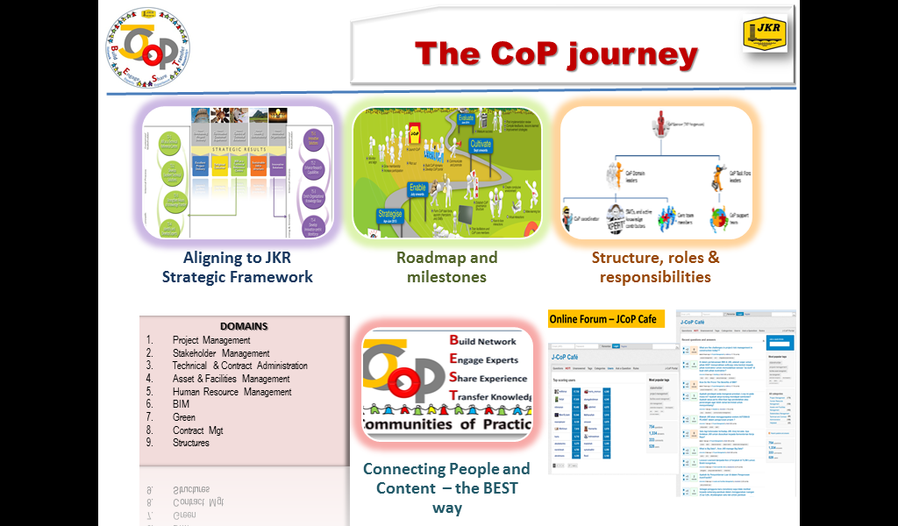
Cultivating CoP in JKR

Slide 22
CoP Domains @ JKR
Stakeholder Management
Human Resource Management
Structure
BIM
Green
Contract Management
Project Management
Assets and Facilities Management
Technical and Contract Administration

Slide 23
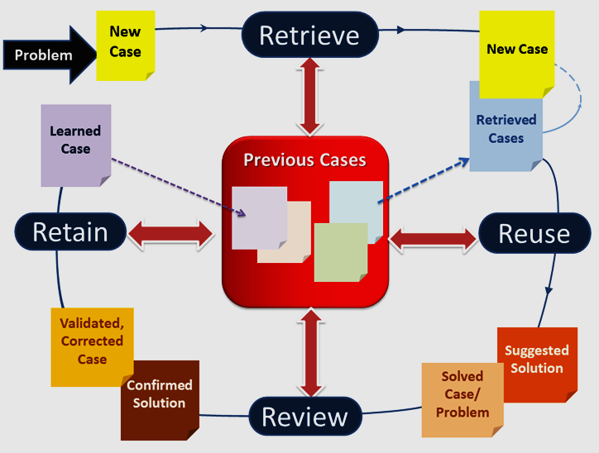
Use What We Already Know

Slide 24
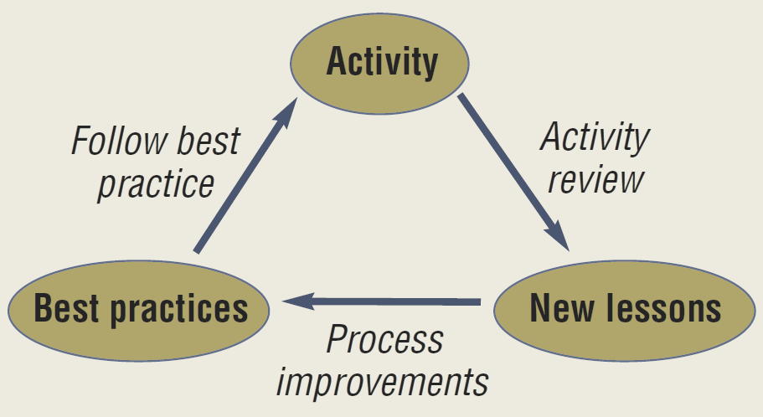
Project Knowledge Reuse –
Project Lessons Learned (PLL)
Learning gained from the process of performing a project
To promote the recurrence of desirable outcomes
To preclude the recurrence of undesirable outcomes
New knowledge and new learnings are identified through activity and review, and incorporated into future work practices
Learn the good practices
Avoid the repeats of bad practices

Slide 25
The question remains:
“Why are lessons learned not captured,
or
if they are captured, not used?”

Slide 26
Common excuses
Not sure what lessons learned are
No knowledge or lack of clear directives on who and how to capture lessons
Lack of time and resources
Lack of management support
Not knowing where to store or search for lessons learned
Fear of getting blamed or feeling ashamed if mistakes are exposed
Fear that auditors pick up wrong doings

Slide 27
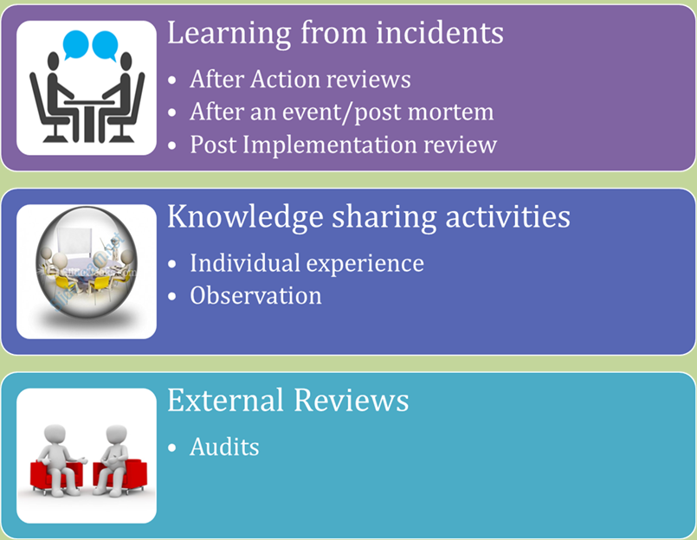
Where can Lessons learned be derived from?

Slide 28
An Improved Approach for Capturing PLL in JKR
Processes
Repository
Search function
Governance
Accountability
Identify
Validate
Roles and responsibilities
Incentive
Disseminate
Analyse and report
Track actions
Update
Quality control
Facilitation
Escalation
Metrics
Documentation
Close out
Components of the new PLL system

Slide 29
Project Knowledge Capture
K-Visits
Learning
After
Retrospect
Learning
During
Peer Assist
Learning Before
Post Implementation Review
After Action Reviews
Techniques
Story telling
Interview
Knowledge Cafe
Coaching & Mentoring
Notes:
Stories provide a richer canvas for people to relate to their own experience. Use metaphors. People will find their own insights
Interviews – we tell more than we can write. Set the context. Right questions must be asked. Capable of generating insights and understanding.
Peer assist – show and tell kind of thing. Highly interactive.

Slide 30
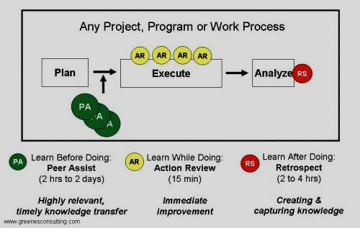
Project Learning at “Mission” Speed
Notes:
Acquiring expertise requires learning the explicit knowledge of a field, the practices of its community, and the interplay between the two. And learning all this requires immersion in a community of practice, enculturation in its ways of seeing, interpreting, and acting. Tacit and explicit dimensions of knowledge apply not only to the individual but also to the social mind or the community of practice. It's common for us to think that all knowledge resides in individual heads, but when we factor in the tacit dimension-especially as it relates to practices-we quickly realize how much more we can know than is bounded by our own knowledge. Much of knowing is brought forth in action, through participation-in the world, with other people, around real problems. A lot of our know-how or knowing comes into being through participating in our community of practice.

Slide 31
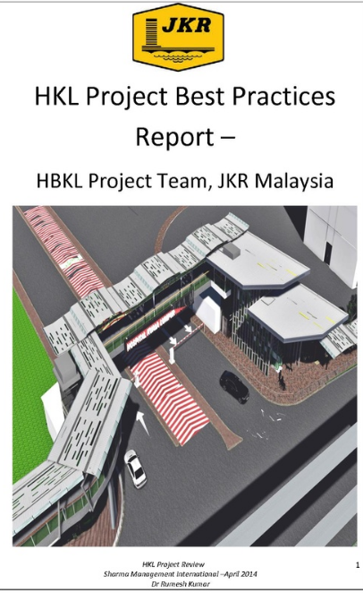
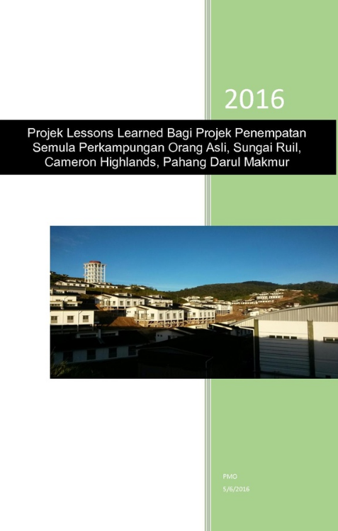
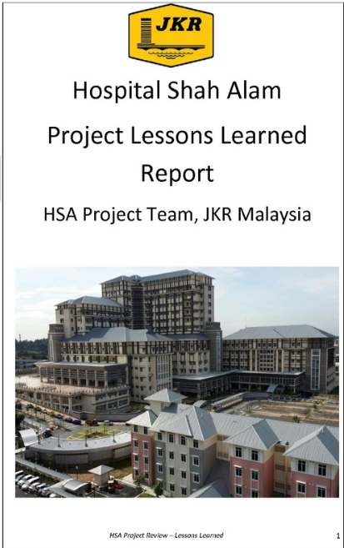
Project Lessons Learned Reports

Slide 32
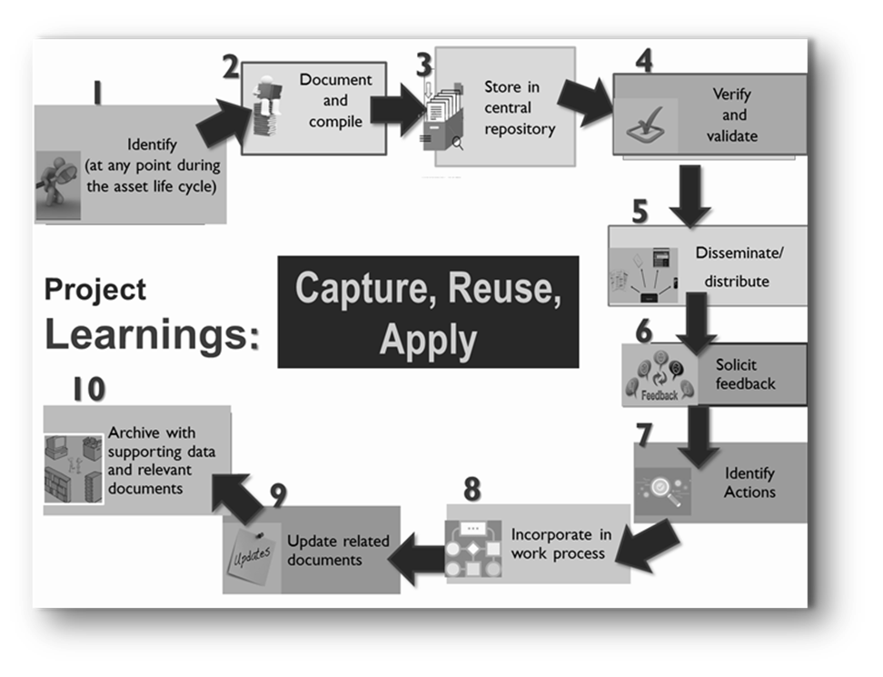
PLL ACTIVITIES

Slide 33
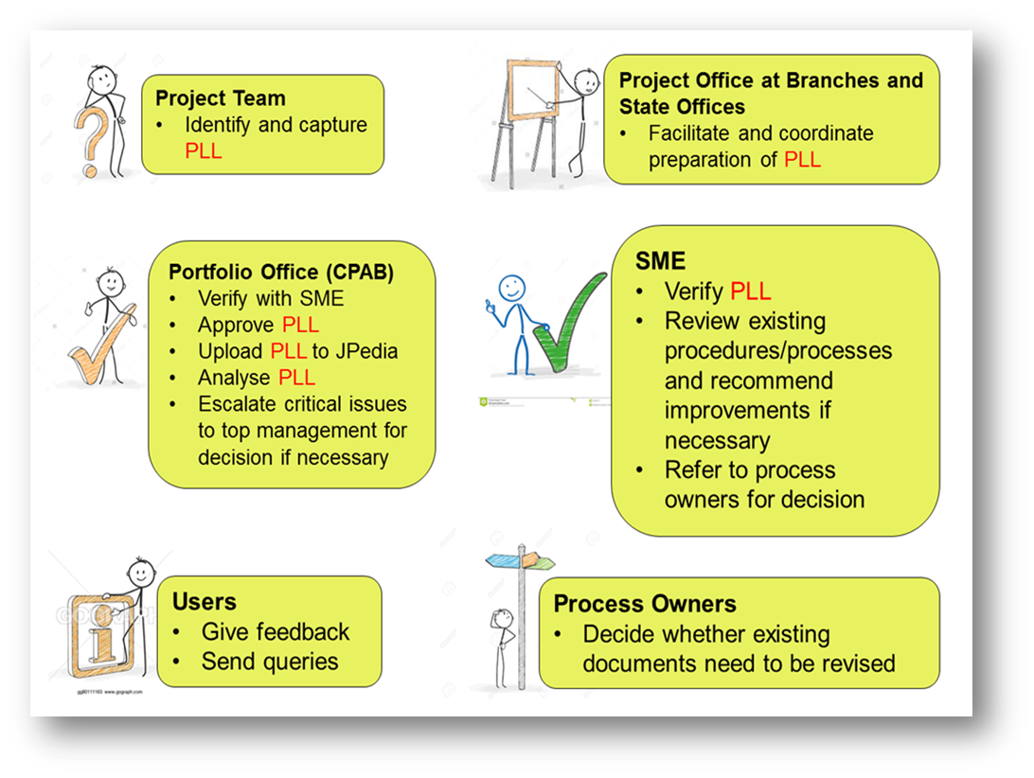
ROLES AND RESPONSIBILITIES

Slide 34
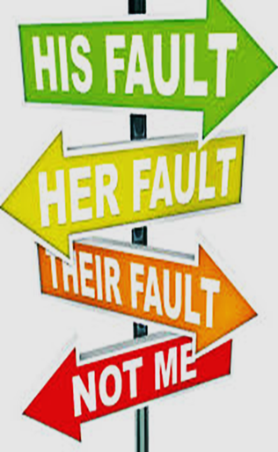
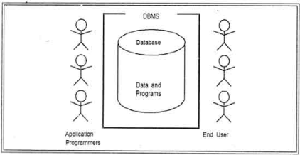

Making It Happen
AWARENESS TALKS
PLL WORKSHOPS
KPI
PLL COMPILATION
EMBEDDING PLL IN WORKFLOW
PLL GUIDE
Stop the Blame Game!
X

Slide 35
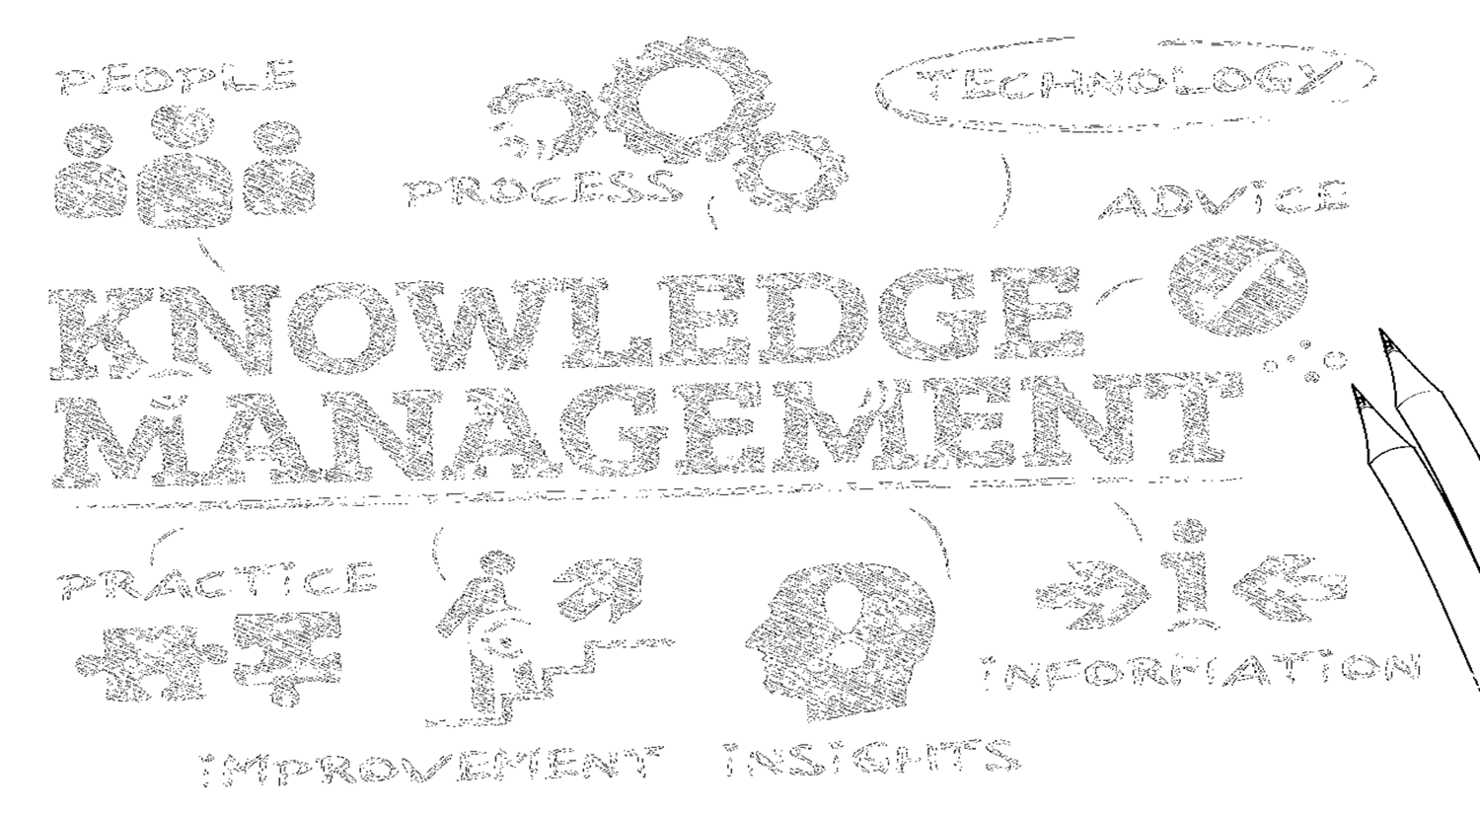
Get the best from KM
JPedia as a first “go-to” place to look for knowledge
JCoP to ask and discuss online, and look for the experts
CoP to interact face to face
Project Lessons Learned to improve project delivery
Right KM tools and techniques to create, capture, share knowledge
E-Learning to learn anytime, any place

Slide 36

Thank you for your attention

