Slide 1
PROJEK KLINIK KESIHATAN JENIS 3 (CR) DENGAN
KUARTERS RANTAU PANJANG, PASIR MAS
PENGGUNAAN IBS DI TAPAK PROJEK
10 NOVEMBER 2020
Oleh:
JKR Jajahan Pasir Mas, Kelantan

Slide 2
KANDUNGAN TAKLIMAT
Pengenalan Projek
Skop Projek
Penggunaan IBS
Kompenen IBS di KK3
Prosedur Pembinaan
Strategik Kerja JKR PM
Masalah dan Tangani
KONTRAKTOR
TARIKH MILIK TAPAK
TARIKH SIAP KONTRAK
TEMPOH PROJEK
KEMENTERIAN
KESIHATAN MALAYSIA
AL RASH CORP. SDN BHD
28 OGOS
2017
26 NOV.
2020
170
MINGGU

Slide 3
PENGENALAN
PELANGGAN
PEGAWAI
PENGUASA
KONTRAKTOR
TARIKH MILIK TAPAK
TARIKH SIAP KONTRAK
TEMPOH PROJEK
KEMENTERIAN
KESIHATAN MALAYSIA
PENGARAH JKR NEGERI KELANTAN
AL RASH CORP. SDN BHD
28 OGOS
2017
26 NOV.
2020
170
MINGGU

Slide 4
LOKASI
Jarak :
35km dari ibupejabat JKR Kelantan
7km dari pekan Rantau Panjang
Kordinat: LONG LANG
: 06° 00’ 07’’ N
: 102° 00’ 12” E
Menghala ke Pekan Rantau Panjang
Menghala ke bandar Kota Bharu

Slide 5
SKOP PROJEK BANGUNAN

Slide 6
PENGUNAAN IBS
Jadual penggunaan komponen IBS
Lokasi | Sasaran | Capai
Kuarters | 100 | 100
Klinik | 100 | 100
Pondok Pengawal | 0 | 0
Pencawang TNB | 0 | 0
Rumah Pam | 0 | 0
Rumah Sampah | 0 | 0
Garaj | 0 | 0
Stor | 0 | 0

Slide 7
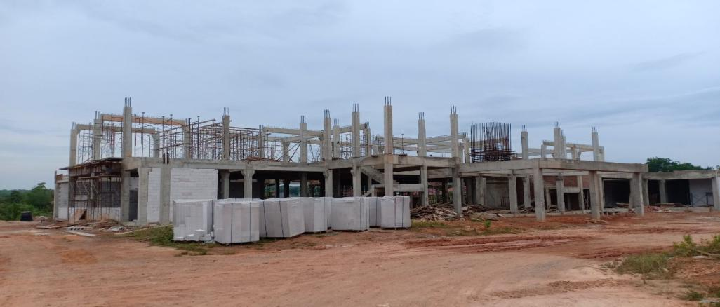
KOMPONEN IBS di KK3
Tiang
Papak
Rasuk
Bata

Slide 8
JUMLAH IBS di KK3
Bata

Slide 9
PROSEDUR PEMBINAAN
PLANNING
DESIGN
DELIVERY
INSTALLATION
FABRICATION
Diselia oleh Pejabat Tapak

Slide 10
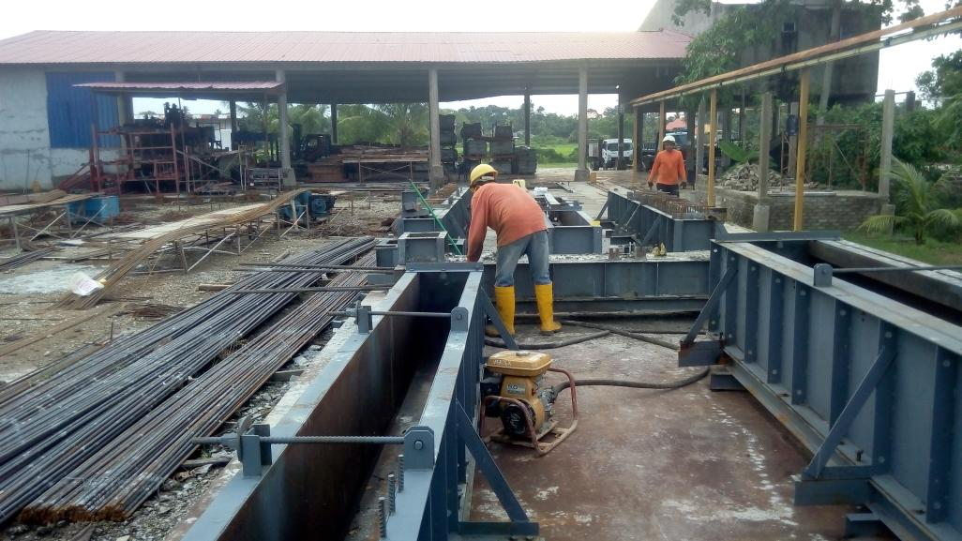
FABRICATION/ PEMASANGAN

Slide 11
Fabrication Process
A
B
C
D
Assembly Mould
Mould Cleaning &
Preparation
Fixing Rebar
Final Inspection
Before Casting
H
G
F
E
Final Inspection
Demoulding
Concreting
Curing

Slide 12
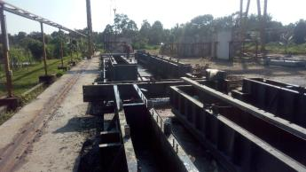
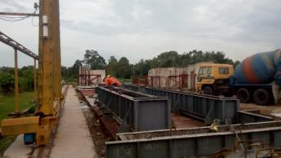
Assembly Mould
Check the flatness of the base mould
Our Practice
Ensure that the dimensions of mould are within the specific tolerances

Slide 13
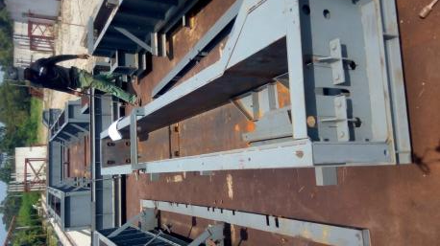
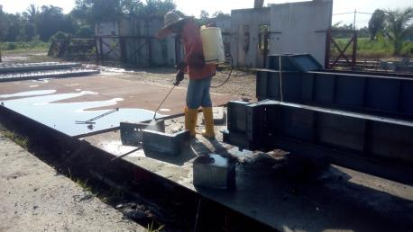
Mould Cleaning and Preparation
Practice
The mould should be clean
Form oil or mould release agent should be apply
Check the joint & Edge of mould

Slide 14
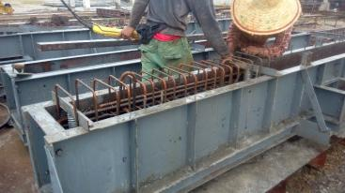
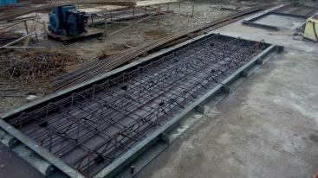
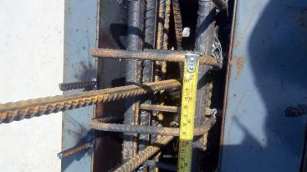
Fixing Rebar
Practice
Check rebar size, spacing & lap length
Rebar, cast in item, corrugated sleeve, lifting hook must be correctly positioned
Sufficient & correct size of spacer

Slide 15
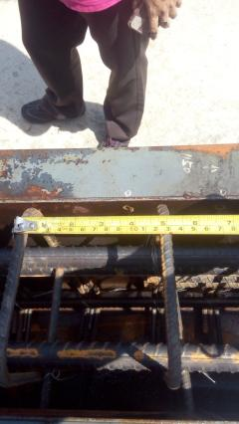
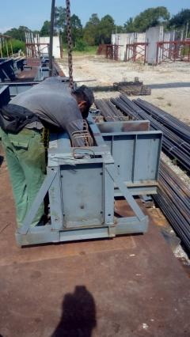
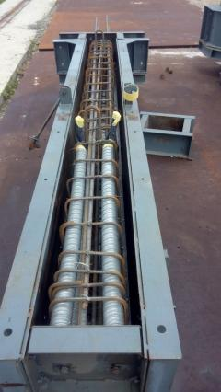
TONTON VIDEO
Final Inspection before casting
Practice
Check & Verify that all
details comply with
Drawing.

Slide 16
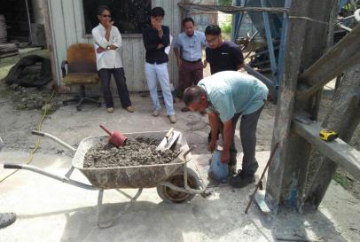
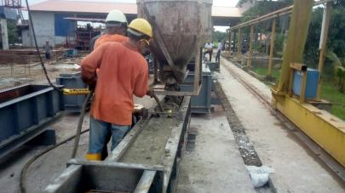
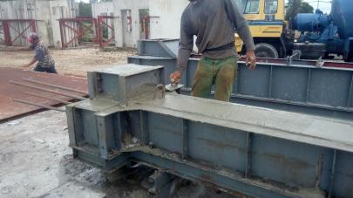
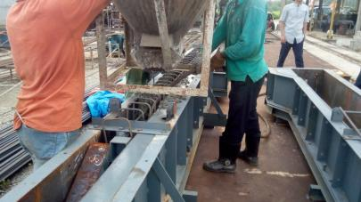
Concreting
TONTON VIDEO
Proper vibration & compaction
Conduct Slump Test
Drop height <1m
Levelling of surface
TONTON VIDEO

Slide 17
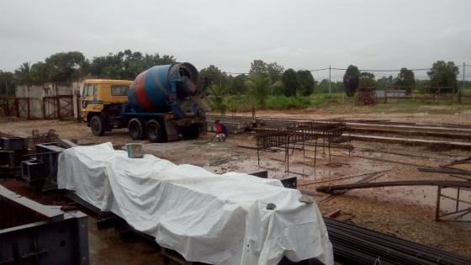
Curing
Guna admixtures
Lebih 5 jam
15N/mm2, kekuatan minimum yang diperlukan sebelum di-mould

Slide 18
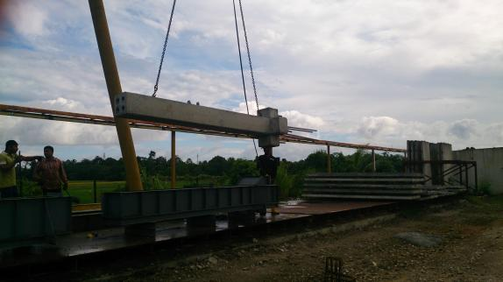
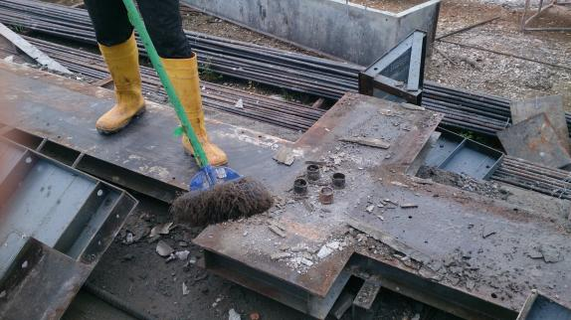
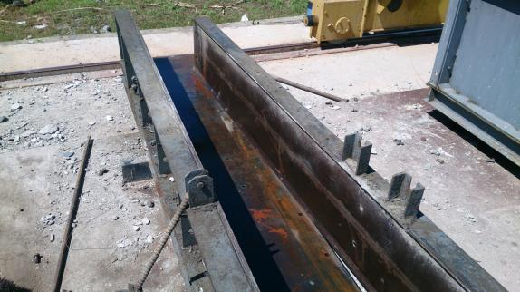
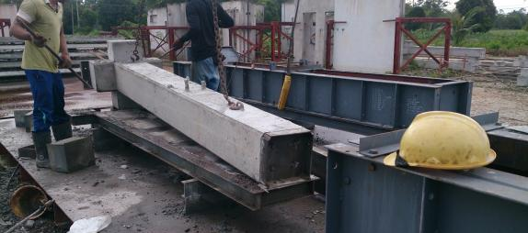
De-moulding
Loosen & remove all bolts & pins, end & side mould form before lifting

Slide 19
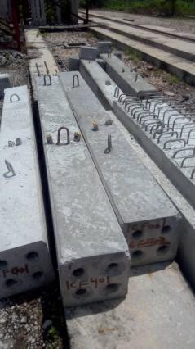
Final Inspection
Check the condition of the finished product
Verify the critical dimension
Proper identification markings should be placed on elements (Code/size/location/weight)
Check the elements have achieved 75% of their design concrete strength before delivery to site

Slide 20
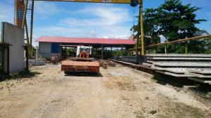
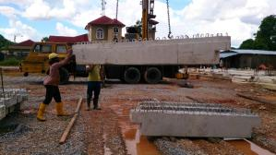
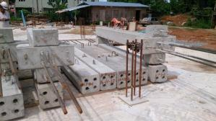
DELIVERY/ PENGHANTARAN
Step 1
Delivery
Step 2
Handling
Step 3
Storage

Slide 21
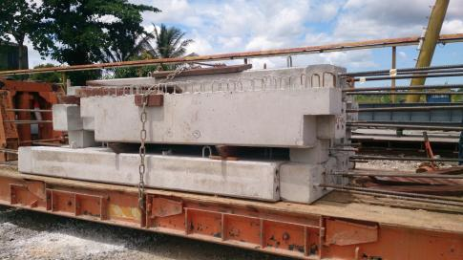
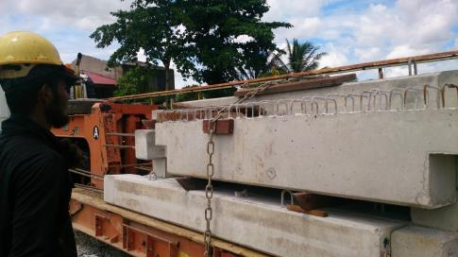
SEBELUM KELUAR KILANG

Slide 22
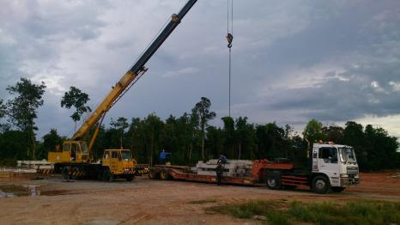
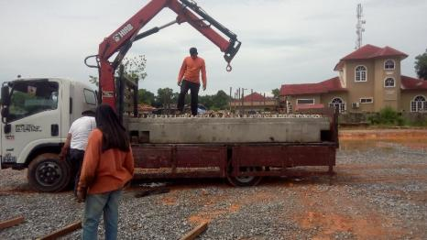
HANDLING/ SEMASA PEMINDAHAN
TONTON VIDEO

Slide 23
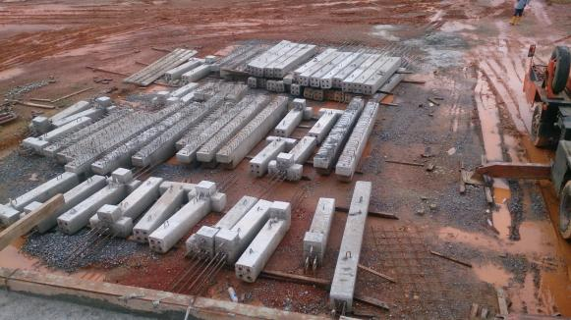
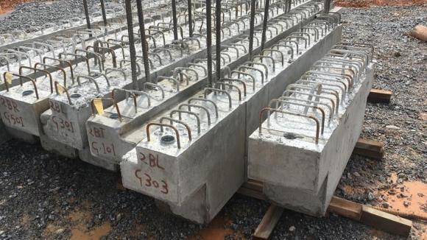
STORAGE/ PENYIMPANAN

Slide 24
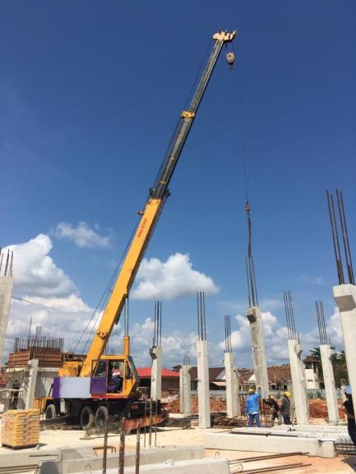
INSTALLATION
1
2
3
Setting out
Lifting & Installation
Grouting Work

Slide 25
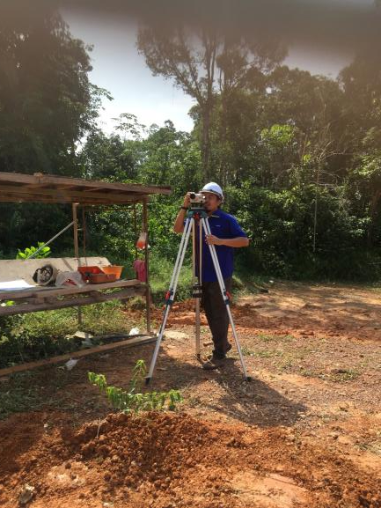
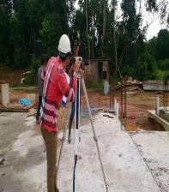
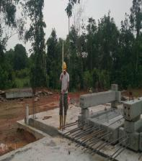
SETTING OUT
Set reference line and offset line to determine the position of precast elements to be installed
Provide level pads ( or shim plates) for setting the level of the elements
Check starter bar

Slide 26
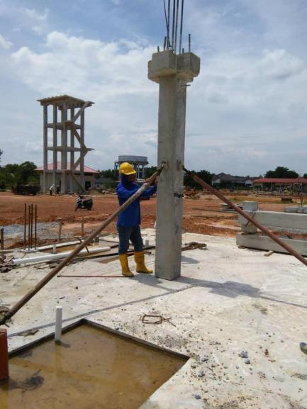
LIFTING & INSTALL
Lift and rig the panel to its designated location with the use of wire ropes
Adjust panel to position and secure it with diagonal props
Check alignment & Verticality of Element
Adjust temporary prop
Check stability of the erected props before releasing the hoisting cable

Slide 27
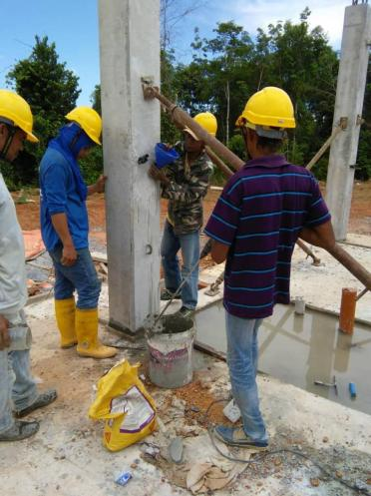
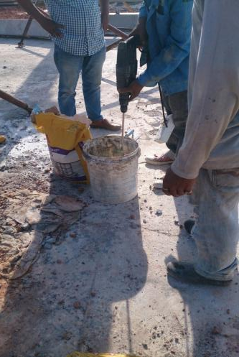
GROUTING WORK
Prepare & apply non-shrink mortal
to seal the gap along bottom edge
of the elements
For corrugated pipe sleeve or splice
sleeve connection, prepare & pour
non- shrink grout into the pipe inlet
provided
Keep the installed elements
undisturbed for at least 24 hrs.

Slide 28
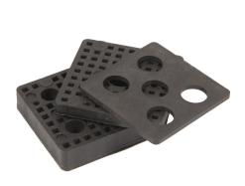
MATERIAL USED IN INSTALLATION
Neoprene pad
Rubber Strip
Shim Plate

Slide 29
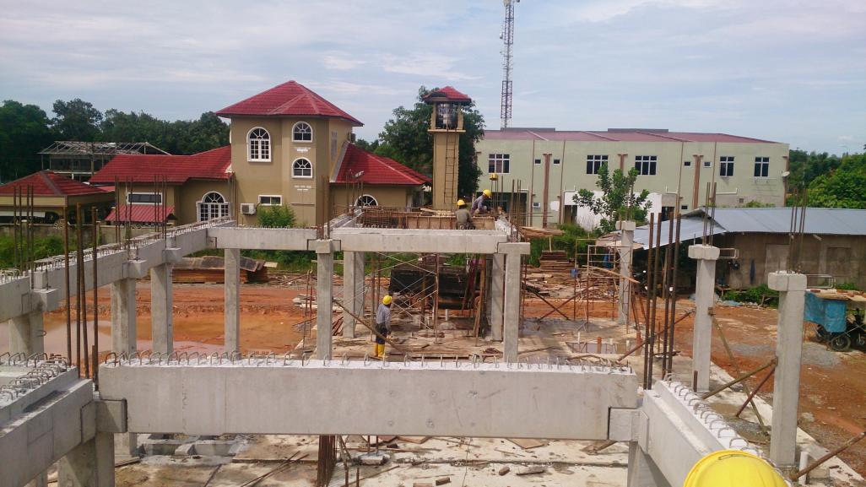
Shim Plate
Rubber Strip
Neoprene pad

Slide 30
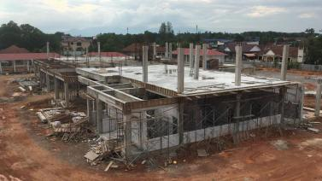
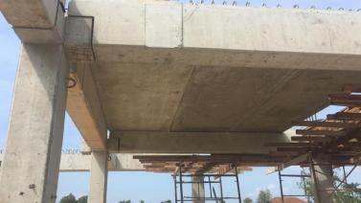
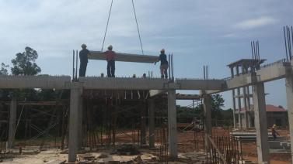
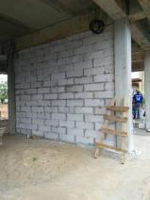
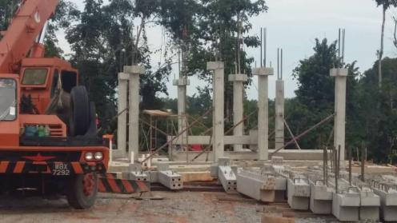
FOTO SEMASA PEMBINAAN

Slide 31
STRATEGI KERJA JRK PM DI KK3
Perbincangan
Pemeriksaan
Lawatan
Pelaporan
Taklimat
Audit

Slide 32
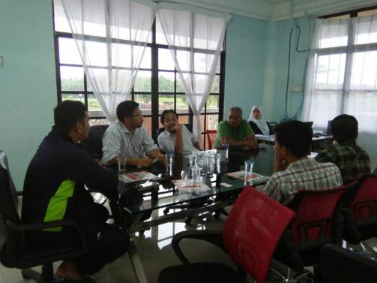
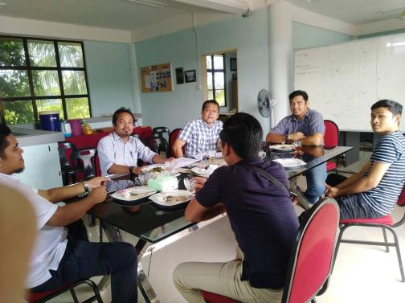
STRATEGI KERJA JRK PM DI KK3
Perbincangan

Slide 33
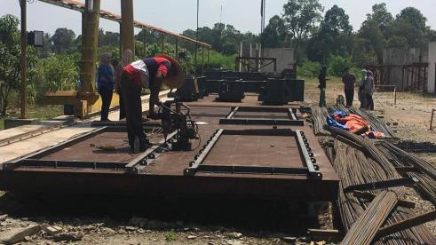
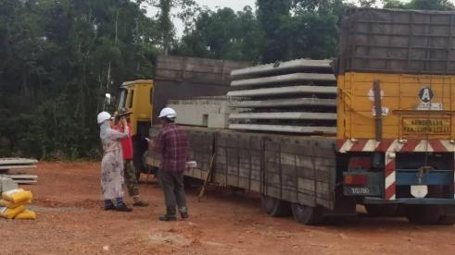
STRATEGI KERJA JRK PM DI KK3
Pemeriksaan

Slide 34
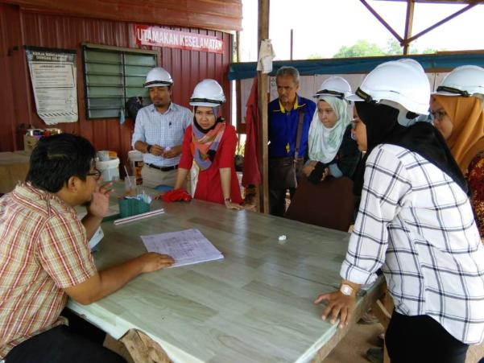
STRATEGI KERJA JRK PM DI KK3
Taklimat

Slide 35
STRATEGI KERJA JRK PM DI KK3
Audit

Slide 36
STRATEGI KERJA JRK PM DI KK3
Lawatan

Slide 37
SUMMARY OF WORK’S DONE FOR IBS COMPONENTS
BLOCK: KUARTERS
Pelaporan
COMPONENT (A) | TOTAL NOS OF COMPONENTS (B) | DELIVERED ON SITE (C) | BALANCED NOT DELIVERED (B-C) | INSTALLED (D) | BALANCED NOT INSTALLED ON-SITE (C-D)
COLUMN | 88 | 84 | 4 | 47 | 37
BEAM | 72 | 56 | 16 (Upper Roof) | 32 | 20
SLAB | 38 | 38 | 0 | 38 | 0
TOTAL | 198 | 178 | 20 | 117 | 57
BLOCK: KLINIK
COMPONENT (A) | TOTAL NOS OF COMPONENTS (B) | DELIVERED ON SITE (C) | BALANCED NOT DELIVERED (B-C) | INSTALLED (D) | BALANCED NOT INSTALLED ON SITE (C-D)
COLUMN | 114 | 17 | 97 | 3 | 15
BEAM | 65 | 19 | 46 | 0 | 19
SLAB | 40 | 12 | 28 | 0 | 12
TOTAL | 179 | 36 | 143 | 3 | 34

Slide 38
SUMMARY OF DELIVERY SCHEDULE
11.10.18
18.10.18
23.10.18
28.10.18
01
02
03
04
8 nos of components delivered
29 nos of components delivered
37 nos of components delivered
8 nos of components delivered
21.1.19
15.1.19
16.12.18
27.11.18
19.11.18
09
08
07
06
05
60 nos of components will be deliver
62 nos of components will be deliver
60 nos of components will be deliver
56 nos of components delivered
55 nos of components delivered

Slide 39
SUMMARY OF INSTALLATION SCHEDULE
Ground floor column | 100%
1st floor beam | 100%
1st floor slab | 100%
1st floor column | 57%
BLOCK: KUARTERS
INSTALLATION WORK’S DONE (until Nov 18)
Install balanced 10% 1st floor slab
16.12.18
In-situ works by Main Con (topping slab)
Install 1st floor column
2.1.19
In-situ works by Main Con (Beam & slab 2nd floor)
Install water tank to roof column
7.1.19
In-situ works by Main Con (beam & slab wt to roof)
Install roof beam
12.1.19
In-situ works by Main Con
Install upper roof beam
FINISH
14.1.19

Slide 40
SUMMARY OF INSTALLATION SCHEDULE
Ground floor column | 100%
1st floor beam | 100%
1st floor slab | 100%
1st floor column | 57%
BLOCK: KUARTERS
INSTALLATION WORK’S DONE (until 19 DEC 18)
PLANNING |  | ACTUAL
DATE | ACTIVITY | DATE | ACTIVITY
16.12.18 | INSTALL BALANCE 10 % SLAB | 13.12.18 | COMPLETE 1ST FLOOR SLAB
02.01.19 | INSTALL 1ST FLOOR COLUMN | 19.12.18 | INSTALL 17/30 1ST FLOOR COLUMN
07.01.19 | INSTALL WATER TANK TO ROOF COLUMN
12.01.19 | INSTALL ROOF BEAM
14.01.19 | INSTALL UPPER ROOF BEAM
14/01/2019 COMPLETE ALL IBS WORK FOR KUARTERS

Slide 41
SUMMARY OF INSTALLATION SCHEDULE
BLOCK: KLINIK
START
Install 1st floor column
16.12.18
In-situ works by Main Con
Install 2nd floor beam
24.12.18
Install hollow core slab
In-situ works by Main Con
19.1.19
Install 2nd floor column
In-situ works by Main Con
5.2.19
Install roof beam
In-situ works by Main Con
10.2.19
11.2.19
FINISH

Slide 42
SUMMARY OF INSTALLATION SCHEDULE
1ST floor column | 5%
BLOCK: KLINIK
INSTALLATION WORK’S DONE (until 19 DEC 18)
PLANNING |  | ACTUAL
DATE | ACTIVITY | DATE | ACTIVITY
16.12.18 | INSTALL FIRST FLOOR COLUM | 16.12.18 – 19.12.18 | DELIVERY 23 ELEMENT INSTALL 3/68 1ST FLOOR COLUMN
24.12.18 | INSTALL 2ND FLOOR BEAM
19.01.19 | INSTALL HOLLOW CORE SLAB
05.02.19 | INSTALL 2ND FLOOR COLUMN
10.02.18 | INSTALL ROOF BEAM
11/02/2019 COMPLETE ALL IBS WORK FOR KLINIK

Slide 43
JANGKAAN MASALAH
(RISIKO)

Slide 46
Sekian, Terima Kasih
Disediakan oleh:
Jabatan Kerja Raya, Jajahan Pasir Mas Kelantan
Tel: 09 790 8040 | Faks: 09 790 8382 | pasirmas@jkr.gov.my
09 Nov 2020

